Slide 1
Agile Fundamentals
A Course from ThoughtWorks Learning™
1
Notes:
Hello, and welcome to The Origins of Agile Software Development, a module in Agile Fundamentals. This module is brought to you by ThoughtWorks Studios, makers of Mingle, Cruise, and Twist.

Slide 2

Your Facilitator
Name:
Role:
Email:
Phone:
Steven List (aka “Doc”)
Lead Trainer
doc@thoughtworks.com
+1 512 924 9248
Plan/Manage
LEGO
Dev
Fun
Core
Origins
Intro
Agenda
Notes:
TIMING: <= 2 Minutes
Introduce yourself – no more than 2 minutes – quick background, relevant experience

Slide 3
Agenda
09:00 – 10:30 Introduction Origins / Philosophy Core practices (Pt 1)
10:30 – 10:45 Break
10:45 – 10:55 Some Fun
10:55 – 12:30 Core practices (Pt 2) Development Practices Discussion
12:30 – 13:30 Lunch
13:30 – 14:30 Lego game (FUN!)
14:30 – 15:00 Discussion
15:00 – 15:15 Break
15:15 – 17:00 Planning / Managing
Plan/Manage
LEGO
Dev
Fun
Core
Origins
Intro
Agenda

Slide 4

Introductions
Who are you?
What do you do?
Why are you here?
All in 30 seconds or less.
Plan/Manage
LEGO
Dev
Fun
Core
Origins
Intro
Agenda
Notes:
TIMING:
Introductions: < 5 minutes
Group Juggle: 5 – 8 minutes
Follow introductions with Group Juggle…
http://wilderdom.com/games/descriptions/GroupJuggle.html
Group Juggle
Fun way to start working together.
Can be used to learn names and develop a sense of interconnectedness.
Stand in a circle, toss a ball to someone, using his/her name, and they in turn toss it to someone else, using the next person's name.
Keep it going, then more balls are introduced and it starts gets crazy.
How to Run a Group Juggle Session
Set up & instructions for 1st round of group juggling
Arrange participants in a circle, not too close, not too far from one another
Include yourself in the circle
Explain that you are going to throw a ball to someone - pick someone out & ask their name, then say
"Hi Freddy, my name is James...here you go!" [underarm throw a ball to Freddy]
Freddy then says "Thank you James", picks someone and says "Hi X, my name is Freddy...here you go!" [throw]....they say "Thank you, Freddy] and on we go.
If you're not trying to learn names, skip the naming part & just throw!
The challenge from here is simply to get the ball thrown around to everyone in the circle, and finally back to the trainer.
2nd round of group juggling
I then say, "Right, well done, now let's see if we can that again - making sure we use the same order, and using each other's names. Remember to say the name of the person you are throwing to, and thank the person, by name, for throwing it to you, OK?"
On the second round, most people will be challenged to remember who to throw it to, and the two names! Take it slow, help the group out, so that each person has a successful second round.
3rd round of group juggling
I then say, "Good, so how about we do it again, but this time, let's let's see how fast we can do it, OK? Here we go...Hi Freddy, my name is James...." [throw]
It will go pretty fast this time, and the group will probably feel quite pleased with themselves.
4th round of group juggling - introducing more balls
I then say, "That's great, but I think you can do faster than that. Come on, let's see how we can really go..." [I then throw and say the name with super fast enthusiasm to set the tone!]
After the first ball has passed through a few hands, I take a 2nd ball out of my pocket (surprise!), and casually, but earnestly say "Hi Freddy...." [throw].
By now everyone is so well trained, the 2nd ball will automatically keep going, and there will be a detectable sense of challenge/excitement.
After a bit, I introduce a 3rd and 4th ball, up to about 6 balls.
Usually I let 4 to 6 balls be juggled for a while (note the balls will be coming back again to the trainer - just keep them going). A group of 12 adults can usually handle 4 to 6 quite well.
If I'm feeling conservative, I just let the group have the success of doing this number of balls, and collect them in when that seems to have been achieved.
But usually, once the group seems competent at 4 to 6 balls I gradually then introduce an unmanageable number of balls into the juggle & maybe also weird objects (e.g., kids soft toys) which all gets crazy, fun, out of control, etc. and ends in a hilarious shambles.
Generally doesn't require debriefing.

Slide 5
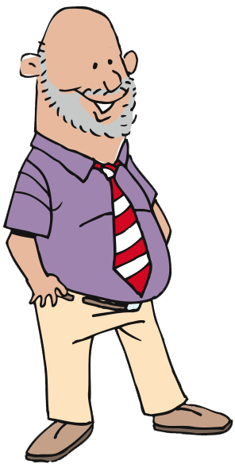
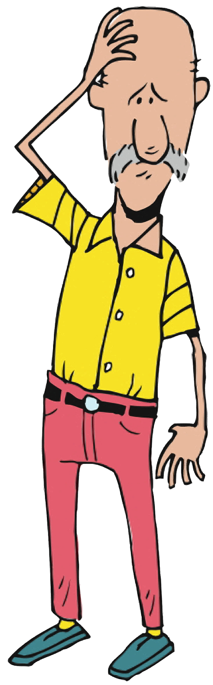
Why are we here?
Hopes
Concerns
Plan/Manage
LEGO
Dev
Fun
Core
Origins
Intro
Agenda
Notes:
TIMING: 3 – 5 minutes

Slide 6
Process Doodle
Divide into groups of 2 – 4 per group
Using materials, graphically represent your current development process.
Roles
Artifacts
Challenges
Do not use people’s names
No criticism
Have fun!
Plan/Manage
LEGO
Dev
Fun
Core
Origins
Intro
Agenda
Notes:
http://blog.tastycupcakes.com/2009/06/process-doodle/
Process Doodle
By Michael McCullough, on June 20th, 2009
Timing: 20 mins
Ingredients:
Whiteboards and/or flip-charts
Markers
Directions:
Divide the participants in to groups and ask them to graphically represent their current development process. Have them think about roles, artifacts produced, and challenges. Invite them to be creative and to not worry about using any formal notation (UML, Gantt Charts, RUP, etc.). Ask them not to use people’s names, or to criticize personalities.
Each team will then then present their creation to the whole group.
Learning Points:
This is an interesting and fun way for a facilitator to gain visibility in to what is working and what the challenges are in an organization’s current process.
This exercise also creates more transparency within a team, by giving people a chance to see how others characterize the process.

Slide 7


Plan/Manage
LEGO
Dev
Fun
Core
Origins
Intro
Agenda
Photo by Steven List
Notes:
Thank you for joining us for The Origins of Agile Software Development, a module in Agile Fundamentals. The next module in the series is The Agile Core, in which we’ll explore some of the practices and methodologies that make Agile what it is.
Until the next time, we wish you well.

Slide 8
The Origins of Agile Software Development
Plan/Manage
LEGO
Dev
Fun
Core
Origins
Intro
Agenda
Notes:
The Agile Core: Story Based Development & Incremental Business Value
User Stories, Use Cases and Scenarios
Looking at the Big Picture – Is up front planning OK?
“Good Enough” Software
Release Early and Often
The story:
Actors and use cases – sterile
Actors are causal, use cases state results of that causality
Use cases are explanatory, and rarely include business value
Storytellers, customers, and stories – comes alive
Roles represent
Stories are demanding, as well as explanatory
Stories tell you why, as well as what
Stories do NOT tell you HOW
Storytellers share experience and needs
The Big Picture – is it possible to know everything up front?
has anyone had a house built? Remodeling done?
Zeno’s Paradox of the Dichotomy
http://en.wikipedia.org/wiki/Zeno%27s_paradoxes#The_dichotomy_paradox
“That which is in locomotion must arrive at the half-way stage before it arrives at the goal.” ~Aristotle, Physics VI:9, 239b10
“The perfect is the enemy of the good.” ~Voltaire
Incremental, with constant review
Fail fast, learn quickly, adapt - PDCA

Slide 9
What’s coming…
Where it came from
Why it came to be
Who were the players
A Manifesto for Agile Software Development
Plan/Manage
LEGO
Dev
Fun
Core
Origins
Intro
Agenda

Slide 10
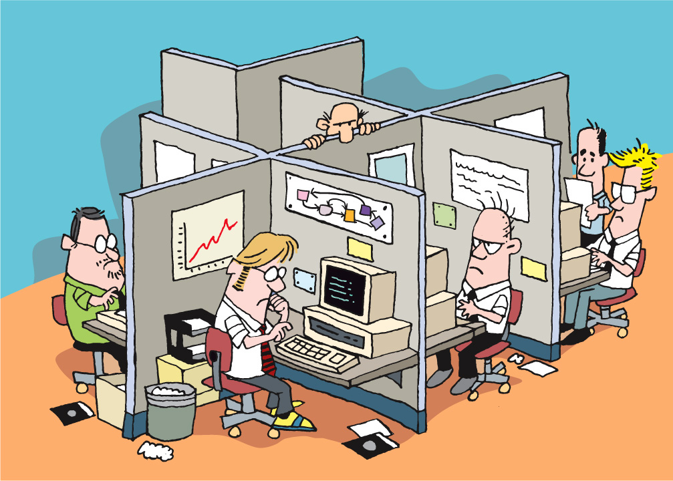
Plan/Manage
LEGO
Dev
Fun
Core
Origins
Intro
Agenda
Notes:
In the beginning, there were offices and cubicles and isolation and darkness. Those who created program code lived within a strict hierarchy, and were known as Architects, Designers, Users, Programmers, Testers, Project Managers, Build Masters, and Technical Writers. It was the rare individual who could cross over from one area of specialty to another. Growing into a more senior role, having more responsibility, required lengthy periods of apprenticeship and hardship. This was a system known as “Waterfall”. Projects were done in “phases” or “stages”, and no phase could begin until the preceding phase was done.
Imagine that you were a tester, back in those days. You’d spend weeks or months reading the specs, planning, organizing your thoughts, all in the service of being able to start your “real” work when the architects, designers, and programmers were done with their jobs. You didn’t really talk to the others all that much, because they had their heads down, busily doing their jobs in their phases. Interruptions were not welcome.
In order to accomplish anything requiring more than one person, a meeting would be called. People arrived late and unprepared. Resenting meetings, some people paid little attention and hurried to escape. Fortunately, back in those days, there were no notebook computers or iPhones, so those forced to attend meetings had nothing to distract them. Meetings tended to be focused around passivity – a presenter presented, and everyone else tried to stay awake. The ideas of participation and collaboration tended to be marginalized.
Imagine the times: massive computer terminals, hardwired to mainframes and “super-microcomputers”, running proprietary operating systems or UNIX. No PCs or Macs, no notebooks, no monitors and ergonomic keyboards, no mice. And no Internet! Truly the Dark Ages.

Slide 11
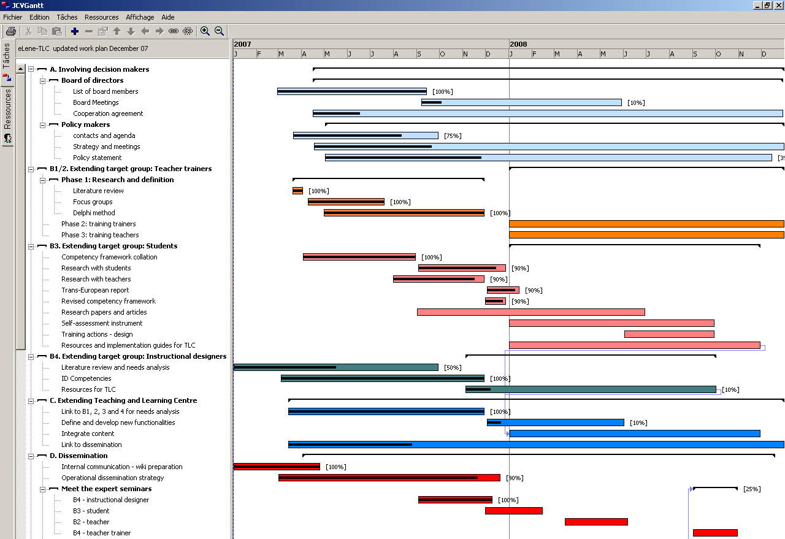
Plan/Manage
LEGO
Dev
Fun
Core
Origins
Intro
Agenda
Notes:
Projects were planned down to the tiniest detail. Project managers and their teams spent substantial time figuring out exactly what they were building, what pieces to build in what order, how long it would take for each piece, and how they were going to assemble them.
The result? Massive planning documents that were generally wrong before they were finished.
After all, how could they know all the things that could go wrong? How could they know what they didn’t know? How could they know what they would learn and how business circumstances and economy and people would change during the course of their development?
They couldn’t. And yet, they tried and tried.
This gave birth to the term “shelfware”.

Slide 12
Software project outcomes: 2004
Plan/Manage
LEGO
Dev
Fun
Core
Origins
Intro
Agenda
The Standish Group CHAOS Reports
Notes:
Reports are periodic – not annual
Only 34% are UNQUALIFIED success

Slide 13
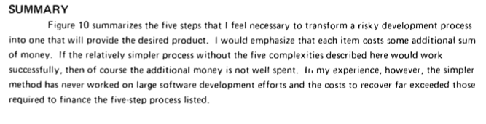
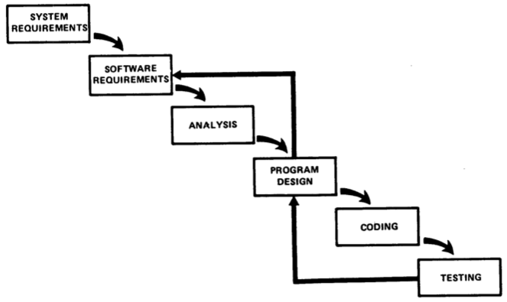
That “Waterfall” diagram...
Plan/Manage
LEGO
Royce, 1970
Dev
Fun
Core
Origins
Intro
Agenda
Notes:
Royce’s original paper – credited with original capture of waterfall diagram – example of what does not work
“If the relatively simpler process without the five complexities described here would work successfully, then of course the additional money is not well spent. In my experience, however, the simpler method HAS NEVER WORKED on large software development efforts and the costs to recover far exceeded those required to finance the five-step process listed.”

Slide 14

Legacy of engineering
Plan/Manage
LEGO
Dev
Fun
Core
Origins
Intro
Agenda
Notes:
Much of this approach came out of the realms of engineering and manufacturing. After all, when you’re building a thing with clearly defined functionality, it’s possible – maybe even required – to know everything you’re going to do up front.
Like building a house. Of course, those of us who have paid someone to build a house know that they never finish on time, don’t we?
NASA is always used as a great example of successful (and sometimes unsuccessful) examples of software engineering at work. It rings true with a lot of places – high complexity, large scale operations, lots of people and decisions made that have a long lasting effect on a project.
Let’s look at how their software processes achieve high quality. This is an ideal method right? Then, we’ll take a look at the cost to achieve this measure. It’s important for us to be aware that Agile is not about dropping quality. In fact, quality a key component. It’s really more about finding a better balance between the quality and the cost used to achieve it.

Slide 15
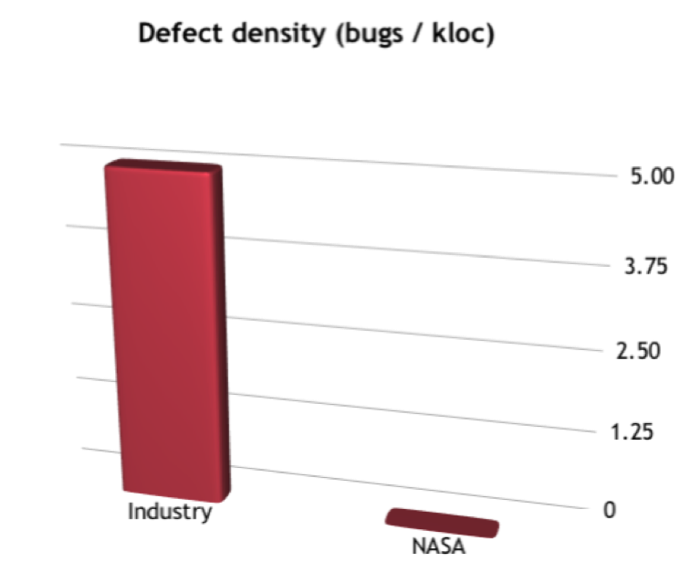
NASA’s defect density
Plan/Manage
LEGO
Dev
Fun
Core
Origins
0.004
Pretty good, right?
Intro
Agenda
Notes:
NASA did a great job of producing software with few or no bugs. After all, lives depended on their work. Many lives.
As you can see from this chart, the industry average was five defects per thousand lines of code, whereas NASA’s was four defects per MILLION lines of code. That’s three orders of magnitude difference. Remarkable! That’s something that any organization would envy, right?
But…

Slide 16
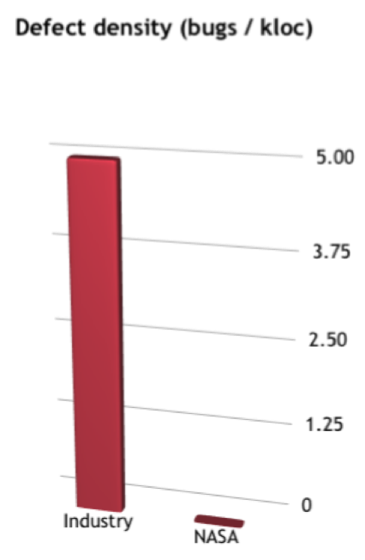
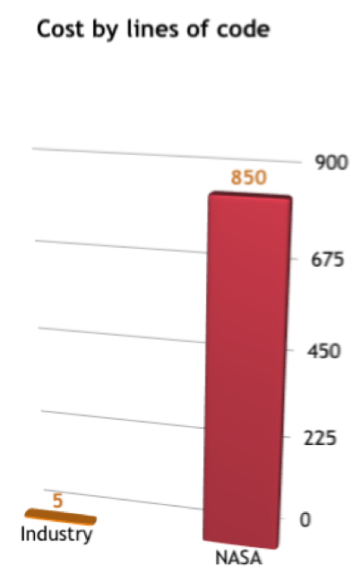
NASA’s defect density
Plan/Manage
LEGO
Dev
Fun
Core
Origins
Intro
Agenda
Notes:
That quality came with a cost. In the software development and information technology professions, the common offering is this: you can have any two of time, dollars, and quality. That is, you can have high quality and low cost, but don’t expect it fast. Or you can have it fast and cheap, but the quality won’t be there. Isn’t that a sad statement for a profession that included the word “engineering” in the name of their profession?
So let’s take a look. As we saw, NASA achieved unheard of quality in their software. [click]
The cost was significant. Notice here that while the industry average cost was five dollars per line of code, NASA’s cost was EIGHT HUNDRED FIFTY DOLLARS per line of code. While a government agency might be able to argue for this kind of expense, private industry could not.
Imagine that your company was producing software with a measly one hundred thousand lines of code. Let’s see – one hundred thousand times eight hundred fifty is EIGHTY-FIVE MILLION DOLLARS. How many companies can afford that kind of investment? Pretty close to none.
Understanding this led some practitioners to start thinking about different – preferably better – ways of doing things.

Slide 17
Plan/Manage
100,000 x $850
=
$85,000,000
EIGHTY-FIVE MILLION DOLLARS
LEGO
Dev
Fun
Core
Origins
Intro
Agenda
Notes:
Imagine that your company was producing software with a measly one hundred thousand lines of code. Let’s see – one hundred thousand times eight hundred fifty is EIGHTY-FIVE MILLION DOLLARS. How many companies can afford that kind of investment? Pretty close to none.
Understanding this led some practitioners to start thinking about different – preferably better – ways of doing things.

Slide 18
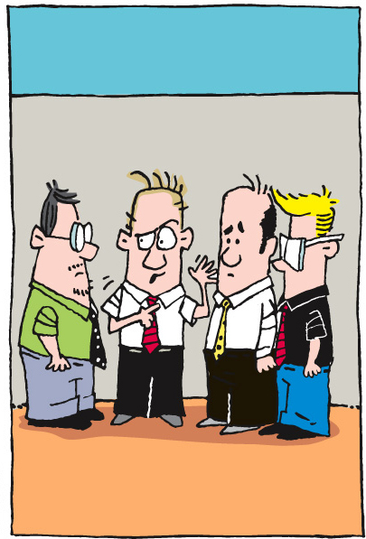
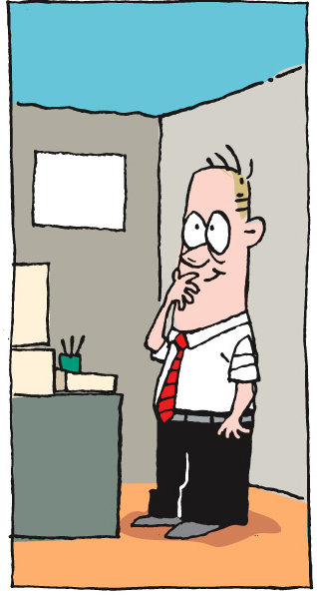
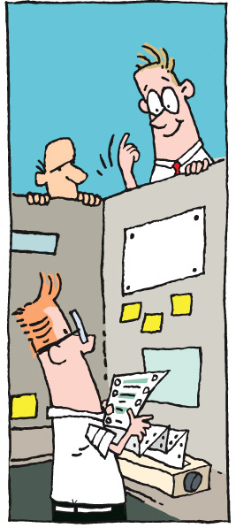
Plan/Manage
LEGO
Dev
Fun
Core
Origins
Intro
Agenda
Notes:
In the 1980’s and early 1990’s, there was this guy named Ken Schwaber. Ken was frustrated with the status quo. He was tired of having to wait to find out what was going on. He was tired of having to call – or attend – “formal” meetings to share information. He was tired of waiting for the waterfall to reach his “level”.
Ken thought about this a lot. After all, this was important stuff. The idea that co-workers could communicate more effectively, sooner, quicker, and easier just seemed to make sense. Ken started to wonder why no one was finding a way to do this. Why not talk to each other every day? In fact, why not find multiple ways for project and product teams to deliver sooner with better results and lower costs?
[Reference: http://www.controlchaos.com/about/?SID=8ef7eb5b2a069a2710abef27d02c851f&SID=7da824062baf60b8e78ec5f99836f092 ]
Ken, working with some colleagues, came up with an approach that he called “Scrum”. Here’s some information about Scrum from Ken Schwaber’s web site:

Slide 19

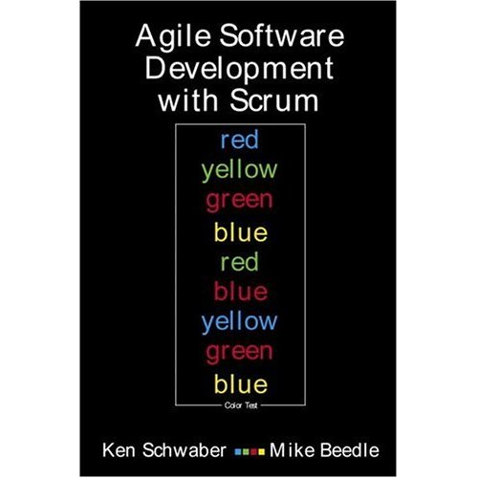
…an agile process to manage and control development work
…a wrapper for existing engineering practices
…a team-based approach to iteratively, incrementally develop systems and products when requirements are rapidly changing
…a process that controls the chaos of conflicting interests and needs
…scalable from single projects to entire organizations. Scrum has controlled and organized development and implementation for multiple interrelated products and projects with over a thousand developers and implementers
…a way for everyone to feel good about their job, their contributions, and that they have done the very best they possibly could
…a way to improve communications and maximize cooperation
…a way to detect and cause the removal of anything that gets in the way of developing and delivering products
…a way to maximize productivity
Plan/Manage
LEGO
Dev
Fun
Core
Origins
Intro
Agenda
Notes:
Scrum is an iterative, incremental process for developing any product or managing any work. It produces a potentially shippable set of functionality at the end of every iteration. It's attributes are:
[CLICK] Scrum is an agile process to manage and control development work.
[CLICK] Scrum is a wrapper for existing engineering practices.
[CLICK] Scrum is a team-based approach to iteratively, incrementally develop systems and products when requirements are rapidly changing
[CLICK] Scrum is a process that controls the chaos of conflicting interests and needs.
[CLICK] Scrum is a way to improve communications and maximize co-operation.
[CLICK] Scrum is a way to detect and cause the removal of anything that gets in the way of developing and delivering products.
[CLICK] Scrum is a way to maximize productivity.
[CLICK] Scrum is scalable from single projects to entire organizations. Scrum has controlled and organized development and implementation for multiple interrelated products and projects with over a thousand developers and implementers.
[CLICK] Scrum is a way for everyone to feel good about their job, their contributions, and that they have done the very best they possibly could.
CLICK
Scrum as applied to product development was first referred to in "The New New Product Development Game", published in Harvard Business Review in 1986, and later elaborated in "The Knowledge Creating Company" both by Ikujiro Nonaka and Hirotaka Takeuchi, published by Oxford University Press in 1995.
Based on their ideas and research in process theory performed in collaboration with DuPont Advanced Research Facility, Scrum was first formulated and presented to the Object Management Group in 1995.
The Scrum process is fully described in a book
CLICK
from Ken Schwaber and Mike Beedle, titled Agile Software Development with Scrum.

Slide 20

Kent Beck
Plan/Manage
LEGO
Dev
Fun
Core
Origins
Intro
Agenda
Notes:
At somewhat the same time, in the mid- to late-1990’s, a fellow named Kent Beck was also thinking about how software projects work. Kent was convinced that there were more effective ways for software developers and testers to do their jobs. He thought that working in isolation, with minimal interaction, was not the ideal. Rather, he conceived of different ways of working (which we’ll talk about more later) that he believed would produce better software with fewer defects.

Slide 21
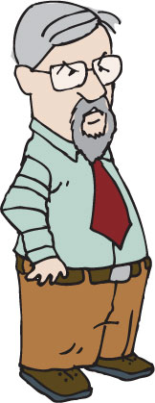
Ron Jeffries
Plan/Manage
LEGO
Dev
Fun
Core
Origins
Intro
Agenda
Notes:
Kent put his ideas together with those of his friend Ron Jeffries. Together, working on a major project at Chrysler, they put their ideas into practice. These ideas shifted the way that software development teams worked, from the physical layout of their work spaces to the way they worked and talked together.

Slide 22

Plan/Manage
LEGO
Dev
Fun
Core
Origins
Intro
Agenda
Notes:
Finally, in 1999, Kent wrote and published his ideas under the name “Extreme Programming.” Extreme Programming has come to be known as “XP.”
[Reference: http://en.wikipedia.org/wiki/Extreme_Programming]
[Reference: http://www.threeriversinstitute.org/Kent%20Beck.htm]
[Reference: http://www.threeriversinstitute.org/]
Going back to its genesis, Extreme Programming was created by Kent Beck during his work on the Chrysler Comprehensive Compensation System (C3) payroll project. Kent became the C3 project leader in March 1996 and began to refine the development method used in the project, which led to his book. Chrysler cancelled the C3 project in February 2000, after the company was acquired by Daimler-Benz.
Although Extreme Programming itself is relatively new, many of its practices have been around for some time; the methodology, after all, takes "best practices" to extreme levels. For example, the "practice of test-first development, planning and writing tests before each micro-increment" was used as early as NASA's Project Mercury, in the early 1960s (Larman 2003). Refactoring, modularity, bottom-up and incremental design were described by Leo Brodie in his book published in 1984.
Ken and Kent, among others, came to realize that a shift in the principles, practices, and methodologies were needed in the ways by which software projects were run and by which developers did their work. They had explored and experimented, and it all began to come together.

Slide 23
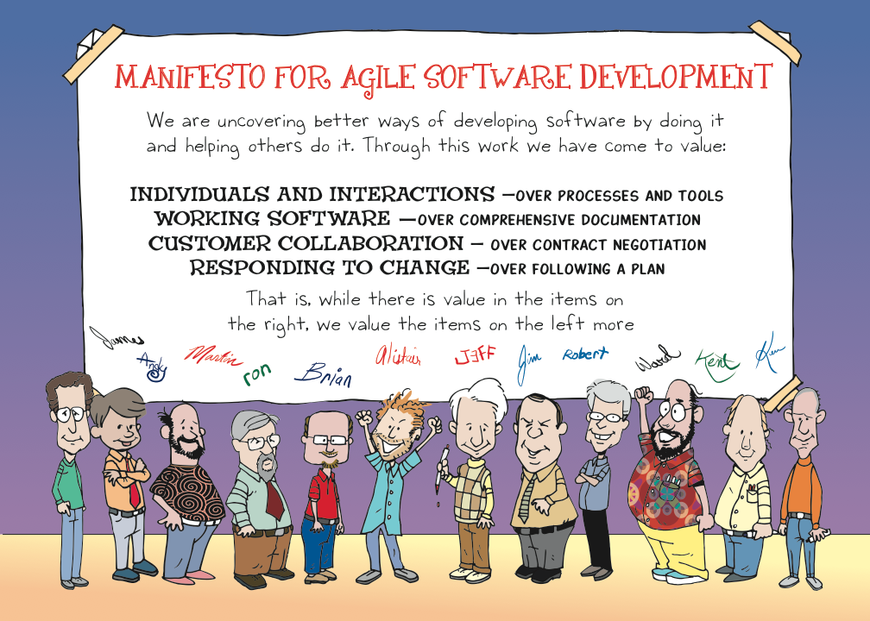
Plan/Manage
LEGO
Dev
Fun
Core
Origins
Intro
Agenda
Notes:
The result of the thinking and activities of folks like Ken Schwaber, Kent Beck, Ward Cunningham, Martin Fowler, Alistair Cockburn, and others was a document called A Manifesto for Agile Software Development.
A group of these folks – the thinkers and doers and experimenters – got together on February 11-13, 2001, at The Lodge at Snowbird ski resort in the Wasatch mountains of Utah, to talk, ski, relax, and try to find common ground - and of course, to eat. What emerged was the Agile -Software Development- Manifesto. Representatives from Extreme Programming, SCRUM, DSDM, Adaptive Software Development, Crystal, Feature-Driven Development, Pragmatic Programming, and others sympathetic to the need for an alternative to documentation driven, heavyweight software development processes convened.

Slide 24
The Agile Manifesto
Plan/Manage
Processes and Tools
Following a Plan
LEGO
Dev
Contract Negotiation
Working Software
Fun
Core
Comprehensive Documentation
Individuals and Interactions
Origins
Intro
Responding to Change
Customer Collaboration
Agenda
Notes:
Now, a bigger gathering of organizational anarchists would be hard to find, so what emerged from this meeting was symbolic - a Manifesto for Agile Software Development - signed by all participants. The only concern with the term agile came from Martin Fowler (a Brit for those who don’t know him) who allowed that most Americans didn’t know how to pronounce the word ‘agile’.
(taken from http://www.agilemanifesto.org)
[Resource: http://www.agilemanifesto.org/history.html]
Many of these folks are legendary today, including:
Kent Beck – author of “Extreme Programming Explained” and “Test-Driven Development by Example”
Mike Beedle – co-author of “Agile Software Development with Scrum” with Ken Schwaber
Arie van Bennekum
Alistair Cockburn – author of “Agile Software Development: The Cooperative Game”, “Writing Effective Use Cases”, “Crystal Clear: A Human-Powered Methodology for Small Teams”
Ward Cunningham – creator of the first wiki, co-author of “The Wiki Way: Quick Collaboration on the Web”, author of “Fit for Developing Software: Framework for Integrated Tests”
Martin Fowler – Chief Scientist of ThoughtWorks, author of “Patterns of Enterprise Application Architecture” and “Analysis Patterns: Reusable Object Models”, co-author of “Refactoring: Improving the Design of Existing Code” with Kent Beck and others, and more
James Grenning
Jim Highsmith – author of “Agile Project Management: Creating Innovative Products”, “Agile Software Development Ecosystems”, and more
Andrew Hunt – co-founder of “The Pragmatic Programmers” and co-author of “The Pragmatic Programmer: From Journeyman to Master”, both with Dave Thomas
Ron Jeffries – author of “Extreme Programming Adventures in C#”, co-author of “Extreme Programming Installed”, co-developer of the eXtreme Programming methodologies
Jon Kern
Brian Marick – author of “The Craft of Software Testing: Subsystems Testing Including Object-Based and Object-Oriented Testing”, “Everyday Scripting with Ruby: For Teams, Testers, and You”, “Programming Cocoa with Ruby: Create Compelling Mac Apps Using RubyCocoa”
Robert C. Martin – known as “Uncle Bob” Martin, author of “Agile Software Development, Principles, Patterns, and Practices”, “Agile Principles, Patterns, and Practices in C#”, “Clean Code: A Handbook of Agile Software Craftsmanship”
Steve Mellor
Ken Schwaber – co-creator of Scrum, with Jeff Sutherland, author of “Agile Project Management with Scrum” and “The Enterprise and Scrum”, co-author of “Agile Software Development with Scrum” with Mike Beedle
Jeff Sutherland – co-creator of Scrum, with Ken Schwaber
Dave Thomas – co-founder of “The Pragmatic Programmers” with Andy Hunt, co-author of “The Pragmatic Programmer: From Journeyman to Master”
Now for a little bit of fun. You each have a worksheet that contains the key concepts that make up the Manifesto. There’s a template on those worksheets, showing how the ideas go together. Let’s take a few minutes to see if we can figure out what the signers of the Manifesto had in mind.
Building the Agile Manifesto
Don't just simply present the agile manifesto. The students will learn more if they have an opportunity to build it. Ensure that your flip chart has the four empty slots for all the statements as well.
Hand out copies of the empty Agile Manifesto (see Student's Handout). Feel free to ask students to work together in pairs or individually. Explain the manifesto is used as a guide for values and that everything on the list is important and we're trying to understand what factors might influence the decisions we make.
Give them five minutes to fill out their form. Build up the manifesto based on everyone's input and discuss why one item appears on one side, and why they are trade offs.

Slide 25
Plan/Manage
LEGO
Dev
Fun
Core
Origins
Intro
Agenda
Notes:
Let’s examine the four value statements, one by one, and see what they mean to us.

Slide 26
Plan/Manage
Individuals and Interactions
over
Processes and Tools
LEGO
Dev
Fun
Core
Origins
Intro
Agenda
Notes:
Individuals and Interactions over Processes and Tools
As a toolmaker, clearly ThoughtWorks Studios believes that there is value in tools and the processes that they support. In fact, all of us use tools every day in our jobs and our lives. Whether it’s a computer, keyboard, mouse, and monitor, or a toaster or a coffee maker, tools make our lives easier. What the authors of the Agile Manifesto were focusing on, however, was their belief that it is people, and the interactions between people, that are more important in ensuring the success of projects. People talking to people, and people as skilled craftspeople and experts in their fields – these are the things to focus on.
Robert Frost said “I am a writer of books in retrospect. I talk in order to understand; I teach in order to learn.” That goes right to the heart of Individuals and Interactions. Agile teams are always teaching each other and learning from each other. Tools and processes are there to free them to do these and other things, not to be the focus of their efforts.
And Ernest Hemingway said “When people talk, listen completely. Most people never listen.” The interactions between individuals require both talking and listening, along with a leavening of doing.

Slide 27
Plan/Manage
Working Software
over
Comprehensive Documentation
LEGO
Dev
Fun
Core
Origins
Intro
Agenda
Notes:
Working Software over Comprehensive Documentation
If you’ve been in the software profession for any length of time, you’ve either been responsible for, involved in, or the victim or beneficiary of some form of documentation or other. The US Government has documents that describe and define the documents that are required for a project. In almost every type of business, it is common to have Requirements Specifications, Design Specifications, Functional Specification, Test Specifications, Code Documentation, Test Results Reports, and so on.
The problem with this is that highly skilled people spend a significant chunk of their time writing documentation that might be read only once, if at all. Sure, the design specs and test specs will be referred to over and over during development and testing. And that’s about it.
The authors of the Agile Manifesto were focused more on show and tell than they were on writing about it. They came out of the world of rapid prototyping and engaging with the customer and the user in new ways, and thought that it made more sense to spend development time on – you guessed it – development.
Of course, there’s still a place for documentation. However, in Agile teams, we try to find ways to either have the system be self-documenting, or to simplify the documentation requirements. As you go through later modules in this course, we’ll talk about things like “test first” and TDD, user stories, showcases, and more.

Slide 28
Plan/Manage
Customer Collaboration
over
Contract Negotiation
LEGO
Dev
Fun
Core
Origins
Intro
Agenda
Notes:
Customer Collaboration over Contract Negotiation
Contracts are in place to enforce agreements. The only time that contracts are referenced is when one party or another has not lived up to their commitment. In software development, specifications represent contracts, if you consider that they spell out what the customer or product manager or user wants, and what the development team commits to delivering.
Isadora Duncan said, “Any intelligent woman who reads the marriage contract, and then goes into it, deserves all the consequences.” Most of us, on reading contracts, are inclined to say “that’s unenforceable” or “they’ll never make us stick to that.”
The problem is that things change. Business circumstances change. The economy changes. Our understanding of the work we do, what our customers need, or the environment in which it’s done changes. And then, if we have a contract, we have to renegotiate, with all that entails – meetings, lawyers, reviews, budgets, schedules, and so on.
Perhaps Diane Sawyer said it best: “I have a contract but it's not a commitment in the ordinary sense. It's our ongoing conversation.”
The authors of the Agile Manifesto seem to believe that it makes more sense to spend more time talking to your customer than spending time negotiating a contract. The time spent with the customer, however, should be focused on the software and the goals to be achieved and the value created or delivered by that software. That is, the time should be spent talking about the things that actually matter.

Slide 29
Plan/Manage
Responding to Change
over
Following a Plan
LEGO
Dev
Fun
Core
Origins
Intro
Agenda
Notes:
Responding to Change over Following a Plan
We’ve talked about change a bit already. In fact, responding to change is one of most difficult things we deal with in life, both at work and elsewhere. In most waterfall organizations, following a plan is far more important than responding to change. Many of us have found ourselves in situations where we’ve had to say “Do you want us to meet our delivery date, or do you want this feature added in?” or “Sure, we can do that. As soon as we renegotiate the contract, modify the project plan, get agreement from all parties, and set a new delivery date.”
Responding to change is one of the hallmarks of Agile. Being able to respond to changes in economy, business, consumer needs and desires, technology, or architecture is crucial to the success of software projects. And yet in Waterfall, it seems like we do everything we can to avoid change and stick to the plan.
Plans are good. Plans are necessary.
According to W. Clement Stone, “No matter how carefully you plan your goals they will never be more that pipe dreams unless you pursue them with gusto. “ This is akin to the Japanese proverb, “Vision without action is a daydream. Action without vision is a nightmare.”
According to Napoleon Hill, “Create a definite plan for carrying out your desire and begin at once, whether you ready or not, to put this plan into action.”
And then there’s Colin Powell’s thought that “No battle plan survives contact with the enemy.” Although this one is more properly attributed to Helmuth von Motlke the Elder, a disciple of Clausewitz.
All of these help us to understand the Agile approach to planning: get enough information to get started, build something, show the customer, and then respond to their feedback. Or in the terms of W. Edwards Deming, Plan-Do-Check-Act. That is, make a plan, execute against the plan, see how you’re doing, and adjust accordingly.
That is, plan and respond to change. Both.

Slide 30
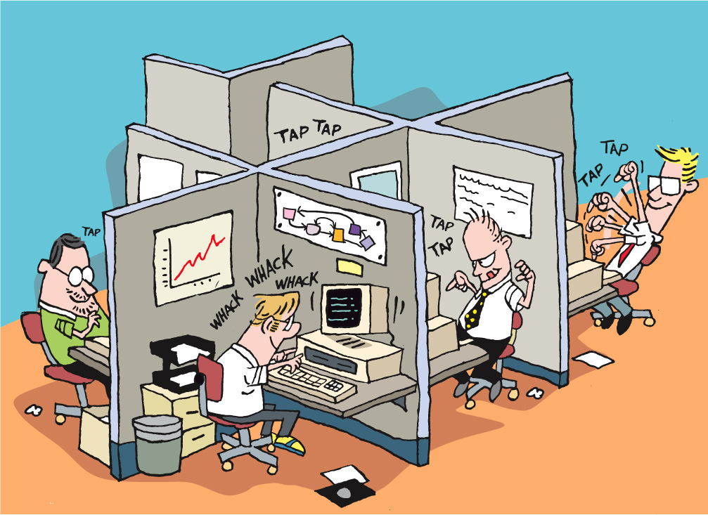
Plan/Manage
LEGO
Dev
Fun
Core
Origins
Intro
Agenda
Notes:
Let’s go back again, and look at how some of these systems – practices, philosophies, and methodologies – came to be.
As we talked about at the beginning of this module, in the old days – maybe as recent as yesterday – developers (also known as programmers, software engineers, and coders) sat in their own private or semi-private spaces, working on their own, talking to their teammates infrequently. Perhaps you’ve heard of “mushroom management”? It goes “keep them in the dark and feed them fertilizer – when they get big enough, can them”.
While this is funny, it’s all to close to reality. Too many managers believe in a divide and conquer strategy, or in mushroom management, handing out just enough information to keep their staffs working. The sad thing is that this is highly ineffective.
All of those folks we just talked about a few minutes ago – Beck and Schwaber and Martin and Fowler and Cockburn and so on – all of them looked at this, mostly from being in these situations themselves, and came up with various ways to try to improve not just the lot of the developers, but also the quality of what they produced, and the speed and cost to deliver.

Slide 31
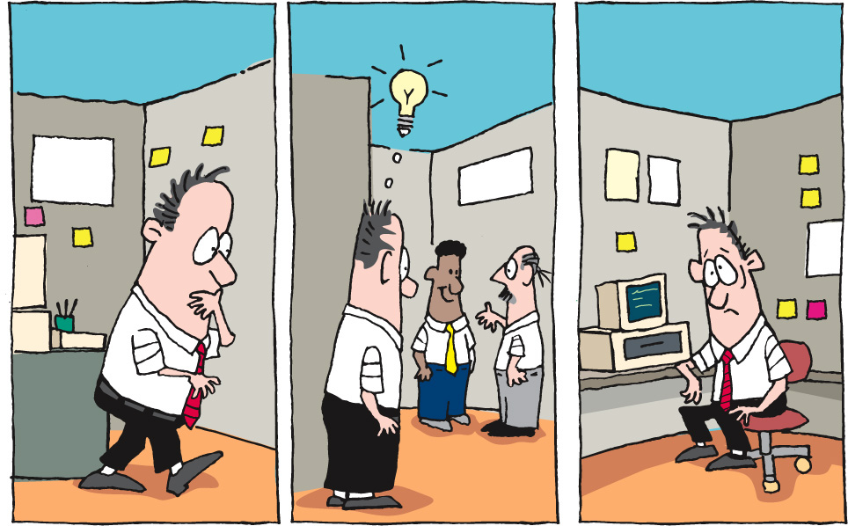
Plan/Manage
LEGO
Dev
Fun
Core
Origins
Intro
Agenda
Notes:
What some of them realized was that there was a problem with isolation and infrequent communication. If I have to leave what I’m doing, find someone else, have a conversation, walk back to my work space, remember what we talked about, and put it into play, I’ve had to context switch two or three times, lost time, and communicated ineffectively. That’s just not an ideal way to work.
So these guys asked “what if?” and “how?” and experimented. They looked at where and how they sat, what their working circumstances were like, how their teams communicated internally and externally, how they managed their requirements and workflow, and more.

Slide 32
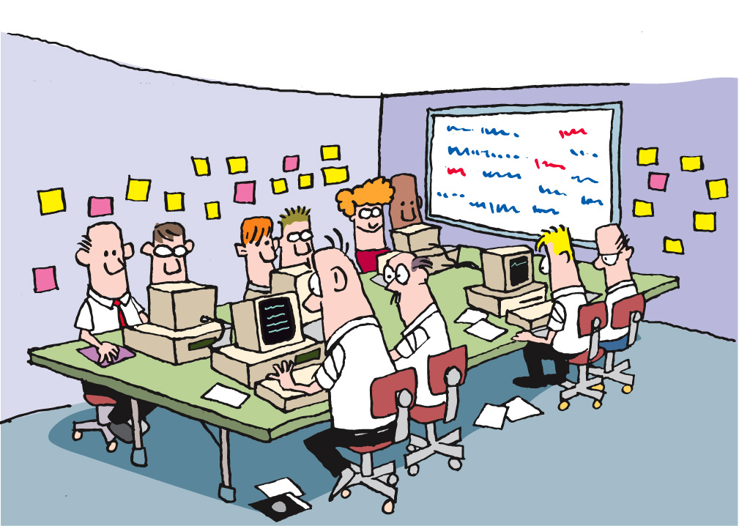
Plan/Manage
LEGO
Dev
Fun
Core
Origins
Intro
Agenda
Notes:
One of the most important outcomes of the C3 project at Chrysler, where Kent Beck and Ron Jeffries pioneered the practices that became eXtreme Programming, or “XP”, was the idea of a collocated team and a team room.

Slide 33
Plan/Manage
LEGO
Dev
Fun
Core
Origins
Intro
Agenda
Notes:
Consider our previous example, where I have to get up, walk around, find someone to answer a question, go back to my office or cubicle, remember what they said… Well, there’s a lot of time and knowledge lost, and productivity is not very high. What if, when I wanted to ask someone a question, they were right there in the room with me? What if I could just ask, immediately use the answer, ask clarifying questions, all without leaving my work space?

Slide 34
Plan/Manage
LEGO
Dev
Fun
Core
Origins
Intro
Agenda
Notes:
The answer is that productivity goes up, the quality of the work goes up, and the time it takes goes down.
Now, let’s look at another part of this. In the old days (yes, we’re still talking about times as recent as yesterday), code reviews were a separate process, conducted with some degree of formality. They usually took place after I’d written and tested my code, when I thought I was done, and when I thought I was ready to move on. Because we had to schedule and arrange and plan the time, code reviews frequently took place some significant time after I thought I was done. Changes were resisted, and feedback was always taken as criticism.
What if code reviews were happening in real time? What if my reviewer was actually sitting right next to me, talking to me about my code, the decisions I’m making, and so on, as I’m writing my code? And what if we changed roles periodically? This is Pair Programming, and is another outcome from the C3 project, and a core practice in XP.

Slide 35
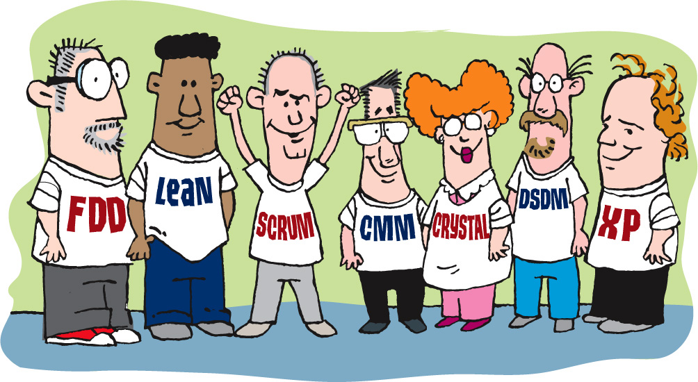
The Evolution of Approaches
Plan/Manage
LEGO
Dev
Fun
Core
Origins
Intro
Agenda
Notes:
All of these approaches – call them philosophies, methodologies, and practices – comprise what we call “Agile”.
Agile is not a single thing. Agile is “A Manifesto for Agile Software Development”.
Agile is a set of things.
Agile is a mindset, a way of thinking, and a way of approaching work. From Feature-Driven Design to Scrum to XP and all the rest, it’s about the commitment to deliver more business value in the same or less time, for the same or less cost. When you read about these different schools of thought, you’ll see that they all overlap in these areas.

Slide 36
It’s not either-or
Scrum
XP
Hybrid / “Scrumban”
Pick the pieces that work best
Plan/Manage
LEGO
Dev
Fun
Core
Origins
Intro
Agenda

Slide 37
Let’s review
Alistair Cockburn: Crystal http://alistair.cockburn.us/Crystal+methodologies+main+foyer
Kent Beck: Extreme Programming http://www.threeriversinstitute.org
Ken Schwaber / Jeff Sutherland / Mike Cohn: Scrum http://www.implementingscrum.com http://www.controlchaos.com http://jeffsutherland.com http://www.mountaingoatsoftware.com
Mary & Tom Poppendieck: Lean http://www.poppendieck.com
General Resource: http://www.InfoQ.com
Plan/Manage
LEGO
Dev
Fun
Core
Origins
Intro
Agenda
Notes:
Talk about each of these people and resources

Slide 38

Plan/Manage
LEGO
Dev
Fun
Core
Origins
Intro
Agenda
Photo by Steven List

Slide 39
Core practices
Plan/Manage
LEGO
Dev
Fun
Core
Origins
Intro
Agenda
Notes:
The Agile Core: Story Based Development & Incremental Business Value
User Stories, Use Cases and Scenarios
Looking at the Big Picture – Is up front planning OK?
“Good Enough” Software
Release Early and Often
The story:
Actors and use cases – sterile
Actors are causal, use cases state results of that causality
Use cases are explanatory, and rarely include business value
Storytellers, customers, and stories – comes alive
Roles represent
Stories are demanding, as well as explanatory
Stories tell you why, as well as what
Stories do NOT tell you HOW
Storytellers share experience and needs
The Big Picture – is it possible to know everything up front?
has anyone had a house built? Remodeling done?
Zeno’s Paradox of the Dichotomy
http://en.wikipedia.org/wiki/Zeno%27s_paradoxes#The_dichotomy_paradox
“That which is in locomotion must arrive at the half-way stage before it arrives at the goal.” ~Aristotle, Physics VI:9, 239b10
“The perfect is the enemy of the good.” ~Voltaire
Incremental, with constant review
Fail fast, learn quickly, adapt - PDCA

Slide 40

Meet Bill
Plan/Manage
LEGO
Dev
Fun
Core
Origins
Intro
Notes:
Meet Bill. Bill is just an average guy. He lives in an apartment, goes to work every day, has friends and family and co-workers. Bill has a reasonable social life, visits with his parents and siblings from time to time, and in general has a pretty decent life.
In many ways, Bill is like you and me. Bill is, in fact, very much like people we work with and live with. You might say that Bill is an “everyman”.
And Bill has been saving his money for a while. He has scrimped and saved and been very disciplined.

Slide 41
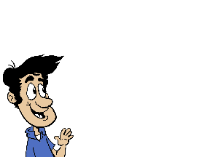
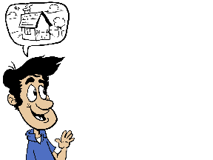
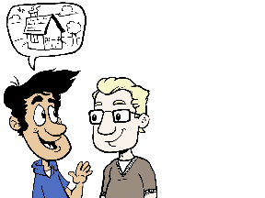
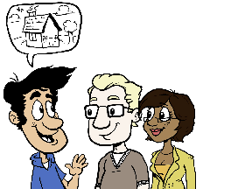
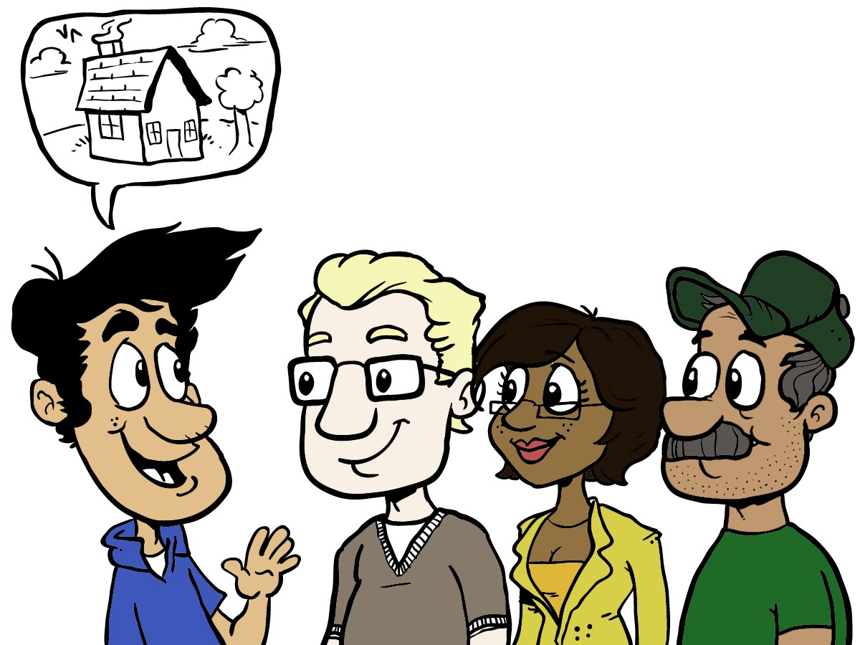
Describing his dream…
Plan/Manage
LEGO
Dev
Fun
Core
Origins
Intro
Agenda
Notes:
As so many of us have done, Bill meets with the people he needs to turn his dream [CLICK] into reality.
[CLICK]
First, there’s the Architect. It’s the Architect’s job to understand what Bill wants, including how he’ll live in the house, his lifestyle, and his vision. The Architect will take that understanding and turn it into a set of drawings and plans, which will be used to inform the construction. Needless to say, Bill will do his best to describe his vision to the Architect, and the Architect will do his best to make sure he understands what Bill wants.
[CLICK]
Then there’s the Designer. Bill tells the Designer about how he wants all the parts to look – plumbing fittings, walls, windows, lights, and so on. It’s the Designer’s responsibility to translate all of this into an overall look that meets Bill’s dream and desires. This is the part that Bill, and visitors to Bill’s house, will see and use the most. So the Designer really needs to understand Bill and his lifestyle and how he expects to use things in his house, right? Bill thinks he has the easy part, because he just needs to tell the Designer how he’ll live in and use the house. No problem!
[CLICK]
Finally, there’s the Contractor. The Contractor will take the Architect’s drawings and plans and the Designer’s renderings, swatches, and samples, and turn it all into a finished house. Bill figures he doesn’t need to tell the Contractor very much, since the Contractor will get what he needs from the Architect and the Designer, and should therefore build exactly what Bill wants.
[CLICK]
As we go forward, it’s worth considering that most of us have either had a house built, or know someone who has.
How does this sound so far?

Slide 42
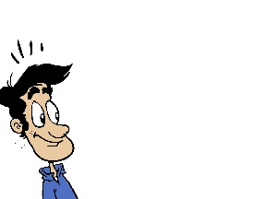
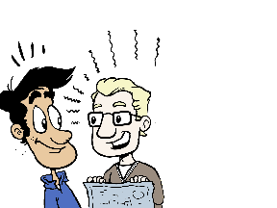

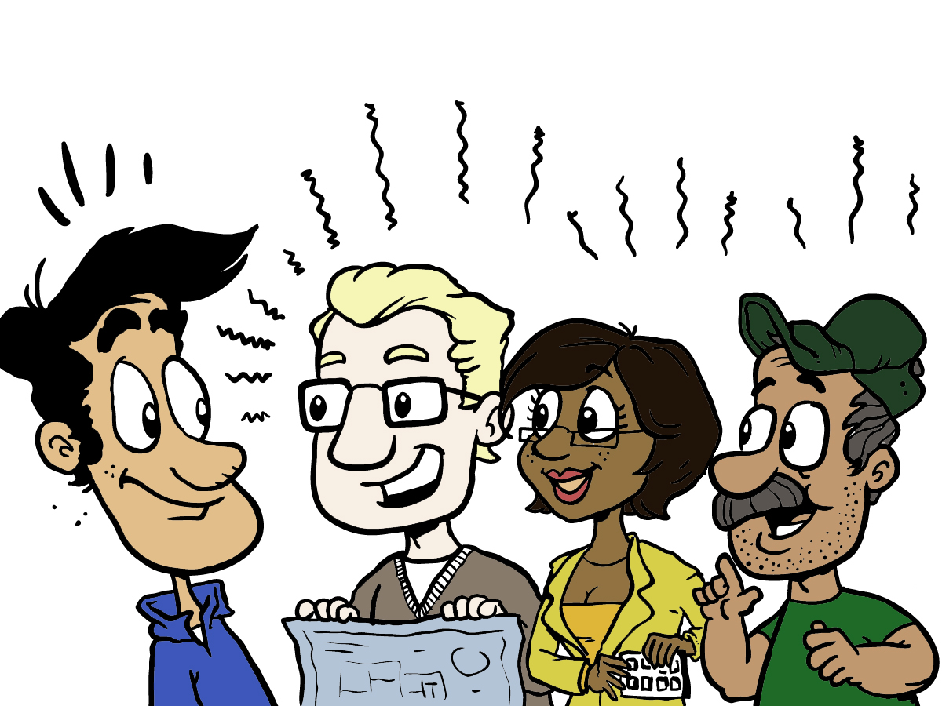
…and making plans
Plan/Manage
LEGO
Dev
Fun
Core
Origins
Intro
Notes:
After spending some time with Bill – at least weeks, maybe months - each of the members of his team goes off to do their work.
[CLICK]
The Architect draws up renderings and plans and blueprints, which he shares with Bill and the Designer and the Contractor.
[CLICK]
The Designer also produces some drawings, and shows Bill samples and swatches, colors and concepts, which she shares with the Architect and the Contractor.
[CLICK]
The Contractor assures Bill that he has a detailed schedule, has all the resources he needs, will keep Bill advised, will ask the Architect and Designer questions as he needs to, and that everything will proceed easily. Really.
Does this sound familiar to you?

Slide 43
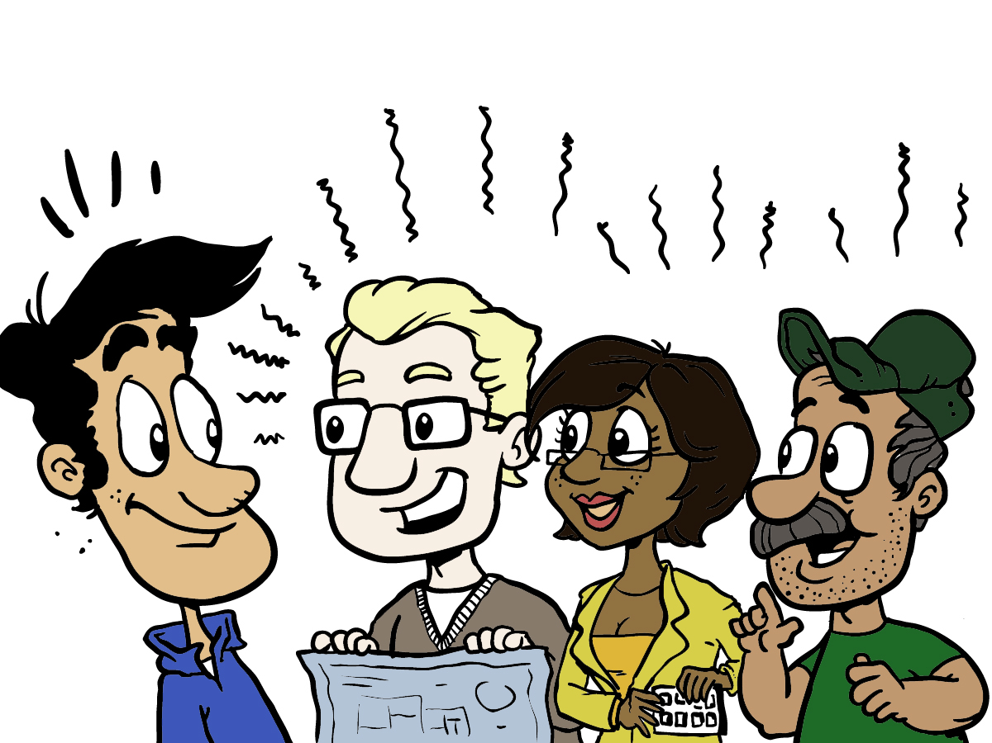
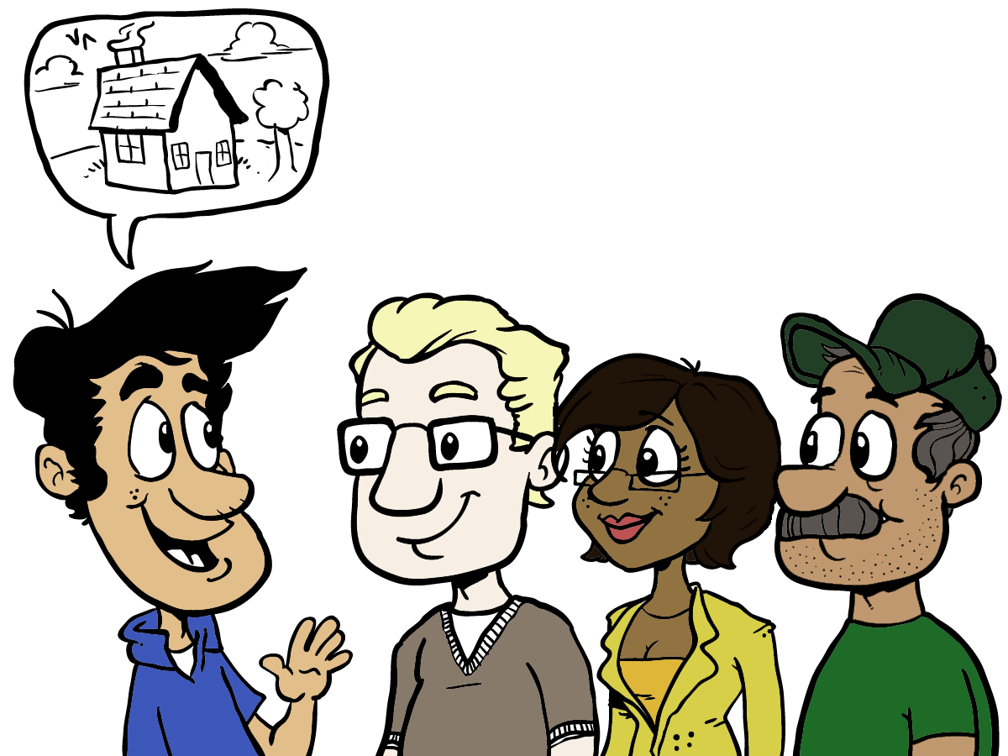
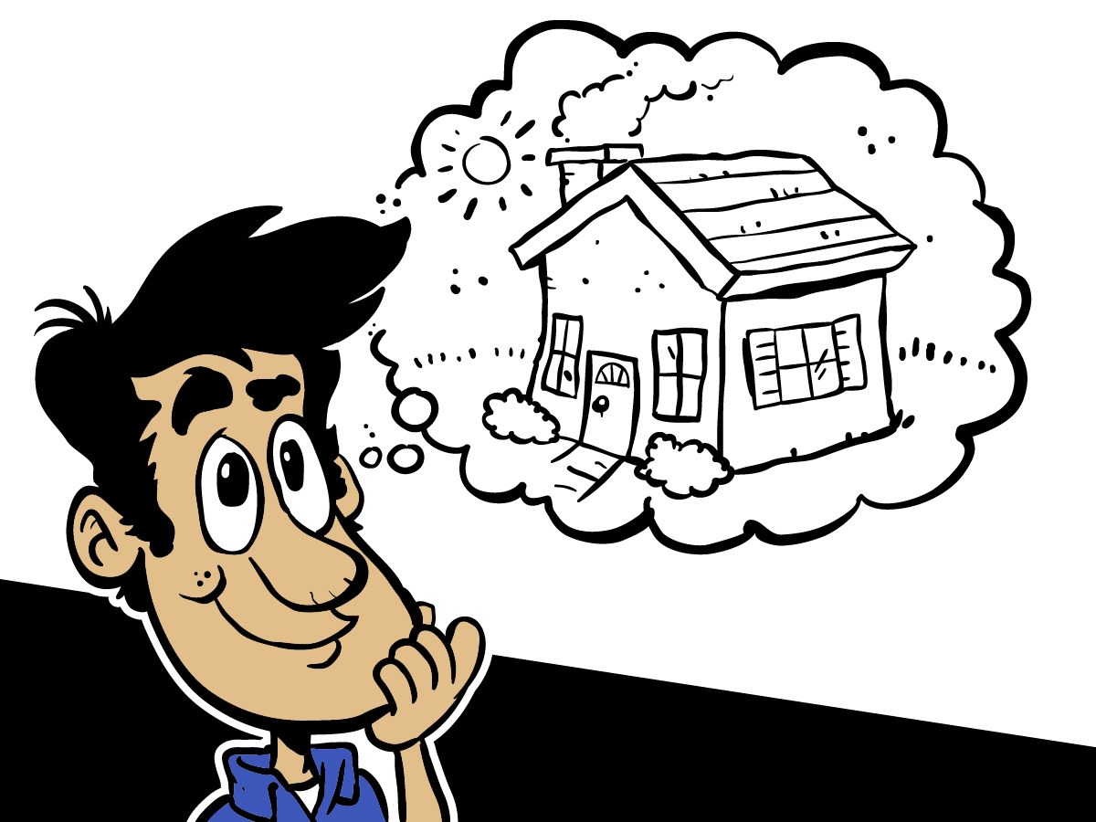
Waiting…
Plan/Manage
LEGO
Dev
Fun
Core
Origins
Intro
Agenda
Notes:
Bill looks over what they’ve supplied. He’s probably a bit confused, because he’s not used to reading blueprints and plans, but he thinks they’ve got it. Okay – he HOPES they’ve got it, because as far as he can tell, they seem to have absorbed and understood everything he’s told them.
Of course, their enthusiasm has a great effect on Bill.
“You’ll love the way the house flows from room to room. You’ll find yourself just wanting to walk through the house over and over.”
[CLICK]
“The colors work so perfectly with the fixtures. You’ll be happy just standing in the middle of each room. And the fixtures will fit your hands perfectly!”
“The schedule looks really good – we’ve got some of our best guys lined up. Come by any time, and you’ll see progress that will make you happy.”
[CLICK]
How could Bill not feel confident and excited?
Then Bill started waiting. And waiting.

Slide 44
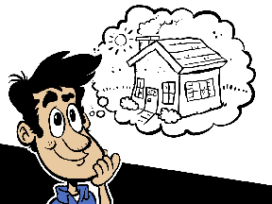
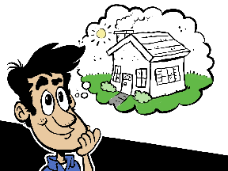


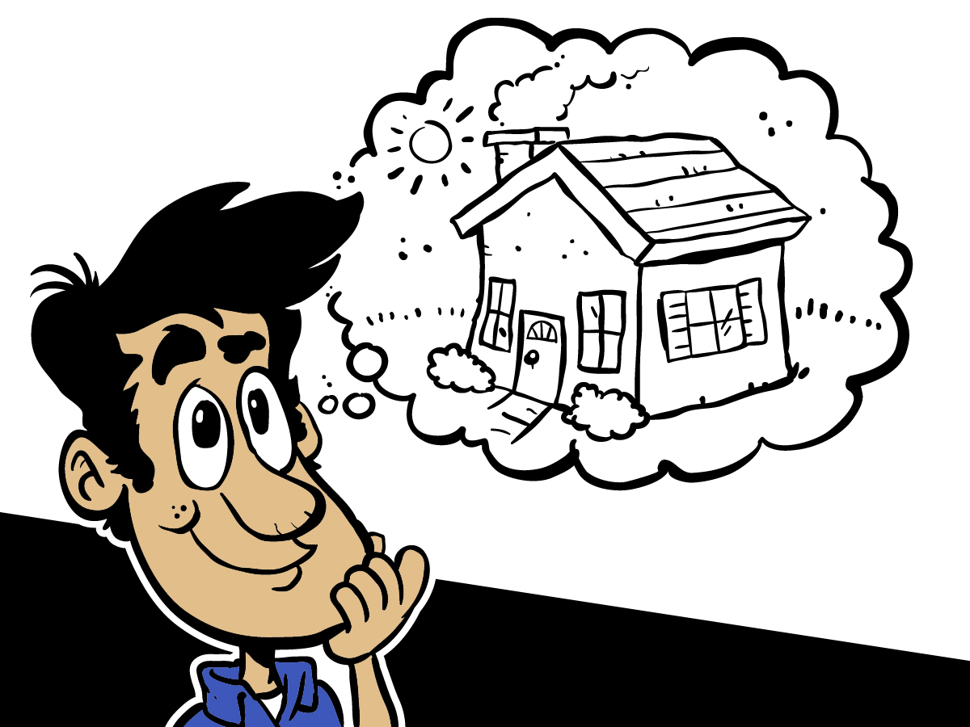
Dreams…
Plan/Manage
LEGO
Dev
Fun
Core
Origins
Intro
Agenda
Notes:
So okay – the schedule slipped a bit. The “guys” got caught up in another project, and had to delay some of this and some of that.
Some of the wonderful plumbing and electrical fixtures had to be backordered, so there were some delays there. Oh – and there was one style that was no longer available, so the Designer picked something different, telling Bill that she really understood what he wanted and this one would be perfect maybe even better than the original and not to worry.
The Architect and the Designer and the Contractor had to get together a few times, because the plans weren’t entirely clear and the Designer understood something different from what the Architect understood from Bill, and the Contractor wasn’t sure what either of them meant.
And through it all, Bill kept the faith. He had his dream, and he had the drawings and plans and renderings and swatches and samples to keep his dream alive.
Every once in a while, Bill would go by the building site. Sometimes it seemed like it didn’t match up with what he expected. When he’d ask, the Contractor would tell him “It’ll be great – it’s hard to understand how the plans and drawings turn into a house until you see the finished house. Trust us – we have your best interests at heart, and really want you to be happy.”
Sometimes, this made Bill uneasy. But he had decided that they were the experts, and he would trust them.
And the day came when the team said “Bill! Your house is ready! Come see!!”

Slide 45

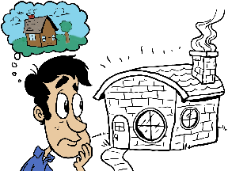
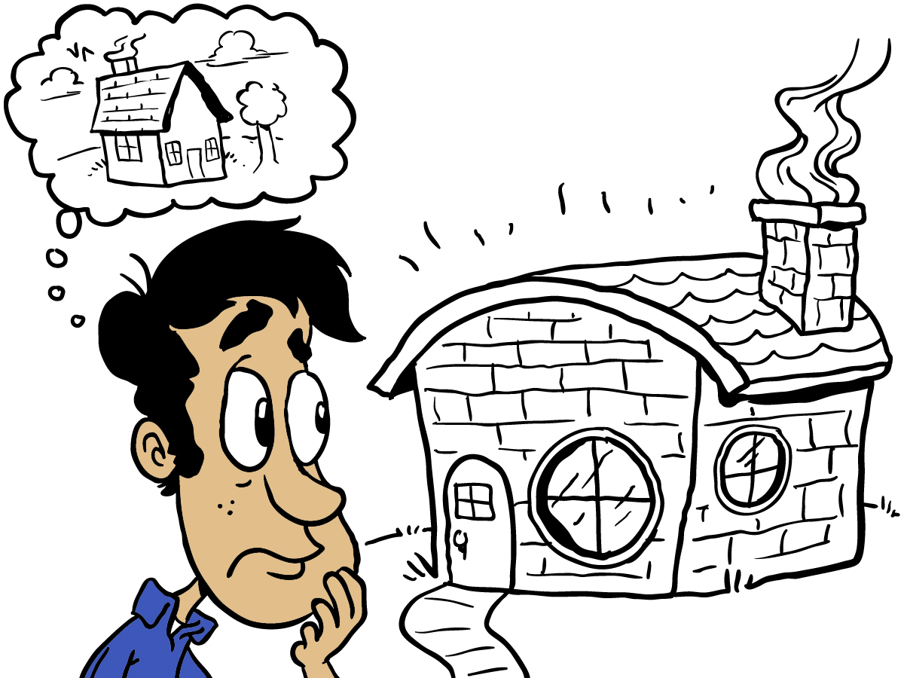
…and reality
Plan/Manage
LEGO
Dev
Fun
Core
Origins
Intro
Agenda
Notes:
…and somehow, in spite of all the conversations and reassurances and plans and drawings and renderings and swatches and samples…
It just isn’t what he expected.
Bill wondered how that could have happened. They’d all worked so hard, and communicated up front, and the plans and all seemed right.
What went wrong? How did Bill’s dream turn into a nightmare?

Slide 46
Shalls, Shoulds, and Reality
The house SHALL have a chimney
The house SHALL have a front door
The house SHALL have windows
The roof SHOULD shed rain and snow
Plan/Manage
LEGO
Dev
Fun
Core
Origins
Intro
Agenda
Notes:
From a functional standpoint, the house meets all of Bill’s requirements. Everything he talked about is there – sort of. The problems are many, however, and Bill isn’t quite sure how he went from what he thought was a clear description of what he wanted, to what he’s got today. Clearly there are bathroom fixtures and lights and doors and windows and everything he said he wanted. And many of them either match his expectations, or are reasonably close. But where they don’t match his vision, poor Bill is just not sure how he ended up with what he got.
He’s convinced that he was specific and clear. He knows he spent plenty of time explaining and sharing his ideas. The Architect, the Designer, and the Contractor have expressed excitement and understanding throughout, and really, really seemed to get it.
How did we get here?
How could we do this better?
What we’ve just gone through is the Waterfall approach to building a home. If you’ve been through this experience, then you know that it happens this way. Some of us are lucky enough to have few problems, and some have had real nightmares become our reality. Contractors know that there will be problems, but they become attached to their plans and schedules, so they impose penalties for changes. Every time you ask for changes, you pay MORE MONEY. This discourages you from making changes, which is their goal.

Slide 47
The Agile Version
Notes:
Let’s start again, and consider how Bill might have gotten the house he wants and needs.
We’re not promising that the end result will exactly match Bill’s vision, because no one can make that promise and actually deliver. In fact, we’re not even going to assure Bill that his vision will remain the same throughout. What we will assure Bill is that when we’re done, he will know why he’s got what he’s got, and that he will be happy with the result.
Why?
Well, let’s get into the story, and hopefully it will become clear.

Slide 48
Story Time
Plan/Manage
LEGO
Dev
Fun
Core
Origins
Intro
Agenda
Notes:
Of course, the first thing Bill needs to do is to assemble his team, and to share his vision.
To begin with, Bill shares the big picture vision. Unlike in the Waterfall approach, however, his team – the Architect, Designer, and Contractor – aren’t trying to understand every detail at once.

Slide 49

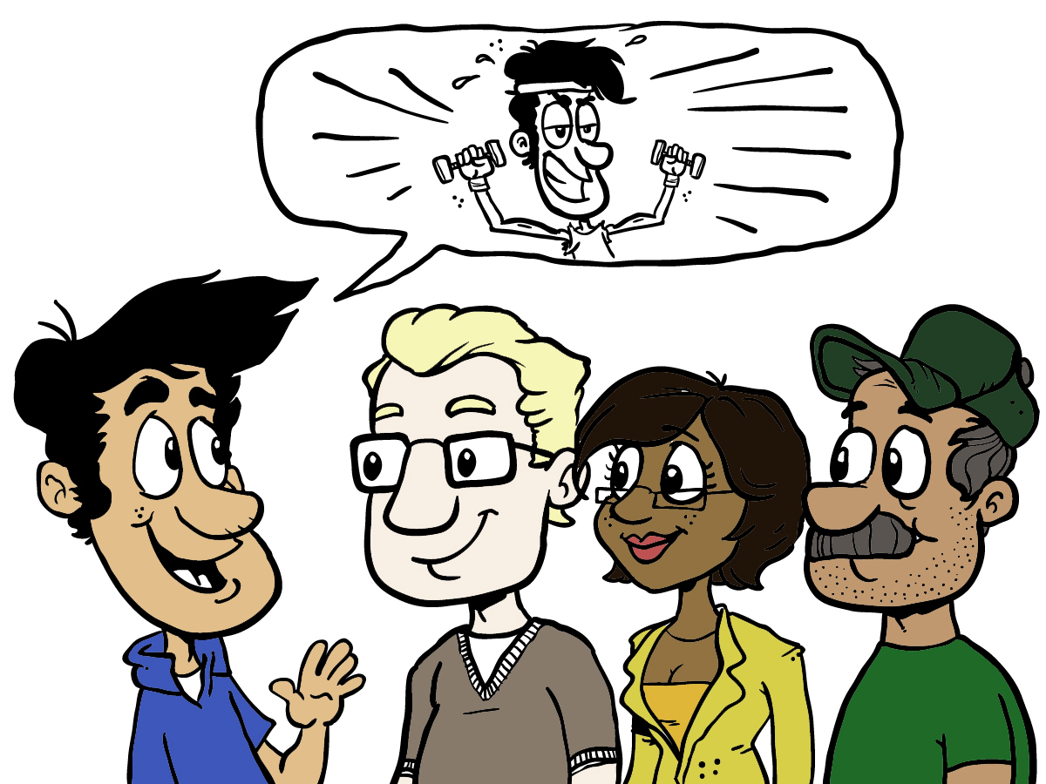
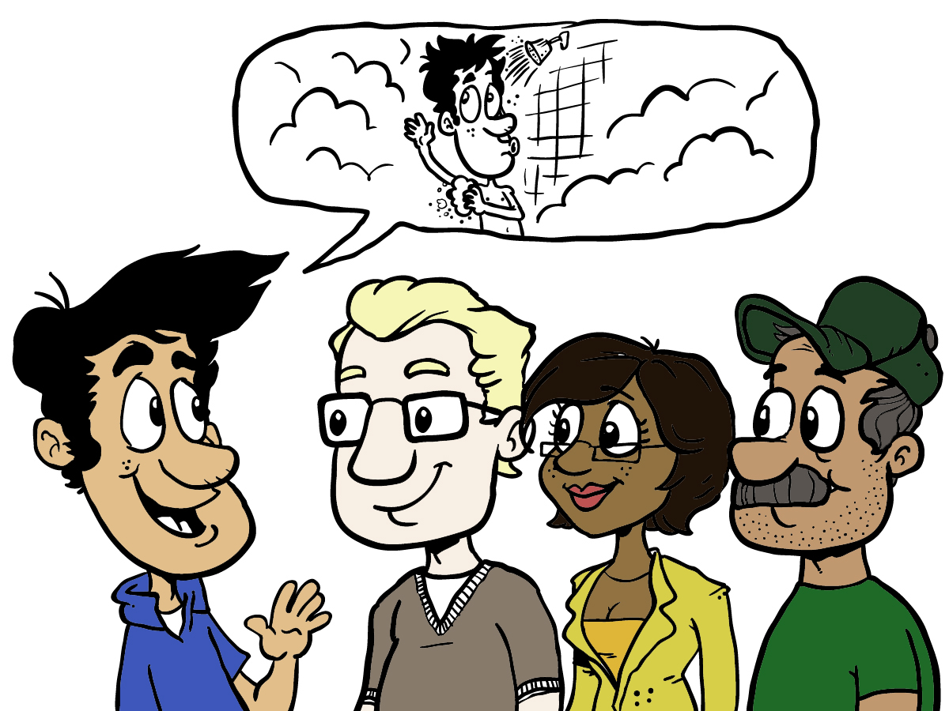
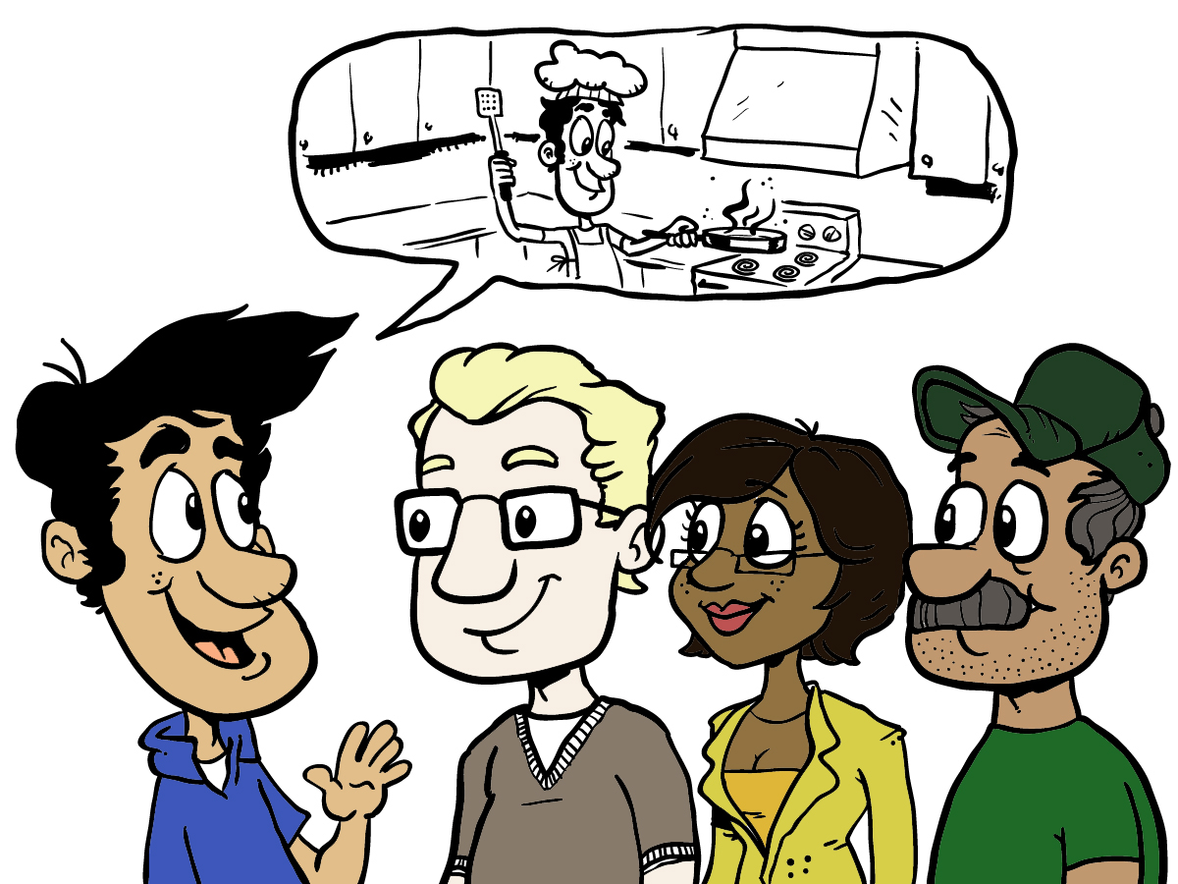
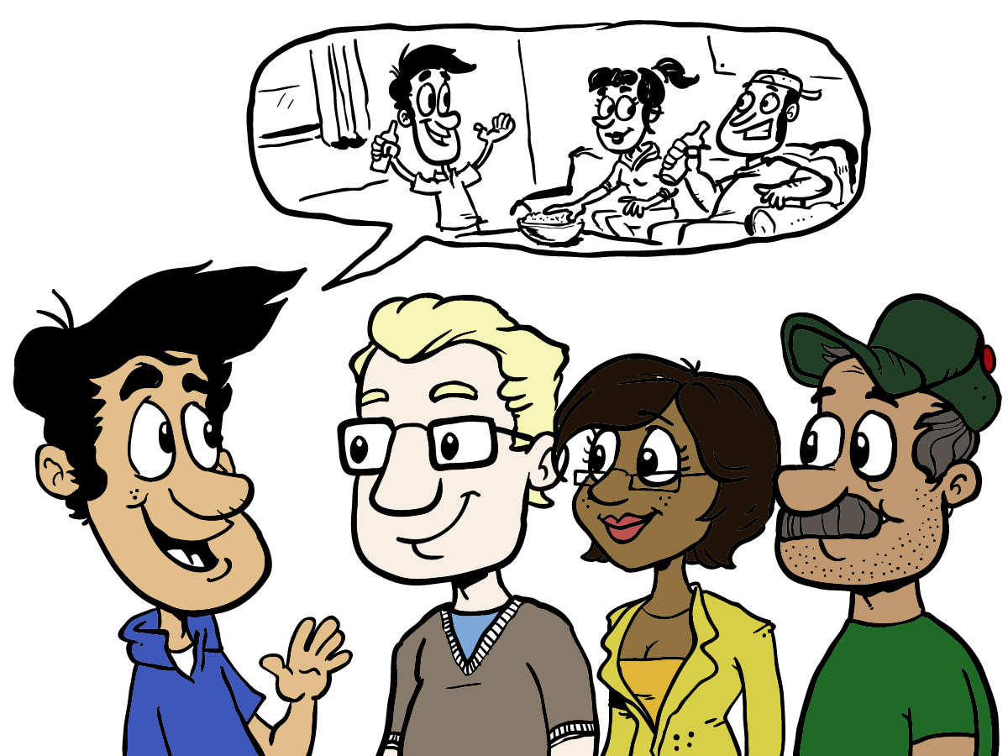
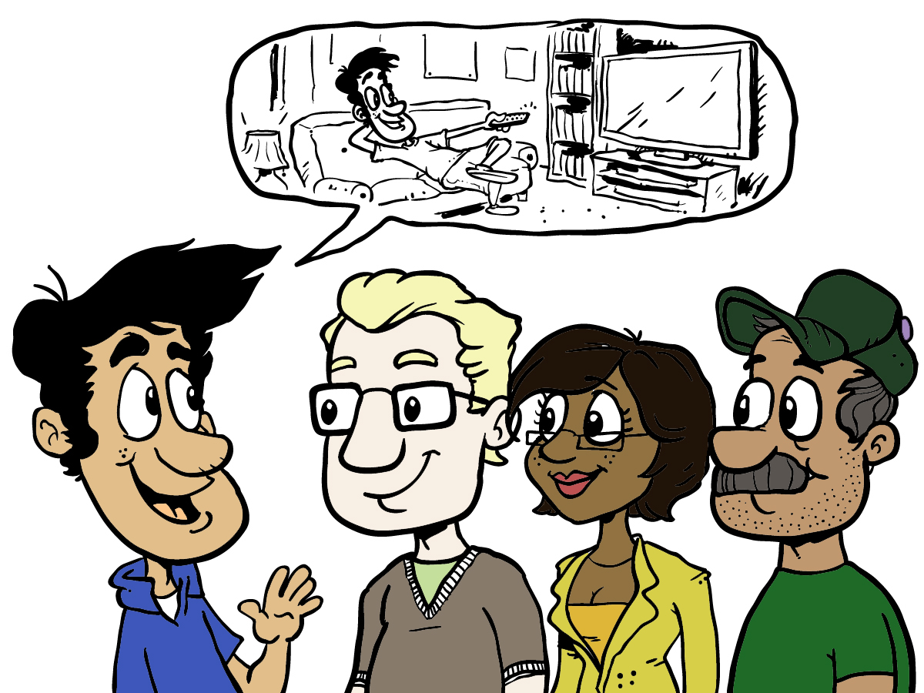
User Stories
Notes:
They’ll get a sense of Bill’s stories, and gain enough of an understanding to get started.
[CLICK]
They’ll ask Bill how he’ll use the various parts of his home. He’ll tell them that he exercises at home, and the kinds of exercises he does, and why he exercises at home.
[CLICK]
Then he’ll tell them about how he’d like to use his bathroom. Seems obvious, right? That’s the problem with not understanding the stories – it’s too easy to make assumptions. For instance, Bill showers every morning, and likes to remove the calluses from his feet. That means he likes to sit down for a bit, but doesn’t want the water streaming in his face while he’s doing it. As you might imagine, this dictates some of the design and layout elements of his shower. And when he scrubs his back, he doesn’t want to bang his elbows on the sides of the shower. And then, Bill shaves after the shower, so he’d like his sink to be a bit closer to him and not to have to bend down so far.
[CLICK]
And Bill likes to cook and entertain. As they talk, he explains that kinds of cooking he likes to do, how he uses his pots and pans and utensils, and how he serves.
[CLICK]
Then there’s Bill’s entertainment room. He talks about what he likes to watch, how he likes to sit, his home theater equipment, and so on. All of this helps his team to understand not just WHAT he wants, but HOW he’ll use it and how he feels about it.

Slide 50
As a…
I want/need…
So that...
As a showerer who likes to be clean
I want my shower to be wide enough so that I can scrub my back without banging my elbows
So that I won’t have bruises on my elbows.
Plan/Manage
LEGO
Dev
Fun
Core
Origins
Intro
Agenda
Notes:
Let’s look at an example of a story. To begin with, we use a standard template to make it easier and more consistent.
We begin with the identification of the role to which the story applies. It might be a consumer, a system administrator, a business analyst, or whatever roles you find in your customer or internal organization. Without going into great detail about roles at this time, it’s important to understand that we distinguish between roles, personas, and real people. We also try to make the roles be clear enough to be useful, without trying to define dozens and dozens of them.
The second part of the story template identifies the goal – the “what”. This records what it is that the role-player or actor wants or needs to do. This is not a definition in terms of what the system will do. It is a goal, in terms of the use or purpose of the system.
The last part is the value statement. Every story is expected to be expressed in terms of the value it will deliver to the actor or to the business, or both. This is probably the trickiest part for most people to get when they’re first starting up with Agile and user stories. We hear things like “well, because we have to!” or “that’s the way it’s done” or “because that their job”. The thing is, understanding what value is being delivered creates a context for the development team that helps them to be more effective in doing their jobs.
So let’s look at an example from Bill’s story list…[CLICK] As you can see, we have a pretty generic role defined here – “showerer” – which might evolve over time. For now, it describes the role. The goal is also pretty clear – a sufficient width of the shower. And the value is also pretty clear – no bruises!

Slide 51
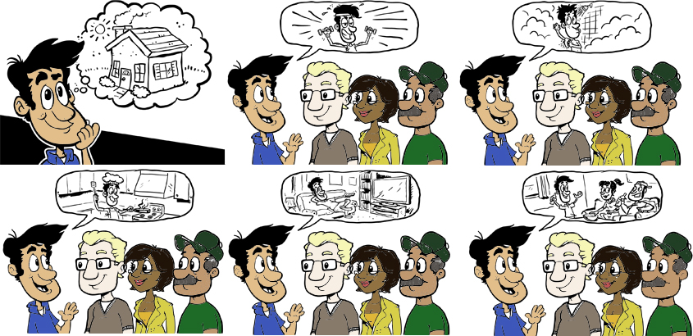
User Stories
Plan/Manage
LEGO
Dev
Fun
Core
Origins
Intro
Agenda
Notes:
Then Bill will tell them about how he likes to cook. He’s not a gourmet chef, by any means, but he does enjoy cooking. He likes to grill, he likes to use seasonings and herbs, and thinks he’d enjoy having fresh herbs. When his team asks him questions about this, he tells them that since it’s pretty hot outside where he lives, he thinks it’d be fun to have herbs growing right there in his kitchen.
Without this conversation, Bill might never have his little herb garden in the window.

Slide 52
As a hobbyist chef
I want to have fresh herbs at my fingertips
So that I won’t have to waste them, and so that my food will have the best, freshest taste.
Plan/Manage
LEGO
Dev
Fun
Core
Origins
Intro
Agenda
Notes:
As you can see, we have a new role, even though we’re talking about the same person. After all, we all fill multiple roles in our work and private lives. That’s why we focus on roles, not personas or real people.
Once again we have the goal – having fresh herbs at his fingertips – and a value.
Note that he doesn’t specify where, how big, the compass direction, or anything else – in fact, he doesn’t specifically identify an herb garden. He just identifies what it is he wants to accomplish – the goal – and why - the value.
Later on, we’ll talk about when and how the details get fleshed out. For now, it’s important to understand that we use stories, that we use a common template for the stories – role, goal, and value – and that we don’t worry about filling in all the details until later.

Slide 53
More Stories
As an avid amateur cook, I want to have a large work surface adjacent to the cook surface, so that I don’t spill or drop things when I’m ready to cook them.
As someone who exercises frequently, I want to have a larger than normal shower, so that I can luxuriate in the shower.
As someone who luxuriates in the shower, I want a bench/seat to relax on, so that my legs don’t tire.
As an
I want
Plan/Manage
so that
LEGO
As
I want
Dev
so that
Fun
Core
As
I want
Origins
so that
Intro
Agenda

Slide 54
User Stories
Plan/Manage
LEGO
Dev
Fun
Core
Origins
Intro
Agenda
Notes:
And so it goes – stories about exercise, cooking, bathing, entertainment and relaxation…
Bill tells the team his stories, and each story fills out the picture in their minds.
Of course, it’s not just about telling the stories, it’s about how those stories turn into architectural and design features of the house, and how those features are constructed.
For instance, knowing that Bill likes to exercise, using free weights and a workout bench, the contractor will choose materials for the floor in Bill’s bedroom that will support that activity without being damaged. A small thing, perhaps, unless you’re the one who’s exercising when the floor starts to give way!
At this point, the team has recorded all of Bill’s stories, and gotten a decent level of understanding of what they mean. They’ve used those stories to develop their initial estimate of how long it will take, what materials they’ll need, and what other resources they’ll need.
One of the important things they keep in mind is that each story they’ve recorded is not complete. The stories are enough to get them started, but they know that when they’re ready to do the actual building, they’ll want to pull out the stories that apply to the part they’re working on and have more discussions.
Does Bill want a bathtub? Does he want the shower over the tub or separate? How about the sink? Just one, or does he want a second one for someone else?

Slide 55
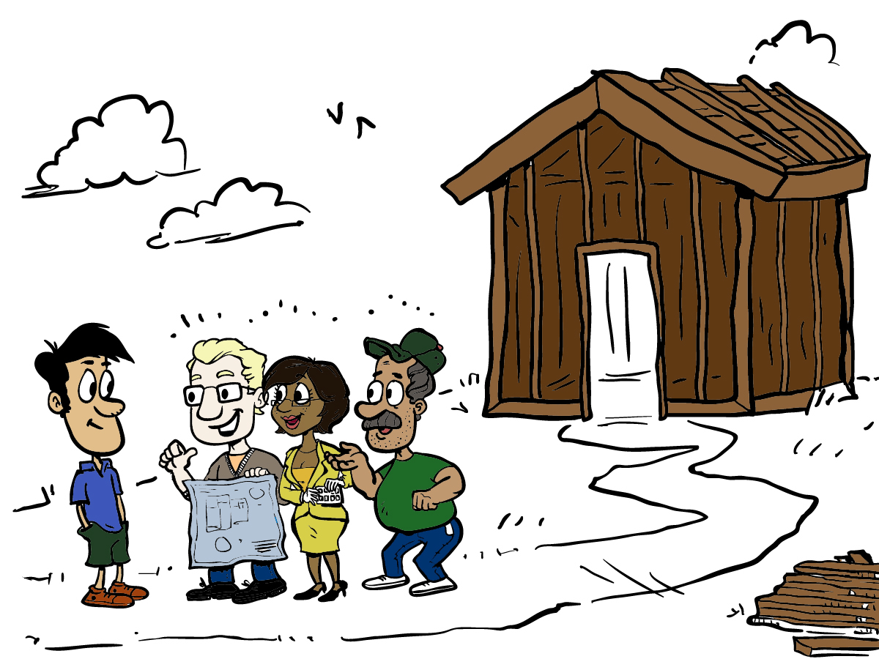
Collaborative, Iterative, Incremental
Plan/Manage
LEGO
Dev
Fun
Core
Origins
Intro
Agenda
Notes:
At each stage of the process, the team gets together with Bill to talk about what they’ve done so far, and to walk through it. They’ll review the stories they’ve used, and make sure that they’ve met Bill’s needs.
They have a short schedule for each of these cycles. Every couple of weeks, they invite Bill out to the building site, and that’s when they do their show-and-tell – their showcase. Each time Bill comes out, there’s a bit more done, and he has a chance to offer his feedback and request changes.

Slide 56
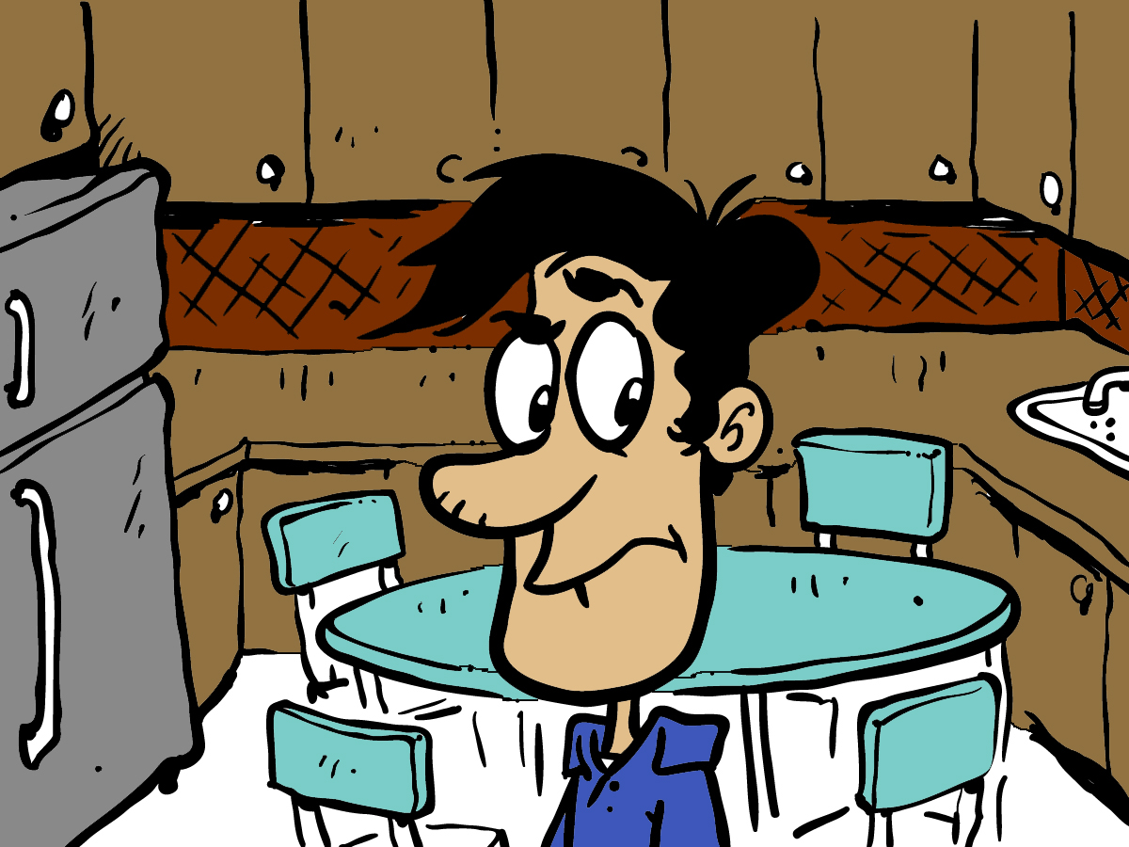
Continuous Feedback Customer Collaboration
Plan/Manage
LEGO
Dev
Fun
Core
Origins
Intro
Agenda
Notes:
Bill really feels like he’s part of the team and part of the process.
He has talked to some of his friends who have built homes, and he realizes that this is very different.
For instance, the kitchen is complete before most of the rest of the house. Bill is able to look at it before all the finish work is done. As he looks it over, he realizes that he’d like the sink in the center of the long counter, rather than off by itself. He hadn’t thought of this before, because it’s not until he’s standing in the kitchen and thinking about working there that he gets the full feel of it.
The team says “no problem” because their approach allows them to respond to changes like this, and because the finish work isn’t done yet.

Slide 57
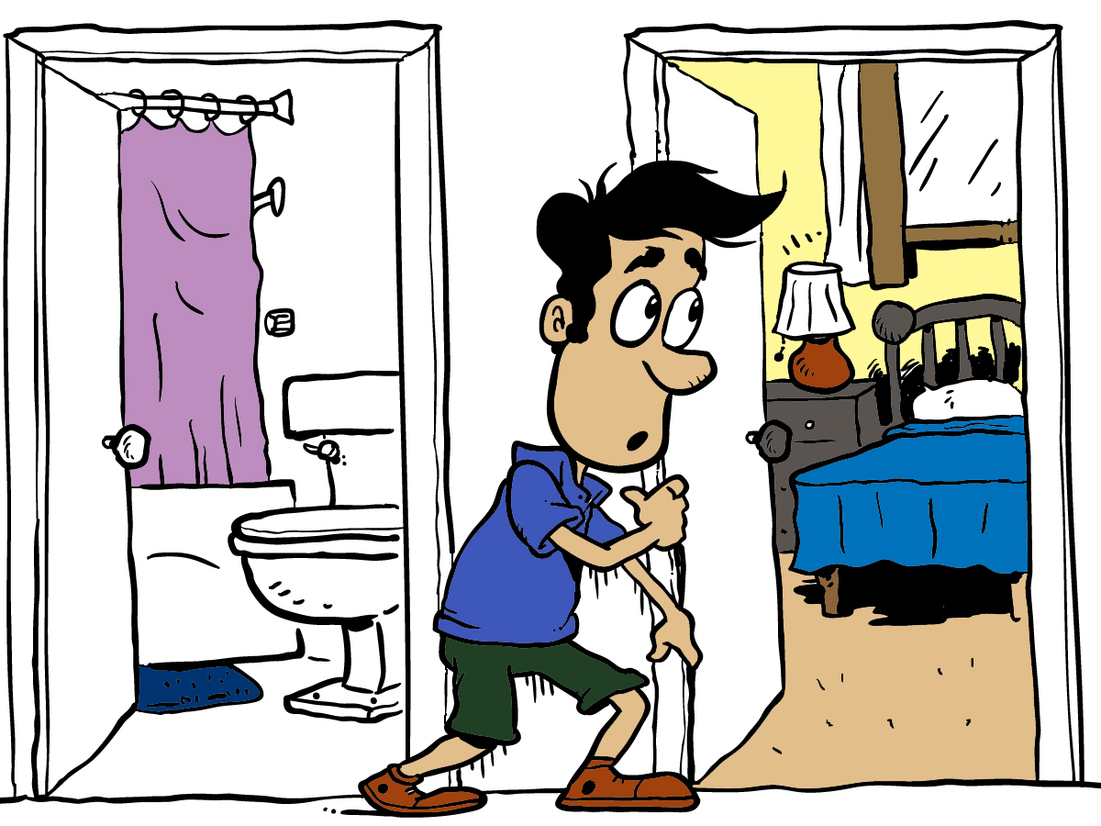
Working Product
Plan/Manage
LEGO
Dev
Fun
Minimally Marketable Features
Core
Origins
Intro
Agenda
Notes:
The team finishes the kitchen, master bedroom, and bathroom. Because of the way that they work, the plumbing and electrical connections are all in place for these rooms.
And so Bill moves into his partially completed house.
Before anyone says anything, yes, we know it’s really not feasible to live in a house that’s under construction.
Or is it? If the part that’s done is carefully isolated from the rest of the work, then it’s conceivable that Bill could be living in there. While the contractors are working on the house during the day, Bill is off at work. Before they leave for the day, the contractors clean up the mess and make sure nothing dangerous is left around. Bill has an agreement with the team that he won’t mess with the incomplete parts until they tell him it’s okay.
So what do you think? Could a home be built this way?

Slide 58
Agile project lifecycle (TW style)
Plan/Manage
LEGO
Dev
Fun
Develop & deploy
Evolve / handover
Inception
Initiation
Core
Origins
Intro
Agenda
Notes:
Conceptual

Slide 59

Agile project lifecycle
Plan/Manage
LEGO
Initiation
(1 – 2 weeks)
Evolve / Handover (…)
Dev
Fun
Core
Origins
Inception
(2 – 4 weeks)
Develop & deploy
(12+ weeks)
Intro
Agenda
Notes:
More concrete – size and time

Slide 60

Agile project lifecycle
Plan/Manage
LEGO
Many time-boxed iterations
Dev
Fun
Core
Origins
Develop & deploy
(12+ weeks)
Intro
Agenda

Slide 61
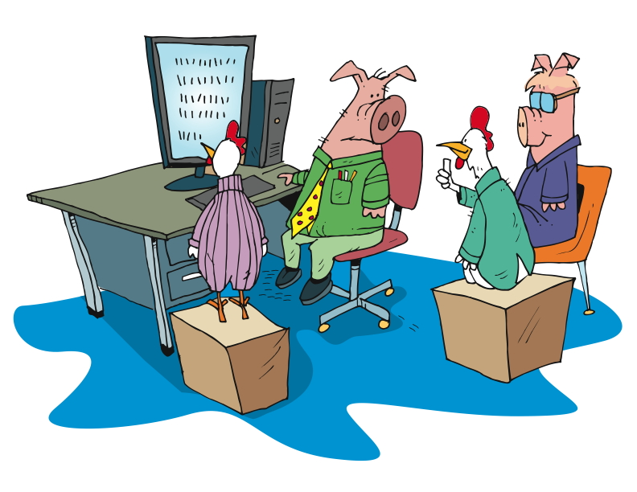
Agile project lifecycle
Plan/Manage
LEGO
Working software showcased to the business
Dev
Fun
Core
Origins
Develop & deploy
(12+ weeks)
Intro
Agenda
Notes:
Talk about UAT – psychologically, people want to “kick the tires”

Slide 62
The basics still apply
Plan/Manage
LEGO
Analyse
Design
Code
Test
Deploy
Dev
Fun
Core
Origins
Intro
Agenda

Slide 63
The flow
Plan/Manage
Daily stand-up
LEGO
Story backlog
Dev
Fun
Core
Origins
Intro
Prioritised subset
prepared for IKO
Iteration Kick-Off (IKO)
Showcase
Working software
Agenda

Slide 65
Retrospective in Action

Slide 66
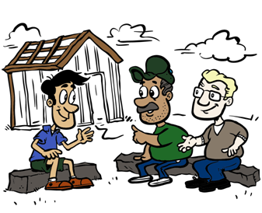
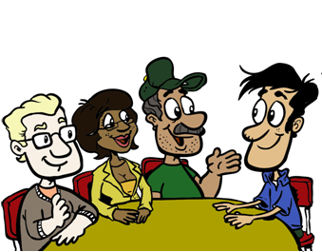
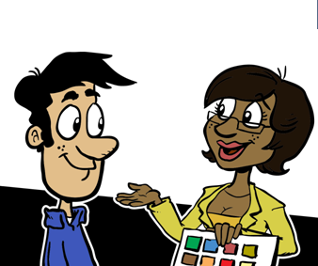
It’s good to talk
The business and delivery teams working together, e.g.
Inception workshops
Creation of stories
Release planning
Daily stand-ups
Showcases
Retrospectives
Notes:
One of the most valuable features of Agile approaches is the ongoing engagement with the customer, sometimes called the product owner.
If you’ve built a home or software, you know that the team is usually reluctant to talk to you, because they’re afraid that you’ll ask for changes and slow them down. They’re afraid that you’ll change your mind along the way, and mess with their schedule and their budget. They’re afraid that you won’t like what they’ve gotten done, and that you’ll judge them, or that you’ll kill the project, or…
Notice that everything I said just now is about them – the team – not about you, the customer or product owner.
In Agile, we’re much more concerned with you – the customer or product owner – than we are about our schedule or some feature we’re emotionally attached to.
In Agile, we commit to constant communication, transparency, and adaptability.
In fact, we’re eager for feedback, so we can be sure that we’re meeting the needs of our customers.

Slide 67

Roles - Implementation
Project Manager
The Agile PM plans, organizes and manages people and resources to bring about the successful completion of specific project goals by being a facilitator of collaborative activity.
Plan/Manage
LEGO
Dev
Fun
Core
Origins
Intro
Agenda

Slide 68

Roles - Implementation
Business Analyst
The BA works closely with the business to understand their needs to help identify business problems and propose solutions. The BA facilitates the communication between the business stakeholders and the solution delivery team.
Plan/Manage
LEGO
Dev
Fun
Core
Origins
Intro
Agenda

Slide 69
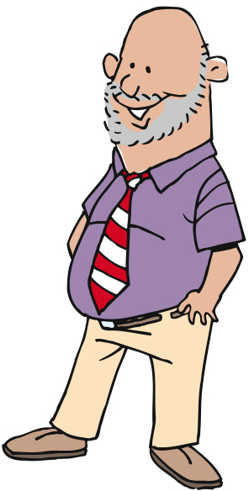
Roles - Implementation
Quality Assurance Analyst
The QA implements acceptance criteria in order to achieve “done” in terms of the developed solution, where “done” means that the work meets the criteria by which the stakeholders will accept the solution (“acceptance criteria”).
Plan/Manage
LEGO
Dev
Fun
Core
Origins
Intro
Agenda

Slide 70
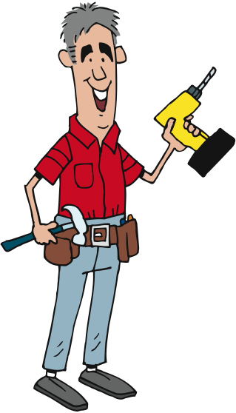
Roles - Implementation
Developer
The Developer turns the requirement into working software. This involves all the traditional technical disciplines such as technical analysis, detailed design, architecture, and testing.
Plan/Manage
LEGO
Dev
Fun
Core
Origins
Intro
Agenda

Slide 71

Roles
Product Owner (“Customer”)
Provides vision for the product or service being developed
Single point of escalation for contending priorities among stakeholders
Plan/Manage
LEGO
Dev
Fun
Core
Origins
Intro
Agenda

Slide 72

Roles
Business Stakeholders
Represents a particular area of the business (e.g. sales / marketing, legal / compliance, etc.) during the lifetime of the project
Participates in key activities, e.g. inception, release planning, showcases, etc.
Plan/Manage
LEGO
Dev
Fun
Core
Origins
Intro
Agenda

Slide 73



Roles
Implementation Stakeholders
Represent a particular area of the wider delivery team (e.g. Operations)
Participate in key activities, e.g. inception, release planning, showcases, etc.
Plan/Manage
LEGO
Dev
Fun
Core
Origins
Intro
Agenda

Slide 74

Worth remembering...
Agile is not something for nothing
It thrives on mutual respect and collective responsibility
Plan/Manage
LEGO
Dev
Fun
Core
Origins
Intro
Agenda
Notes:
Agile is not something for nothing
The approach embraces change and significantly reduces its cost, but it isn’t a magic wand
It thrives on mutual respect and collective responsibility
Teams work hard to ensure the business have the best information possible to make informed decisions...
...and a decision made is the collective responsibility of both business and implementation

Slide 75
What we’ve covered
User Stories
Iterative & Incremental
Continuous Feedback
The Project Lifecycle
Stand-Ups
Retrospectives
Plan/Manage
LEGO
Dev
Fun
Core
Origins
Intro
Agenda

Slide 76

Plan/Manage
LEGO
Dev
Fun
Core
Origins
Intro
Agenda
Photo by Steven List
Notes:
Thank you for joining us for The Agile Core, a module in Agile Fundamentals. The next module in the series is Development Practices, in which we’ll talk about what goes on in the team, and how they get from here to there.
Until the next time, we wish you well.

Slide 77
Some fun
Plan/Manage
LEGO
Dev
Fun
Core
Origins
Intro
Agenda

Slide 78
Bizz Buzz
Stand in a large circle(ish) so everyone can see everyone else
Count off around the circle, starting at 1
When you come to a number that is a multiple of 5, clap instead of saying the number
When you come to a number that is a multiple of 7, turn around in place instead of saying the number
(continued on next slide)
Plan/Manage
LEGO
Dev
Fun
Core
Origins
Intro
Agenda

Slide 79
Bizz Buzz
If you do what you’re not supposed to, or don’t do what you’re supposed to, you’re out and you sit down
The group gets to decide if you’re out
When someone is out, start over at 1
Plan/Manage
LEGO
Dev
Fun
Core
Origins
Intro
Agenda

Slide 80
Technical practices
Plan/Manage
LEGO
Dev
Fun
Core
Origins
Intro
Agenda
Notes:
The Agile Core: Story Based Development & Incremental Business Value
User Stories, Use Cases and Scenarios
Looking at the Big Picture – Is up front planning OK?
“Good Enough” Software
Release Early and Often
The story:
Actors and use cases – sterile
Actors are causal, use cases state results of that causality
Use cases are explanatory, and rarely include business value
Storytellers, customers, and stories – comes alive
Roles represent
Stories are demanding, as well as explanatory
Stories tell you why, as well as what
Stories do NOT tell you HOW
Storytellers share experience and needs
The Big Picture – is it possible to know everything up front?
has anyone had a house built? Remodeling done?
Zeno’s Paradox of the Dichotomy
http://en.wikipedia.org/wiki/Zeno%27s_paradoxes#The_dichotomy_paradox
“That which is in locomotion must arrive at the half-way stage before it arrives at the goal.” ~Aristotle, Physics VI:9, 239b10
“The perfect is the enemy of the good.” ~Voltaire
Incremental, with constant review
Fail fast, learn quickly, adapt - PDCA

Slide 81
Core development practices
Test Driven Development
Automated testing and the central role of “Quality”
Refactoring
Pairing
Continuous integration
Plan/Manage
LEGO
Dev
Fun
Core
Origins
Intro
Agenda

Slide 82
Before Test-Driven
Plan/Manage
LEGO
Dev
Fun
Core
Origins
Intro
Agenda

Slide 83

An Idea
Plan/Manage
LEGO
Dev
Fun
Core
Origins
Intro
Agenda
Notes:
Test-Driven Design / Test-First
“Test-driven development (TDD) is a software development technique that uses short development iterations based on pre-written test cases that define desired improvements or new functions. Each iteration produces code necessary to pass that iteration's tests. Finally, the programmer or team refactors the code to accommodate changes. A key TDD concept is that preparing tests before coding facilitates rapid feedback changes. Note that test-driven development is a software design method, not merely a method of testing.”
http://en.wikipedia.org/wiki/Test-driven_development
First figure out how to determine if you’ve succeeded, then build it
Concept: Waterfall version
* Frames:
Barefoot, primitive man with idea of shoes
Man tells someone else what he’s thinking
Other man constructing something in his cave
Other man delivers something that is outrageous, and loosely like shoes
Original man wearing (things), looking unhappy and confused
Concept: making shoes – they must fit the foot
* Frames:
Frame: barefoot, primitive man with idea of shoes – walking over stones, through streams, kicking a (coconut),…
Frame:
Text: TEST FAILS
Image: man stepping on rocks, painful
Frame:
Text: DEVELOP
Image: man attaching cords/strips of leather to a piece of bark
Frame:
Text: TEST PASS
Image: man with piece of bark strapped to foot, satisfied look
Frame:
Text: REFACTOR
Image: man cuts bark to shape of foot
Frame:
Text: TEST FAILS
Image: man walking under falling pebbles, pebbles hitting top of foot, man looking pained

Slide 84

Requirements
Plan/Manage
LEGO
Dev
Fun
Core
Origins
Intro
Agenda
Notes:
Test-Driven Design / Test-First
“Test-driven development (TDD) is a software development technique that uses short development iterations based on pre-written test cases that define desired improvements or new functions. Each iteration produces code necessary to pass that iteration's tests. Finally, the programmer or team refactors the code to accommodate changes. A key TDD concept is that preparing tests before coding facilitates rapid feedback changes. Note that test-driven development is a software design method, not merely a method of testing.”
http://en.wikipedia.org/wiki/Test-driven_development
First figure out how to determine if you’ve succeeded, then build it
Concept: Waterfall version
* Frames:
Barefoot, primitive man with idea of shoes
Man tells someone else what he’s thinking
Other man constructing something in his cave
Other man delivers something that is outrageous, and loosely like shoes
Original man wearing (things), looking unhappy and confused
Concept: making shoes – they must fit the foot
* Frames:
Frame: barefoot, primitive man with idea of shoes – walking over stones, through streams, kicking a (coconut),…
Frame:
Text: TEST FAILS
Image: man stepping on rocks, painful
Frame:
Text: DEVELOP
Image: man attaching cords/strips of leather to a piece of bark
Frame:
Text: TEST PASS
Image: man with piece of bark strapped to foot, satisfied look
Frame:
Text: REFACTOR
Image: man cuts bark to shape of foot
Frame:
Text: TEST FAILS
Image: man walking under falling pebbles, pebbles hitting top of foot, man looking pained

Slide 85

Development
Plan/Manage
LEGO
Dev
Fun
Core
Origins
Intro
Agenda
Notes:
Test-Driven Design / Test-First
“Test-driven development (TDD) is a software development technique that uses short development iterations based on pre-written test cases that define desired improvements or new functions. Each iteration produces code necessary to pass that iteration's tests. Finally, the programmer or team refactors the code to accommodate changes. A key TDD concept is that preparing tests before coding facilitates rapid feedback changes. Note that test-driven development is a software design method, not merely a method of testing.”
http://en.wikipedia.org/wiki/Test-driven_development
First figure out how to determine if you’ve succeeded, then build it
Concept: Waterfall version
* Frames:
Barefoot, primitive man with idea of shoes
Man tells someone else what he’s thinking
Other man constructing something in his cave
Other man delivers something that is outrageous, and loosely like shoes
Original man wearing (things), looking unhappy and confused
Concept: making shoes – they must fit the foot
* Frames:
Frame: barefoot, primitive man with idea of shoes – walking over stones, through streams, kicking a (coconut),…
Frame:
Text: TEST FAILS
Image: man stepping on rocks, painful
Frame:
Text: DEVELOP
Image: man attaching cords/strips of leather to a piece of bark
Frame:
Text: TEST PASS
Image: man with piece of bark strapped to foot, satisfied look
Frame:
Text: REFACTOR
Image: man cuts bark to shape of foot
Frame:
Text: TEST FAILS
Image: man walking under falling pebbles, pebbles hitting top of foot, man looking pained

Slide 86

Ready for Testing
Plan/Manage
LEGO
Dev
Fun
Core
Origins
Intro
Agenda
Notes:
Test-Driven Design / Test-First
“Test-driven development (TDD) is a software development technique that uses short development iterations based on pre-written test cases that define desired improvements or new functions. Each iteration produces code necessary to pass that iteration's tests. Finally, the programmer or team refactors the code to accommodate changes. A key TDD concept is that preparing tests before coding facilitates rapid feedback changes. Note that test-driven development is a software design method, not merely a method of testing.”
http://en.wikipedia.org/wiki/Test-driven_development
First figure out how to determine if you’ve succeeded, then build it
Concept: Waterfall version
* Frames:
Barefoot, primitive man with idea of shoes
Man tells someone else what he’s thinking
Other man constructing something in his cave
Other man delivers something that is outrageous, and loosely like shoes
Original man wearing (things), looking unhappy and confused
Concept: making shoes – they must fit the foot
* Frames:
Frame: barefoot, primitive man with idea of shoes – walking over stones, through streams, kicking a (coconut),…
Frame:
Text: TEST FAILS
Image: man stepping on rocks, painful
Frame:
Text: DEVELOP
Image: man attaching cords/strips of leather to a piece of bark
Frame:
Text: TEST PASS
Image: man with piece of bark strapped to foot, satisfied look
Frame:
Text: REFACTOR
Image: man cuts bark to shape of foot
Frame:
Text: TEST FAILS
Image: man walking under falling pebbles, pebbles hitting top of foot, man looking pained

Slide 87

User Acceptance Testing
Plan/Manage
LEGO
Dev
Fun
Core
Origins
Intro
Agenda
Notes:
Test-Driven Design / Test-First
“Test-driven development (TDD) is a software development technique that uses short development iterations based on pre-written test cases that define desired improvements or new functions. Each iteration produces code necessary to pass that iteration's tests. Finally, the programmer or team refactors the code to accommodate changes. A key TDD concept is that preparing tests before coding facilitates rapid feedback changes. Note that test-driven development is a software design method, not merely a method of testing.”
http://en.wikipedia.org/wiki/Test-driven_development
First figure out how to determine if you’ve succeeded, then build it
Concept: Waterfall version
* Frames:
Barefoot, primitive man with idea of shoes
Man tells someone else what he’s thinking
Other man constructing something in his cave
Other man delivers something that is outrageous, and loosely like shoes
Original man wearing (things), looking unhappy and confused
Concept: making shoes – they must fit the foot
* Frames:
Frame: barefoot, primitive man with idea of shoes – walking over stones, through streams, kicking a (coconut),…
Frame:
Text: TEST FAILS
Image: man stepping on rocks, painful
Frame:
Text: DEVELOP
Image: man attaching cords/strips of leather to a piece of bark
Frame:
Text: TEST PASS
Image: man with piece of bark strapped to foot, satisfied look
Frame:
Text: REFACTOR
Image: man cuts bark to shape of foot
Frame:
Text: TEST FAILS
Image: man walking under falling pebbles, pebbles hitting top of foot, man looking pained

Slide 88
Test-Driven Development
Plan/Manage
LEGO
Dev
Fun
Core
Origins
Intro
Agenda

Slide 89

A User Story
Plan/Manage
LEGO
Dev
Fun
Core
Origins
Intro
Agenda
Notes:
Test-Driven Design / Test-First
“Test-driven development (TDD) is a software development technique that uses short development iterations based on pre-written test cases that define desired improvements or new functions. Each iteration produces code necessary to pass that iteration's tests. Finally, the programmer or team refactors the code to accommodate changes. A key TDD concept is that preparing tests before coding facilitates rapid feedback changes. Note that test-driven development is a software design method, not merely a method of testing.”
http://en.wikipedia.org/wiki/Test-driven_development
First figure out how to determine if you’ve succeeded, then build it
Concept: Waterfall version
* Frames:
Barefoot, primitive man with idea of shoes
Man tells someone else what he’s thinking
Other man constructing something in his cave
Other man delivers something that is outrageous, and loosely like shoes
Original man wearing (things), looking unhappy and confused
Concept: making shoes – they must fit the foot
* Frames:
Frame: barefoot, primitive man with idea of shoes – walking over stones, through streams, kicking a (coconut),…
Frame:
Text: TEST FAILS
Image: man stepping on rocks, painful
Frame:
Text: DEVELOP
Image: man attaching cords/strips of leather to a piece of bark
Frame:
Text: TEST PASS
Image: man with piece of bark strapped to foot, satisfied look
Frame:
Text: REFACTOR
Image: man cuts bark to shape of foot
Frame:
Text: TEST FAILS
Image: man walking under falling pebbles, pebbles hitting top of foot, man looking pained

Slide 90

Test First
Plan/Manage
LEGO
Dev
Fun
Core
Origins
Intro
Agenda
Notes:
Test-Driven Design / Test-First
“Test-driven development (TDD) is a software development technique that uses short development iterations based on pre-written test cases that define desired improvements or new functions. Each iteration produces code necessary to pass that iteration's tests. Finally, the programmer or team refactors the code to accommodate changes. A key TDD concept is that preparing tests before coding facilitates rapid feedback changes. Note that test-driven development is a software design method, not merely a method of testing.”
http://en.wikipedia.org/wiki/Test-driven_development
First figure out how to determine if you’ve succeeded, then build it
Concept: Waterfall version
* Frames:
Barefoot, primitive man with idea of shoes
Man tells someone else what he’s thinking
Other man constructing something in his cave
Other man delivers something that is outrageous, and loosely like shoes
Original man wearing (things), looking unhappy and confused
Concept: making shoes – they must fit the foot
* Frames:
Frame: barefoot, primitive man with idea of shoes – walking over stones, through streams, kicking a (coconut),…
Frame:
Text: TEST FAILS
Image: man stepping on rocks, painful
Frame:
Text: DEVELOP
Image: man attaching cords/strips of leather to a piece of bark
Frame:
Text: TEST PASS
Image: man with piece of bark strapped to foot, satisfied look
Frame:
Text: REFACTOR
Image: man cuts bark to shape of foot
Frame:
Text: TEST FAILS
Image: man walking under falling pebbles, pebbles hitting top of foot, man looking pained

Slide 91

Plan/Manage
LEGO
Dev
Fun
Core
Origins
Intro
Agenda
Notes:
Test-Driven Design / Test-First
“Test-driven development (TDD) is a software development technique that uses short development iterations based on pre-written test cases that define desired improvements or new functions. Each iteration produces code necessary to pass that iteration's tests. Finally, the programmer or team refactors the code to accommodate changes. A key TDD concept is that preparing tests before coding facilitates rapid feedback changes. Note that test-driven development is a software design method, not merely a method of testing.”
http://en.wikipedia.org/wiki/Test-driven_development
First figure out how to determine if you’ve succeeded, then build it
Concept: Waterfall version
* Frames:
Barefoot, primitive man with idea of shoes
Man tells someone else what he’s thinking
Other man constructing something in his cave
Other man delivers something that is outrageous, and loosely like shoes
Original man wearing (things), looking unhappy and confused
Concept: making shoes – they must fit the foot
* Frames:
Frame: barefoot, primitive man with idea of shoes – walking over stones, through streams, kicking a (coconut),…
Frame:
Text: TEST FAILS
Image: man stepping on rocks, painful
Frame:
Text: DEVELOP
Image: man attaching cords/strips of leather to a piece of bark
Frame:
Text: TEST PASS
Image: man with piece of bark strapped to foot, satisfied look
Frame:
Text: REFACTOR
Image: man cuts bark to shape of foot
Frame:
Text: TEST FAILS
Image: man walking under falling pebbles, pebbles hitting top of foot, man looking pained

Slide 92

Plan/Manage
LEGO
Dev
Fun
Core
Origins
Intro
Agenda
Notes:
Test-Driven Design / Test-First
“Test-driven development (TDD) is a software development technique that uses short development iterations based on pre-written test cases that define desired improvements or new functions. Each iteration produces code necessary to pass that iteration's tests. Finally, the programmer or team refactors the code to accommodate changes. A key TDD concept is that preparing tests before coding facilitates rapid feedback changes. Note that test-driven development is a software design method, not merely a method of testing.”
http://en.wikipedia.org/wiki/Test-driven_development
First figure out how to determine if you’ve succeeded, then build it
Concept: Waterfall version
* Frames:
Barefoot, primitive man with idea of shoes
Man tells someone else what he’s thinking
Other man constructing something in his cave
Other man delivers something that is outrageous, and loosely like shoes
Original man wearing (things), looking unhappy and confused
Concept: making shoes – they must fit the foot
* Frames:
Frame: barefoot, primitive man with idea of shoes – walking over stones, through streams, kicking a (coconut),…
Frame:
Text: TEST FAILS
Image: man stepping on rocks, painful
Frame:
Text: DEVELOP
Image: man attaching cords/strips of leather to a piece of bark
Frame:
Text: TEST PASS
Image: man with piece of bark strapped to foot, satisfied look
Frame:
Text: REFACTOR
Image: man cuts bark to shape of foot
Frame:
Text: TEST FAILS
Image: man walking under falling pebbles, pebbles hitting top of foot, man looking pained

Slide 93

Plan/Manage
LEGO
Dev
Fun
Core
Origins
Intro
Agenda
Notes:
Test-Driven Design / Test-First
“Test-driven development (TDD) is a software development technique that uses short development iterations based on pre-written test cases that define desired improvements or new functions. Each iteration produces code necessary to pass that iteration's tests. Finally, the programmer or team refactors the code to accommodate changes. A key TDD concept is that preparing tests before coding facilitates rapid feedback changes. Note that test-driven development is a software design method, not merely a method of testing.”
http://en.wikipedia.org/wiki/Test-driven_development
First figure out how to determine if you’ve succeeded, then build it
Concept: Waterfall version
* Frames:
Barefoot, primitive man with idea of shoes
Man tells someone else what he’s thinking
Other man constructing something in his cave
Other man delivers something that is outrageous, and loosely like shoes
Original man wearing (things), looking unhappy and confused
Concept: making shoes – they must fit the foot
* Frames:
Frame: barefoot, primitive man with idea of shoes – walking over stones, through streams, kicking a (coconut),…
Frame:
Text: TEST FAILS
Image: man stepping on rocks, painful
Frame:
Text: DEVELOP
Image: man attaching cords/strips of leather to a piece of bark
Frame:
Text: TEST PASS
Image: man with piece of bark strapped to foot, satisfied look
Frame:
Text: REFACTOR
Image: man cuts bark to shape of foot
Frame:
Text: TEST FAILS
Image: man walking under falling pebbles, pebbles hitting top of foot, man looking pained

Slide 94

Plan/Manage
LEGO
Dev
Fun
Core
Origins
Intro
Agenda
Notes:
Test-Driven Design / Test-First
“Test-driven development (TDD) is a software development technique that uses short development iterations based on pre-written test cases that define desired improvements or new functions. Each iteration produces code necessary to pass that iteration's tests. Finally, the programmer or team refactors the code to accommodate changes. A key TDD concept is that preparing tests before coding facilitates rapid feedback changes. Note that test-driven development is a software design method, not merely a method of testing.”
http://en.wikipedia.org/wiki/Test-driven_development
First figure out how to determine if you’ve succeeded, then build it
Concept: Waterfall version
* Frames:
Barefoot, primitive man with idea of shoes
Man tells someone else what he’s thinking
Other man constructing something in his cave
Other man delivers something that is outrageous, and loosely like shoes
Original man wearing (things), looking unhappy and confused
Concept: making shoes – they must fit the foot
* Frames:
Frame: barefoot, primitive man with idea of shoes – walking over stones, through streams, kicking a (coconut),…
Frame:
Text: TEST FAILS
Image: man stepping on rocks, painful
Frame:
Text: DEVELOP
Image: man attaching cords/strips of leather to a piece of bark
Frame:
Text: TEST PASS
Image: man with piece of bark strapped to foot, satisfied look
Frame:
Text: REFACTOR
Image: man cuts bark to shape of foot
Frame:
Text: TEST FAILS
Image: man walking under falling pebbles, pebbles hitting top of foot, man looking pained

Slide 95
Automated testing and the central role of “Quality”
Plan/Manage
LEGO
Dev
Fun
Core
Origins
Intro
Agenda

Slide 96
What is Quality?
Plan/Manage
LEGO
Dev
Fun
Core
Origins
Intro
Agenda

Slide 97




The usual
Plan/Manage
LEGO
Dev
Fun
Core
Origins
Intro
Agenda
Notes:
The usual: only checking quality at the end
Concept: quality checked sporadically, or at the end
Quality is SUBJECTIVE

Slide 98
Better: When is Quality?
Plan/Manage
LEGO
Dev
Fun
Core
Origins
Intro
Agenda

Slide 99




Quality is part of everything
Plan/Manage
LEGO
Dev
Fun
Core
Origins
Intro
Agenda
Notes:
Agile: Quality is a part of every step along the way
Concept: quality checked every step of the way
* Strip: Various stages of a house under construction, with workers checking work against plans, measuring carefully, testing strength and solidity;
* Frame: last frame shows plumber hooking bathroom plumbing to water main, happy/beaming, checking off a checkbox on a clipboard

Slide 100
Baked in?
Plan/Manage
LEGO
Dev
Fun
Core
Origins
Intro
Agenda

Slide 101

Acceptance criteria
Plan/Manage
LEGO
Dev
Fun
Core
Origins
Intro
Agenda
Notes:
Acceptance Testing
Concept: what the user (homeowner) had in mind
* Strip: Homeowner (woman), imagining single control kitchen sink faucet, with markings for hot and cold; turning on cold, showing it to be cold (maybe ice cubes coming out?); turning on hot, showing it to be hot (steam)?; turning to middle, showing warm (maybe washing hands?); talking to contractor, gesturing, previous imaginations showing
* Strip: Contractor, seeing finished work, considering; turning on hot, but cold comes out – big word FAIL; turning on cold, but hot comes out – big word FAIL; turning to middle, warm comes out – big word PASS

Slide 102


Plan/Manage
LEGO
Dev
Fun
Core
Origins
Intro
Agenda
Notes:
Given (When) Then – context, circumstances, expectations

Slide 103

Am I done?
Plan/Manage
LEGO
Dev
Fun
Core
Origins
Intro
Agenda
Notes:
Acceptance Testing
Concept: what the user (homeowner) had in mind
* Strip: Homeowner (woman), imagining single control kitchen sink faucet, with markings for hot and cold; turning on cold, showing it to be cold (maybe ice cubes coming out?); turning on hot, showing it to be hot (steam)?; turning to middle, showing warm (maybe washing hands?); talking to contractor, gesturing, previous imaginations showing
* Strip: Contractor, seeing finished work, considering; turning on hot, but cold comes out – big word FAIL; turning on cold, but hot comes out – big word FAIL; turning to middle, warm comes out – big word PASS

Slide 104

Automation
Doesn’t replace
manual testing
Plan/Manage
LEGO
Dev
Fun
Core
Origins
Intro
Agenda
Notes:
Automated Testing
Concept: tests are good, but not effective if they are manual – too time consuming and costly.
* Strip: Repeat of 7 (Regression Testing), b. We’ll talk about how long this takes, and how it’s dependent on the availability of the plumber and the homeowner.
* Strip: Con tractor pushing big ON button on a Robot; Robot testing icemaker, sink, other plumbing. Can be multiple frames, showing robot doing various tasks.
There needs to be a change made before we can show that the robot is coming and testing stuff to make sure that the change did not affect earlier functionality

Slide 105
Plan/Manage
LEGO
Dev
Fun
Core
Origins
Intro
Agenda
Notes:
About to talk about IntelliJ – set context

Slide 106

Plan/Manage
LEGO
Dev
Fun
Core
Origins
Intro
Agenda

Slide 107


Plan/Manage
LEGO
Dev
Fun
Core
Origins
Intro
Agenda

Slide 108


Plan/Manage
LEGO
Dev
Fun
Core
Origins
Intro
Agenda

Slide 109
Levels and types of testing
Plan/Manage
LEGO
Dev
Fun
Core
Origins
Intro
Agenda

Slide 110

Unit Testing/TDD
Plan/Manage
LEGO
Dev
Fun
Core
Origins
Intro
Agenda
Notes:
Unit Testing/TDD
Concept: a specific component, checking quality
* Strip: architect/designer making drawing of large man jumping up and down on stairs, floors, etc – man has T-shirt saying “300 LBS”; contractor and workers, contractor pointing to drawing and T-shirt; 300 pound man, standing in area where stairs will be, looking around, giving thumbs up; 300 pound man jumping up and down at top of barely framed stairs, attached to bungee cord going up; stairs collapsing, man hanging, giving thumbs down
Talk about BDD/FDD/…?

Slide 111

Functional Testing
Plan/Manage
LEGO
Dev
Fun
Core
Origins
Intro
Agenda
Notes:
Functional Testi ng
Concept: water and/or electricity
* Strip: Plumbers laying piping in foundation; plumbers attaching plumbing fixtures in framed house; plumber turning on faucet, somehow show water flowing through pipes; plumber watching water run out into bucket, beaming, thumbs up
I really liked the concept of illustrating QA ideas with practical real-life examples

Slide 112

User Acceptance Testing
Plan/Manage
LEGO
Dev
Fun
Core
Origins
Intro
Agenda
Notes:
User Acceptance Testing
Concept: Someone, user or user advocate, does manual testing
* Strip: Woman inspecting shower stall; woman taking shower; woman giving contractors a thumbs-up (no nudity or anything risqué)

Slide 113

Regression Testing
Plan/Manage
LEGO
Dev
Fun
Core
Origins
Intro
Agenda
Notes:
Regression Testing
Concept: after changes, things that worked before should still work
* Strip: Contractor hooking up icemaker connection to water; Contractor showing homeowner ice cubes being made; Homeowner rechecking sink, fails; Plumber fixing water under sink; Homeowner checking ice maker and sink – all works – thumbs up

Slide 114
Refactoring
Plan/Manage
LEGO
Dev
Fun
Core
Origins
Intro
Agenda

Slide 115

Plan/Manage
LEGO
Dev
Fun
Core
Origins
Intro
Agenda
Notes:
Refactoring
“In software engineering, ‘refactoring’ source code means improving it without changing its overall results, and is sometimes informally referred to as ‘cleaning it up’. Refactoring neither fixes bugs nor adds new functionality, though it might precede either activity. Rather, it improves the understandability of the code, changes its internal structure and design, and removes dead code.
“These changes are intended to make the code easier to comprehend, more maintainable, and more amenable to change. Refactoring is usually motivated by the difficulty of adding new functionality to a program or fixing a bug in it.”
http://en.wikipedia.org/wiki/Refactoring
“In computer programming, code smell is any symptom in the source code of a program that possibly indicates a deeper problem.
“Often the deeper problem hinted by a code smell can be uncovered when the code is subjected to a short feedback cycle where it is refactored in small, controlled steps, and the resulting design is examined to see if there are any further code smells that indicate the need of more refactoring. From the point of view of a programmer charged with performing refactoring, code smells are heuristics to indicate when to refactor, and what specific refactoring techniques to use. Thus, a code smell is a driver for refactoring.”
http://en.wikipedia.org/wiki/Code_smell
Understand code smells before understanding refactoring
Concept: Code smells represented by real smells
Frames (separate, so they can appear on separate slides):
Man walks into house, raises head and sniffs the air
Man walking around house, sniffing
Man standing by kitchen counter/island, looking at dog, shaking finger at dog (implied smelliness hidden from view)
Strip:
Programmer1 banging away on keyboard, code on monitor
Programmer1 pointing to monitor, Programmer2 nodding
Programmer1 walks away, Programmer2 sits at keyboard and monitor
Programmer2 looks puzzled, sniffing for smell
Programmer1 looking over Programmer2’s shoulder, Programmer2 pointing at monitor
Refactoring is about making it cleaner, more understandable, more maintainable
Concept: Some kind of Rube Goldberg machine
Frames:
First view of machine – ball starts at one end, goes through all sorts of weird stuff, comes out the other end – chute at start end feeds ball into machine, fades/blurs off image, receiving chute at other end, same kind of fade/blur
Woman (workmanlike, maybe with tool belt?) looking at machine, considering, maybe hand on cheek
Woman removing parts, connecting other/remaining parts – start and end remain the same, ball moves through from start to finish
Woman removing more parts, connecting remaining parts – start and end remain the same, ball moves through from start to finish
Woman removes more parts, connecting start to end with a simple chute – start and end chutes remain the same – woman looking satisfied, ball moves through from start to finish

Slide 116

Plan/Manage
LEGO
Dev
Fun
Core
Origins
Intro
Agenda
Notes:
Refactoring
“In software engineering, ‘refactoring’ source code means improving it without changing its overall results, and is sometimes informally referred to as ‘cleaning it up’. Refactoring neither fixes bugs nor adds new functionality, though it might precede either activity. Rather, it improves the understandability of the code, changes its internal structure and design, and removes dead code.
“These changes are intended to make the code easier to comprehend, more maintainable, and more amenable to change. Refactoring is usually motivated by the difficulty of adding new functionality to a program or fixing a bug in it.”
http://en.wikipedia.org/wiki/Refactoring
“In computer programming, code smell is any symptom in the source code of a program that possibly indicates a deeper problem.
“Often the deeper problem hinted by a code smell can be uncovered when the code is subjected to a short feedback cycle where it is refactored in small, controlled steps, and the resulting design is examined to see if there are any further code smells that indicate the need of more refactoring. From the point of view of a programmer charged with performing refactoring, code smells are heuristics to indicate when to refactor, and what specific refactoring techniques to use. Thus, a code smell is a driver for refactoring.”
http://en.wikipedia.org/wiki/Code_smell
Understand code smells before understanding refactoring
Concept: Code smells represented by real smells
Frames (separate, so they can appear on separate slides):
Man walks into house, raises head and sniffs the air
Man walking around house, sniffing
Man standing by kitchen counter/island, looking at dog, shaking finger at dog (implied smelliness hidden from view)
Strip:
Programmer1 banging away on keyboard, code on monitor
Programmer1 pointing to monitor, Programmer2 nodding
Programmer1 walks away, Programmer2 sits at keyboard and monitor
Programmer2 looks puzzled, sniffing for smell
Programmer1 looking over Programmer2’s shoulder, Programmer2 pointing at monitor
Refactoring is about making it cleaner, more understandable, more maintainable
Concept: Some kind of Rube Goldberg machine
Frames:
First view of machine – ball starts at one end, goes through all sorts of weird stuff, comes out the other end – chute at start end feeds ball into machine, fades/blurs off image, receiving chute at other end, same kind of fade/blur
Woman (workmanlike, maybe with tool belt?) looking at machine, considering, maybe hand on cheek
Woman removing parts, connecting other/remaining parts – start and end remain the same, ball moves through from start to finish
Woman removing more parts, connecting remaining parts – start and end remain the same, ball moves through from start to finish
Woman removes more parts, connecting start to end with a simple chute – start and end chutes remain the same – woman looking satisfied, ball moves through from start to finish

Slide 117

Plan/Manage
LEGO
Dev
Fun
Core
Origins
Intro
Agenda
Notes:
Refactoring
“In software engineering, ‘refactoring’ source code means improving it without changing its overall results, and is sometimes informally referred to as ‘cleaning it up’. Refactoring neither fixes bugs nor adds new functionality, though it might precede either activity. Rather, it improves the understandability of the code, changes its internal structure and design, and removes dead code.
“These changes are intended to make the code easier to comprehend, more maintainable, and more amenable to change. Refactoring is usually motivated by the difficulty of adding new functionality to a program or fixing a bug in it.”
http://en.wikipedia.org/wiki/Refactoring
“In computer programming, code smell is any symptom in the source code of a program that possibly indicates a deeper problem.
“Often the deeper problem hinted by a code smell can be uncovered when the code is subjected to a short feedback cycle where it is refactored in small, controlled steps, and the resulting design is examined to see if there are any further code smells that indicate the need of more refactoring. From the point of view of a programmer charged with performing refactoring, code smells are heuristics to indicate when to refactor, and what specific refactoring techniques to use. Thus, a code smell is a driver for refactoring.”
http://en.wikipedia.org/wiki/Code_smell
Understand code smells before understanding refactoring
Concept: Code smells represented by real smells
Frames (separate, so they can appear on separate slides):
Man walks into house, raises head and sniffs the air
Man walking around house, sniffing
Man standing by kitchen counter/island, looking at dog, shaking finger at dog (implied smelliness hidden from view)
Strip:
Programmer1 banging away on keyboard, code on monitor
Programmer1 pointing to monitor, Programmer2 nodding
Programmer1 walks away, Programmer2 sits at keyboard and monitor
Programmer2 looks puzzled, sniffing for smell
Programmer1 looking over Programmer2’s shoulder, Programmer2 pointing at monitor
Refactoring is about making it cleaner, more understandable, more maintainable
Concept: Some kind of Rube Goldberg machine
Frames:
First view of machine – ball starts at one end, goes through all sorts of weird stuff, comes out the other end – chute at start end feeds ball into machine, fades/blurs off image, receiving chute at other end, same kind of fade/blur
Woman (workmanlike, maybe with tool belt?) looking at machine, considering, maybe hand on cheek
Woman removing parts, connecting other/remaining parts – start and end remain the same, ball moves through from start to finish
Woman removing more parts, connecting remaining parts – start and end remain the same, ball moves through from start to finish
Woman removes more parts, connecting start to end with a simple chute – start and end chutes remain the same – woman looking satisfied, ball moves through from start to finish

Slide 118

Plan/Manage
LEGO
Dev
Fun
Core
Origins
Intro
Agenda
Notes:
Refactoring
“In software engineering, ‘refactoring’ source code means improving it without changing its overall results, and is sometimes informally referred to as ‘cleaning it up’. Refactoring neither fixes bugs nor adds new functionality, though it might precede either activity. Rather, it improves the understandability of the code, changes its internal structure and design, and removes dead code.
“These changes are intended to make the code easier to comprehend, more maintainable, and more amenable to change. Refactoring is usually motivated by the difficulty of adding new functionality to a program or fixing a bug in it.”
http://en.wikipedia.org/wiki/Refactoring
“In computer programming, code smell is any symptom in the source code of a program that possibly indicates a deeper problem.
“Often the deeper problem hinted by a code smell can be uncovered when the code is subjected to a short feedback cycle where it is refactored in small, controlled steps, and the resulting design is examined to see if there are any further code smells that indicate the need of more refactoring. From the point of view of a programmer charged with performing refactoring, code smells are heuristics to indicate when to refactor, and what specific refactoring techniques to use. Thus, a code smell is a driver for refactoring.”
http://en.wikipedia.org/wiki/Code_smell
Understand code smells before understanding refactoring
Concept: Code smells represented by real smells
Frames (separate, so they can appear on separate slides):
Man walks into house, raises head and sniffs the air
Man walking around house, sniffing
Man standing by kitchen counter/island, looking at dog, shaking finger at dog (implied smelliness hidden from view)
Strip:
Programmer1 banging away on keyboard, code on monitor
Programmer1 pointing to monitor, Programmer2 nodding
Programmer1 walks away, Programmer2 sits at keyboard and monitor
Programmer2 looks puzzled, sniffing for smell
Programmer1 looking over Programmer2’s shoulder, Programmer2 pointing at monitor
Refactoring is about making it cleaner, more understandable, more maintainable
Concept: Some kind of Rube Goldberg machine
Frames:
First view of machine – ball starts at one end, goes through all sorts of weird stuff, comes out the other end – chute at start end feeds ball into machine, fades/blurs off image, receiving chute at other end, same kind of fade/blur
Woman (workmanlike, maybe with tool belt?) looking at machine, considering, maybe hand on cheek
Woman removing parts, connecting other/remaining parts – start and end remain the same, ball moves through from start to finish
Woman removing more parts, connecting remaining parts – start and end remain the same, ball moves through from start to finish
Woman removes more parts, connecting start to end with a simple chute – start and end chutes remain the same – woman looking satisfied, ball moves through from start to finish

Slide 119

Plan/Manage
LEGO
Dev
Fun
Core
Origins
Intro
Agenda
Notes:
Refactoring
“In software engineering, ‘refactoring’ source code means improving it without changing its overall results, and is sometimes informally referred to as ‘cleaning it up’. Refactoring neither fixes bugs nor adds new functionality, though it might precede either activity. Rather, it improves the understandability of the code, changes its internal structure and design, and removes dead code.
“These changes are intended to make the code easier to comprehend, more maintainable, and more amenable to change. Refactoring is usually motivated by the difficulty of adding new functionality to a program or fixing a bug in it.”
http://en.wikipedia.org/wiki/Refactoring
“In computer programming, code smell is any symptom in the source code of a program that possibly indicates a deeper problem.
“Often the deeper problem hinted by a code smell can be uncovered when the code is subjected to a short feedback cycle where it is refactored in small, controlled steps, and the resulting design is examined to see if there are any further code smells that indicate the need of more refactoring. From the point of view of a programmer charged with performing refactoring, code smells are heuristics to indicate when to refactor, and what specific refactoring techniques to use. Thus, a code smell is a driver for refactoring.”
http://en.wikipedia.org/wiki/Code_smell
Understand code smells before understanding refactoring
Concept: Code smells represented by real smells
Frames (separate, so they can appear on separate slides):
Man walks into house, raises head and sniffs the air
Man walking around house, sniffing
Man standing by kitchen counter/island, looking at dog, shaking finger at dog (implied smelliness hidden from view)
Strip:
Programmer1 banging away on keyboard, code on monitor
Programmer1 pointing to monitor, Programmer2 nodding
Programmer1 walks away, Programmer2 sits at keyboard and monitor
Programmer2 looks puzzled, sniffing for smell
Programmer1 looking over Programmer2’s shoulder, Programmer2 pointing at monitor
Refactoring is about making it cleaner, more understandable, more maintainable
Concept: Some kind of Rube Goldberg machine
Frames:
First view of machine – ball starts at one end, goes through all sorts of weird stuff, comes out the other end – chute at start end feeds ball into machine, fades/blurs off image, receiving chute at other end, same kind of fade/blur
Woman (workmanlike, maybe with tool belt?) looking at machine, considering, maybe hand on cheek
Woman removing parts, connecting other/remaining parts – start and end remain the same, ball moves through from start to finish
Woman removing more parts, connecting remaining parts – start and end remain the same, ball moves through from start to finish
Woman removes more parts, connecting start to end with a simple chute – start and end chutes remain the same – woman looking satisfied, ball moves through from start to finish

Slide 120
Pairing
Plan/Manage
LEGO
Dev
Fun
Core
Origins
Intro
Agenda
Notes:
Let’s start with something fun: Common arguments against pair programming….

Slide 121
Pairing
Why it sucks, and why you should hate it

Slide 122
Its distracting!
Hard to focus on the problem at hand when your pair is sitting next to you talking

Slide 123
Costly
Two people doing the work of one

Slide 124
Low morale
Only spend 50% of your time doing any actual work

Slide 125
Hygiene
What?! I have to shower every day?!

Slide 126
Stop slowing me down!
Explaining thoughts to my pair will slow me down

Slide 127
Pairing
Now let’s talk about the reasons you should do it

Slide 128
Development The Waterfall Way
Plan/Manage
LEGO
Dev
Fun
Core
Origins
Intro
Agenda
Notes:
Now that we’ve talked about Test-Driven Development, it’s time to talk about Development. That is, the work you do to pass tests and deliver value.
First, of course, we’ll look at the Waterfall way.

Slide 129

Plan/Manage
LEGO
Dev
Fun
Core
Origins
Intro
Agenda
Notes:
We sit down, confident of our ability.
We read the instructions, follow them carefully.
At some point we realize we’ve put widget A into slot 1 as we were told, but we put it in BACKWARDS.
Take it apart to reverse widget A
Let’s consider the classic approach. For those of you who are parents, or who have ever bought anything that says that dreaded phrase “some assembly required” – this example is for you!
Most of us have had the same kinds of experiences. We sit down, confident of our ability to put the thing together. We read the instructions, and we follow them very, very carefully. And, at some point, we realize that we’ve put widget A into slot B, just as we were supposed to, but we put it in BACKWARDS! And now we have to take the thing apart far enough to reverse widget A. And then we get to put it all together again. Sigh.

Slide 130

Plan/Manage
LEGO
Dev
Fun
Core
Origins
Intro
Agenda
Notes:
Or we get to the end, but it just doesn’t look right.
How can we avoid this?
-----------------------------------------------------------------------------------------------------------------
Or we get all the way to the end, only to find that we’ve somehow managed to put it all together, but it doesn’t look anything like the picture.
Why does this happen? How can we avoid it?
Maybe…

Slide 131
The Agile Way: Pairing
Plan/Manage
LEGO
Dev
Fun
Core
Origins
Intro
Agenda
Notes:
In the module The Origins of Agile Software Development, we talked about Kent Beck and how he came up with Extreme Programming. At that time, we mentioned pairing. Let’s look at pairing in a little more detail now.
Here’s a definition:
“Pair programming is a software development technique in which two programmers work together at one work station. One types in code while the other reviews each line of code as it's typed in. The person typing is called the driver. The person reviewing the code is called the observer or navigator. The two programmers switch roles periodically.
“While reviewing, the observer also considers the strategic direction of the work, coming up with ideas for improvements and likely future problems to address. This frees the driver to focus all of his or her attention on the "tactical" aspects of completing the current task, using the observer as a safety net and guide.”
http://en.wikipedia.org/wiki/Pair_programming
Two of everything is better than one – minds, (pairs of) hands, (pairs of) eyes.
Let’s see why…

Slide 132
“Pair programming is a software development technique in which two programmers work together at one work station. One types in code while the other reviews each line of code as it's typed in. The person typing is called the driver. The person reviewing the code is called the observer or navigator. The two programmers switch roles periodically.
“While reviewing, the observer also considers the strategic direction of the work, coming up with ideas for improvements and likely future problems to address. This frees the driver to focus all of his or her attention on the "tactical" aspects of completing the current task, using the observer as a safety net and guide.”
http://en.wikipedia.org/wiki/Pair_programming
Plan/Manage
LEGO
Dev
Fun
Core
Origins
Intro
Agenda

Slide 133

Plan/Manage
LEGO
Dev
Fun
Core
Origins
Intro
Agenda
Notes:
We believe that having 2 people working together produces better results.
Better means…
Fewer defects
Less rework
More creativity
Easier to maintain
Sitting side by side
Working on one piece of code
One is the driver – hands on the keyboard and mouse
Two is navigating, doing code review, asking questions, maybe doing research
Change roles periodically
Instead of being distracting, it turns out to be helpful, useful
-----------------------------------------------------------------------------------------------
Unlike in our classical approach, in Agile we believe that having two people working together produces better results. That is, by “better” we mean that there will be fewer defects, less rework, more creativity, and the results will be easier to maintain.
So in actual practice, pairing would say that there are two people sitting side by side, working on one piece of code together. One – as it said in the definition – is the driver, with hands on keyboard and mouse. The other will be navigating – doing real-time code review, asking questions, maybe doing a little research on the side. They will be bouncing ideas off each other. They will change roles periodically.

Slide 134

Plan/Manage
LEGO
Dev
Fun
Core
Origins
Intro
Agenda
Notes:
By switching roles,
they stay fresh,
check each other’s work and
get done faster
Instead of low morale, you get collaboration, quality and camaraderie
Let’s talk about quality
2 heads are better than 1 – solution is likely to be better
Will see the problem AS IT HAPPENS. If they are paying attention.
--------------------------------------------------------------------------------------------------------------------------
The driver becomes the navigator and the navigator becomes the driver. Between the two of them, they manage to stay reasonably fresh, to check each other’s work, and to get done faster.
Yes, faster.
But let’s get back to fewer defects. We’re all familiar with the adage “two heads are better than one.” This means that having two people thinking about the same problem is likely to produce a better solution than one working alone.
After all, if one of us is looking at the directions, and the other is putting the thing together, the odds are in our favor that the one looking at the directions and the pictures will notice that widget A is in slot B the wrong way AS IT HAPPENS.

Slide 135

Plan/Manage
LEGO
Dev
Fun
Core
Origins
Intro
Agenda
Notes:
Now let’s get back to faster.
2 people doing the work of one?
Cost me 2x as much?
No to both.
Let’s take a bigger, longer view of the challenge.
-----------------------------------------------------------------------------------------------------------------------
We hear repeatedly “but doesn’t that mean that I have two people doing the work of one? Doesn’t’ that mean that it will cost me twice as much, or take twice as long, to get the same thing done?”
There are two answers to that, and both of them are “no”.
In order to understand the answer, you have to take a bigger and longer view of the challenge.

Slide 136
Plan/Manage
LEGO
Dev
Fun
Core
Origins
Intro
Agenda
Notes:
It drives around the point when you find the defect.
If found after, I have to:
Undo what I’ve done
Redo it
Double checking other widgets
You could say that the one defect took 3 x the time and money
Now for the longer view.
If I leave widget A backwards, then
Slowly over time there is wear on widget A
It has to be replaced
Now I have to find the problem
Undo what I’ve done
Redo it
Double checking other widgets
Let’s get back to putting widget A the wrong way in slot B. In that case, I have to undo all the work I’ve done from the time I put widget A into slot B, right? Then I have to redo all the work I’ve done since then, double-checking my work to make sure I’m not putting any other widgets in backwards. That means that one single, solitary defect caused me to spend THREE TIMES the time and money to get the same job done. What if I’d caught that defect earlier? Then my cost might be 10% over, not 200% over.
Okay – that’s a relatively easy one. Now we’ll take the longer view…
Imagine that I get it all put together, and it works like a charm. Even though widget A is in slot B backwards, the thing works. But what’s happening is that widget A is slowly wearing, to the point that instead of having a life of five years, it has a life of five months! Assuming that everything else is working fine, all I have to do is disassemble the thing, get a new widget A, put it into slot B properly (assuming I figured out why it failed in the first place), and then rebuild the thing.
Yes, I just spent more like 500% of the original time, as compared to 300% if I catch it before I’m done in the first place, or 110% if I catch it as early as possible. Why 500%? Well, it might be 400%, and it might be 5,000%. The thing is, studies show that the cost of changing something when software is in production is DRAMATICALLY higher than changing it just after it’s done.
So if the minimal cost to fix one defect late in the game is 300%, and the cost of catching it and fixing it early is 110% or less, then if I catch just one bug in one piece of code at the time my pair is putting it in, I’ve just saved at least 80% in cost.
Let’s go over that…

Slide 137
110% * 2 = 220%
300%
300% - 220% = 80%
8 hours * .8 = 6.4 hours
6.4 * US$40 = US$256
US$256 * 1000 = US$256,000
Plan/Manage
LEGO
Dev
Fun
Core
Origins
Intro
Agenda
Notes:
Catch a bug when working on it costs me 110% of the cost of development x 2 developers
Compared to 300% cost to fix when work is done or later.
Let’s say it took 8 hours to originally build the code.
$256 to fix the one bug.
What if there are 1000 bugs. Not unreasonable for a fairly large sized application.
Consider time 64,000 hours. About 160 person days.
------------------------------------------------------------------------------------------------------------------------
If it costs me 110% for two people, that’s 220%, right? So having two people working together, where they catch and fix one bug, costs 220%. Of course, they’ll catch and fix far more than one. But we’ll stick with just one for the moment.
Compare to that the cost to fix the bug after all the work is done. That’s 300% or higher, because we have to do all the work to figure out where the bug is, refresh our minds about the code, go fix the code, write a new test or two, verify that we haven’t broken anything, check to make sure whether anything else is affected by this change,…
Well, as you can see, the costs mount up very quickly.
For the sake of argument, we’ll say that it took eight hours to develop the code. Then the delta is 6.4 hours (eight hours times 80%).
Again, for the sake of argument, let’s say our developer gets paid forty dollars per hour. That’s a difference of $256. That means that without pairing, it could cost us $256 to fix this one bug if it’s caught late, rather than early.
$256 is not such a big deal, right? What if we expect to find and fix a measly one thousand bugs during the course of our development.
That’s two hundred fifty-six thousand dollars! That’s not small. And one thousand bugs is a small number for a sizable project.
And let’s not forget the time. That $256,000 also represents 6,400 person hours of effort! If we maintain the same size staff, that’s 160 person days added to our schedule, which is NOT included in our project plan.
As we consider this, also consider that 300% is pretty minimal, when you consider that the bug was probably found by QA or by a customer, so there’ll be time to reproduce it, document it, and report and track it. And of course once it’s supposedly fixed, there’s the cost of retesting and reverifying.
You can see that in the Agile community, there’s a strong argument in favor of pairing from many perspectives.

Slide 138
Other references
Plan/Manage
Public demo http://blogs.agilefaqs.com/2010/06/13/pair-programming-public-demo/
Blog by Fred George http://processpeoplepods.blogspot.com/search/label/Pair%20Programming
Based on a survey
100% agreed that they had more confidence in their solution than when they program alone
96% agreed that they enjoy their job more than when programming alone
LEGO
Dev
Fun
Core
Origins
Intro
Agenda
http://www.google.co.in/url?sa=t&source=web&cd=5&ved=0CDcQFjAE&url=http%3A%2F%2Fciteseerx.ist.psu.edu%2Fviewdoc%2Fdownload%3Fdoi%3D10.1.1.140.1522%26rep%3Drep1%26type%3Dpdf&ei=sawtTMT3C9DCrAeCt_HzBQ&usg=AFQjCNFtguL_Wf_1aHLgr8Z0gjZ4YbvSLQ&sig2=vleHOi_mQ6rKMI-G2jmPtw

Slide 139
Experiment
Plan/Manage
15 full-time experienced programmers working for 45 months on a challenging problem
5 individuals
5 pairs
The team completed the task
40% more quickly and effectively
Producing better algorithms in less time
Greater confidence in their solution
Enjoyed their work
LEGO
Dev
Fun
Core
Origins
Intro
Agenda

Slide 140

Hygiene
Plan/Manage
LEGO
Dev
Fun
Core
Origins
Intro
Agenda
Notes:
Regarding hygiene, please be considerate to your neighbor.
This is not just an agile concept.
Which brings us to …….
[CLICK]

Slide 141
Understanding Smells
Plan/Manage
LEGO
Dev
Fun
Core
Origins
Intro
Agenda
Notes:
Let’s move on to something kind of stinky – smells! There are process smells and code smells and situation smells and all sorts of smells.

Slide 142

Notes:
Read definition
Walk into your home and something doesn’t smell right.
You walk around to try to find the culprit. Garbage, Laundry, Fido?
Smells are subtle
The smell is not the problem, its what’s causing the smell
Once you identify it, you can do something about it.
------------------------------------------------------------------------------------------------------------------------
As usual, let’s start with a defnition:
“In computer programming, code smell is any symptom in the source code of a program that possibly indicates a deeper problem.
“Often the deeper problem hinted by a code smell can be uncovered when the code is subjected to a short feedback cycle where it is refactored in small, controlled steps, and the resulting design is examined to see if there are any further code smells that indicate the need of more refactoring. From the point of view of a programmer charged with performing refactoring, code smells are heuristics to indicate when to refactor, and what specific refactoring techniques to use. Thus, a code smell is a driver for refactoring.”
http://en.wikipedia.org/wiki/Code_smell
[CLICK]
To get the idea of smells, imagine walking into your home, and you realize that something stinks. Literally. You smell something, and you know it’s not right, but you’re not sure what it is. Gas? Garbage? Dirty laundry? Whatever it is, it’s the smell that leads you to explore and eventually to discover the source of the smell.
Smells are subtle, in that it’s not the smell itself that’s the problem, but rather what the smell indicates about something deeper or bigger.
Once you’ve discovered the source of a smell, you can do something about it.

Slide 143
Examples of Code Smells
Long Methods
Explaining Comments
Magic Numbers
Plan/Manage
LEGO
Dev
Fun
Core
Origins
Intro
Agenda
Notes:
Remember that Smells are merely a way to recognize potential refactorings
Long Methods suggest Extract Method
Explaining Comments – suggest extract method and remove comments
Magic Numbers - An unnamed or ill-documented numerical constant value. From wikipedia.
“Refactoring to Patterns” by Joshua Kerievsky is an excellent resource for developers looking for ways to identify smells and their suggested refactorings

Slide 144

Pairing and Smells
Plan/Manage
LEGO
Dev
Fun
Core
Origins
Intro
Agenda
Notes:
Let’s go back to the hygiene issue
You work out. You can’t really smell yourself, because you’ve been – immersed in it.
Consider what happens when you work by yourself.
You may not notice the smells you are creating.
Pairing helps
Looking back at our discussion about pairing, we can see where smells come into play.
Forgive the somewhat graphic discussion, but consider what happens when you exercise. Typically, if you’re exercising hard, or working hard, you’ll sweat. When you sweat, you sometimes produce an unpleasant odor. And yet we generally cannot smell our own odor at that time, because we’ve been – if you will – immersed in it.
Now consider what happens when you work by yourself. You might do something that’s just a little bit less than optimal. Then as you continue to build on that, the suboptimization subtly increases, you being all unaware because you’ve been immersed in it all along.
Just as with the gentle aroma that comes from heavy exercise, you may be producing code smells. Without the presence of someone else to – sniff – help you identify those smells, you might go along happily thinking all is good. That’s where pairing comes in.

Slide 145
Plan/Manage
LEGO
Dev
Fun
Core
Origins
Intro
Agenda
Notes:
Team smells
Someone with headphones
May not be a smell, but worth investigating
Same pair all the time
Regular issues with one BA’s stories
-----------------------------------------------------------------------------------------
Let’s also consider a different form of smell – team smells. Imagine that you have a collocated team. As you walk into the team room, you notice that one member of the team has headphones on and is bopping along to some music that only they can hear. Everyone seems happy, most of the team is pairing, work is getting done, and yet…
That team member with the headphones on is a team smell. Why? One of the keys to success on an agile team is ongoing communication and osmotic learning. Osmotic learning is the learning that takes place when conversations and discussions are going on, and I learn just by overhearing. And, of course, I may hear something that stimulates me to jump in and contribute. The team dynamics on Agile teams are exciting, because there’s so much communication going on.
So if you have a team member with headphones on, they’re disconnected from the rest of the team, isolated from any osmotic learning, and not contributing to the life of the team.
It’s not NECESSARILY a bad thing. But as with any smell, it’s worth investigating.

Slide 146
Before continuous integration
Plan/Manage
LEGO
Dev
Fun
Core
Origins
Intro
Agenda

Slide 147

Notes:
Continuous Integration
“Continuous Integration is a software development practice where members of a team integrate their work frequently, usually each person integrates at least daily - leading to multiple integrations per day. Each integration is verified by an automated build (including test) to detect integration errors as quickly as possible. Many teams find that this approach leads to significantly reduced integration problems and allows a team to develop cohesive software more rapidly.”
http://www.martinfowler.com/articles/continuousIntegration.html
Need to convey the importance of developing tests, running all tests at each “release”
Defects and successes are visible (visibility)
Quick feedback
Repeatability
Generalized – no more “it works on MY laptop”
Explicit about every step of making deployable build – no Columbo
http://www.martinfowler.com/articles/continuousIntegration.html
Integration Waterfall Style
Concept: build all the parts, then put them together at the end
Frames (separate, not a strip)
Contractors building separate rooms – one group building a bedroom, one building a bathroom, one building a kitchen, one building a living room; set in the Spring – blossoming flowers and trees
Contractors putting rooms together: kitchen is too tall, bedroom is too wide, bathroom plumbing doesn’t match up to anything, living room floor is higher than the other rooms; contractors are standing around looking confused, scratching heads – set in the Fall – leaves falling off trees, flowers dead
Contractors modify each of the rooms; image of calendar pages flying away
Contractors assembling rooms: they fit together – set in the Winter – snow on the ground
Concept: Continuous Integration
Concept: build and check and adapt
Frames (separate, not a strip)
Contractors framing separate rooms, as above – bedroom, bathroom, kitchen, living room – rooms are only framed – Spring – no plumbing in bathroom yet
Contractors putting rooms together to see if they match – still Spring
Contractors find that the kitchen is too high, bedroom is too wide, bathroom is fine, living room floor is higher than others – still only framed, still Spring
Contractors working on separate rooms again, adjusting mismatch areas – still only framed, still Spring
Contractors putting rooms together, all frames line up
Contractors working on separate rooms again, adding walls to all rooms, adding plumbing to bathroom and kitchen – still Spring
Contractors putting rooms together, all frames still line up, plumbing lines up – Summer now
Contractors working on separate rooms, doing finish work, installing fixtures and such
Contractors putting rooms together, checking fittings and plumbing, everything matches up – late Summer – grass is dry, flowers are drooping, sun is bright in sky

Slide 148

Notes:
Continuous Integration
“Continuous Integration is a software development practice where members of a team integrate their work frequently, usually each person integrates at least daily - leading to multiple integrations per day. Each integration is verified by an automated build (including test) to detect integration errors as quickly as possible. Many teams find that this approach leads to significantly reduced integration problems and allows a team to develop cohesive software more rapidly.”
http://www.martinfowler.com/articles/continuousIntegration.html
Need to convey the importance of developing tests, running all tests at each “release”
Defects and successes are visible (visibility)
Quick feedback
Repeatability
Generalized – no more “it works on MY laptop”
Explicit about every step of making deployable build – no Columbo
http://www.martinfowler.com/articles/continuousIntegration.html
Integration Waterfall Style
Concept: build all the parts, then put them together at the end
Frames (separate, not a strip)
Contractors building separate rooms – one group building a bedroom, one building a bathroom, one building a kitchen, one building a living room; set in the Spring – blossoming flowers and trees
Contractors putting rooms together: kitchen is too tall, bedroom is too wide, bathroom plumbing doesn’t match up to anything, living room floor is higher than the other rooms; contractors are standing around looking confused, scratching heads – set in the Fall – leaves falling off trees, flowers dead
Contractors modify each of the rooms; image of calendar pages flying away
Contractors assembling rooms: they fit together – set in the Winter – snow on the ground
Concept: Continuous Integration
Concept: build and check and adapt
Frames (separate, not a strip)
Contractors framing separate rooms, as above – bedroom, bathroom, kitchen, living room – rooms are only framed – Spring – no plumbing in bathroom yet
Contractors putting rooms together to see if they match – still Spring
Contractors find that the kitchen is too high, bedroom is too wide, bathroom is fine, living room floor is higher than others – still only framed, still Spring
Contractors working on separate rooms again, adjusting mismatch areas – still only framed, still Spring
Contractors putting rooms together, all frames line up
Contractors working on separate rooms again, adding walls to all rooms, adding plumbing to bathroom and kitchen – still Spring
Contractors putting rooms together, all frames still line up, plumbing lines up – Summer now
Contractors working on separate rooms, doing finish work, installing fixtures and such
Contractors putting rooms together, checking fittings and plumbing, everything matches up – late Summer – grass is dry, flowers are drooping, sun is bright in sky

Slide 149

Notes:
Continuous Integration
“Continuous Integration is a software development practice where members of a team integrate their work frequently, usually each person integrates at least daily - leading to multiple integrations per day. Each integration is verified by an automated build (including test) to detect integration errors as quickly as possible. Many teams find that this approach leads to significantly reduced integration problems and allows a team to develop cohesive software more rapidly.”
http://www.martinfowler.com/articles/continuousIntegration.html
Need to convey the importance of developing tests, running all tests at each “release”
Defects and successes are visible (visibility)
Quick feedback
Repeatability
Generalized – no more “it works on MY laptop”
Explicit about every step of making deployable build – no Columbo
http://www.martinfowler.com/articles/continuousIntegration.html
Integration Waterfall Style
Concept: build all the parts, then put them together at the end
Frames (separate, not a strip)
Contractors building separate rooms – one group building a bedroom, one building a bathroom, one building a kitchen, one building a living room; set in the Spring – blossoming flowers and trees
Contractors putting rooms together: kitchen is too tall, bedroom is too wide, bathroom plumbing doesn’t match up to anything, living room floor is higher than the other rooms; contractors are standing around looking confused, scratching heads – set in the Fall – leaves falling off trees, flowers dead
Contractors modify each of the rooms; image of calendar pages flying away
Contractors assembling rooms: they fit together – set in the Winter – snow on the ground
Concept: Continuous Integration
Concept: build and check and adapt
Frames (separate, not a strip)
Contractors framing separate rooms, as above – bedroom, bathroom, kitchen, living room – rooms are only framed – Spring – no plumbing in bathroom yet
Contractors putting rooms together to see if they match – still Spring
Contractors find that the kitchen is too high, bedroom is too wide, bathroom is fine, living room floor is higher than others – still only framed, still Spring
Contractors working on separate rooms again, adjusting mismatch areas – still only framed, still Spring
Contractors putting rooms together, all frames line up
Contractors working on separate rooms again, adding walls to all rooms, adding plumbing to bathroom and kitchen – still Spring
Contractors putting rooms together, all frames still line up, plumbing lines up – Summer now
Contractors working on separate rooms, doing finish work, installing fixtures and such
Contractors putting rooms together, checking fittings and plumbing, everything matches up – late Summer – grass is dry, flowers are drooping, sun is bright in sky

Slide 150

Eventually…
Notes:
Continuous Integration
“Continuous Integration is a software development practice where members of a team integrate their work frequently, usually each person integrates at least daily - leading to multiple integrations per day. Each integration is verified by an automated build (including test) to detect integration errors as quickly as possible. Many teams find that this approach leads to significantly reduced integration problems and allows a team to develop cohesive software more rapidly.”
http://www.martinfowler.com/articles/continuousIntegration.html
Need to convey the importance of developing tests, running all tests at each “release”
Defects and successes are visible (visibility)
Quick feedback
Repeatability
Generalized – no more “it works on MY laptop”
Explicit about every step of making deployable build – no Columbo
http://www.martinfowler.com/articles/continuousIntegration.html
Integration Waterfall Style
Concept: build all the parts, then put them together at the end
Frames (separate, not a strip)
Contractors building separate rooms – one group building a bedroom, one building a bathroom, one building a kitchen, one building a living room; set in the Spring – blossoming flowers and trees
Contractors putting rooms together: kitchen is too tall, bedroom is too wide, bathroom plumbing doesn’t match up to anything, living room floor is higher than the other rooms; contractors are standing around looking confused, scratching heads – set in the Fall – leaves falling off trees, flowers dead
Contractors modify each of the rooms; image of calendar pages flying away
Contractors assembling rooms: they fit together – set in the Winter – snow on the ground
Concept: Continuous Integration
Concept: build and check and adapt
Frames (separate, not a strip)
Contractors framing separate rooms, as above – bedroom, bathroom, kitchen, living room – rooms are only framed – Spring – no plumbing in bathroom yet
Contractors putting rooms together to see if they match – still Spring
Contractors find that the kitchen is too high, bedroom is too wide, bathroom is fine, living room floor is higher than others – still only framed, still Spring
Contractors working on separate rooms again, adjusting mismatch areas – still only framed, still Spring
Contractors putting rooms together, all frames line up
Contractors working on separate rooms again, adding walls to all rooms, adding plumbing to bathroom and kitchen – still Spring
Contractors putting rooms together, all frames still line up, plumbing lines up – Summer now
Contractors working on separate rooms, doing finish work, installing fixtures and such
Contractors putting rooms together, checking fittings and plumbing, everything matches up – late Summer – grass is dry, flowers are drooping, sun is bright in sky

Slide 151
Continuous Integration
Plan/Manage
LEGO
Dev
Fun
Core
Origins
Intro
Agenda

Slide 152

Independent Action
Notes:
Talk about PDCA? This step involves both Plan and Do
Continuous Integration
“Continuous Integration is a software development practice where members of a team integrate their work frequently, usually each person integrates at least daily - leading to multiple integrations per day. Each integration is verified by an automated build (including test) to detect integration errors as quickly as possible. Many teams find that this approach leads to significantly reduced integration problems and allows a team to develop cohesive software more rapidly.”
http://www.martinfowler.com/articles/continuousIntegration.html
Need to convey the importance of developing tests, running all tests at each “release”
Defects and successes are visible (visibility)
Quick feedback
Repeatability
Generalized – no more “it works on MY laptop”
Explicit about every step of making deployable build – no Columbo
http://www.martinfowler.com/articles/continuousIntegration.html
Integration Waterfall Style
Concept: build all the parts, then put them together at the end
Frames (separate, not a strip)
Contractors building separate rooms – one group building a bedroom, one building a bathroom, one building a kitchen, one building a living room; set in the Spring – blossoming flowers and trees
Contractors putting rooms together: kitchen is too tall, bedroom is too wide, bathroom plumbing doesn’t match up to anything, living room floor is higher than the other rooms; contractors are standing around looking confused, scratching heads – set in the Fall – leaves falling off trees, flowers dead
Contractors modify each of the rooms; image of calendar pages flying away
Contractors assembling rooms: they fit together – set in the Winter – snow on the ground
Concept: Continuous Integration
Concept: build and check and adapt
Frames (separate, not a strip)
Contractors framing separate rooms, as above – bedroom, bathroom, kitchen, living room – rooms are only framed – Spring – no plumbing in bathroom yet
Contractors putting rooms together to see if they match – still Spring
Contractors find that the kitchen is too high, bedroom is too wide, bathroom is fine, living room floor is higher than others – still only framed, still Spring
Contractors working on separate rooms again, adjusting mismatch areas – still only framed, still Spring
Contractors putting rooms together, all frames line up
Contractors working on separate rooms again, adding walls to all rooms, adding plumbing to bathroom and kitchen – still Spring
Contractors putting rooms together, all frames still line up, plumbing lines up – Summer now
Contractors working on separate rooms, doing finish work, installing fixtures and such
Contractors putting rooms together, checking fittings and plumbing, everything matches up – late Summer – grass is dry, flowers are drooping, sun is bright in sky

Slide 153

Check and Fail Early
Notes:
Check (PDCA)
Continuous Integration
“Continuous Integration is a software development practice where members of a team integrate their work frequently, usually each person integrates at least daily - leading to multiple integrations per day. Each integration is verified by an automated build (including test) to detect integration errors as quickly as possible. Many teams find that this approach leads to significantly reduced integration problems and allows a team to develop cohesive software more rapidly.”
http://www.martinfowler.com/articles/continuousIntegration.html
Need to convey the importance of developing tests, running all tests at each “release”
Defects and successes are visible (visibility)
Quick feedback
Repeatability
Generalized – no more “it works on MY laptop”
Explicit about every step of making deployable build – no Columbo
http://www.martinfowler.com/articles/continuousIntegration.html
Integration Waterfall Style
Concept: build all the parts, then put them together at the end
Frames (separate, not a strip)
Contractors building separate rooms – one group building a bedroom, one building a bathroom, one building a kitchen, one building a living room; set in the Spring – blossoming flowers and trees
Contractors putting rooms together: kitchen is too tall, bedroom is too wide, bathroom plumbing doesn’t match up to anything, living room floor is higher than the other rooms; contractors are standing around looking confused, scratching heads – set in the Fall – leaves falling off trees, flowers dead
Contractors modify each of the rooms; image of calendar pages flying away
Contractors assembling rooms: they fit together – set in the Winter – snow on the ground
Concept: Continuous Integration
Concept: build and check and adapt
Frames (separate, not a strip)
Contractors framing separate rooms, as above – bedroom, bathroom, kitchen, living room – rooms are only framed – Spring – no plumbing in bathroom yet
Contractors putting rooms together to see if they match – still Spring
Contractors find that the kitchen is too high, bedroom is too wide, bathroom is fine, living room floor is higher than others – still only framed, still Spring
Contractors working on separate rooms again, adjusting mismatch areas – still only framed, still Spring
Contractors putting rooms together, all frames line up
Contractors working on separate rooms again, adding walls to all rooms, adding plumbing to bathroom and kitchen – still Spring
Contractors putting rooms together, all frames still line up, plumbing lines up – Summer now
Contractors working on separate rooms, doing finish work, installing fixtures and such
Contractors putting rooms together, checking fittings and plumbing, everything matches up – late Summer – grass is dry, flowers are drooping, sun is bright in sky

Slide 154

Check
Notes:
Continuous Integration
“Continuous Integration is a software development practice where members of a team integrate their work frequently, usually each person integrates at least daily - leading to multiple integrations per day. Each integration is verified by an automated build (including test) to detect integration errors as quickly as possible. Many teams find that this approach leads to significantly reduced integration problems and allows a team to develop cohesive software more rapidly.”
http://www.martinfowler.com/articles/continuousIntegration.html
Need to convey the importance of developing tests, running all tests at each “release”
Defects and successes are visible (visibility)
Quick feedback
Repeatability
Generalized – no more “it works on MY laptop”
Explicit about every step of making deployable build – no Columbo
http://www.martinfowler.com/articles/continuousIntegration.html
Integration Waterfall Style
Concept: build all the parts, then put them together at the end
Frames (separate, not a strip)
Contractors building separate rooms – one group building a bedroom, one building a bathroom, one building a kitchen, one building a living room; set in the Spring – blossoming flowers and trees
Contractors putting rooms together: kitchen is too tall, bedroom is too wide, bathroom plumbing doesn’t match up to anything, living room floor is higher than the other rooms; contractors are standing around looking confused, scratching heads – set in the Fall – leaves falling off trees, flowers dead
Contractors modify each of the rooms; image of calendar pages flying away
Contractors assembling rooms: they fit together – set in the Winter – snow on the ground
Concept: Continuous Integration
Concept: build and check and adapt
Frames (separate, not a strip)
Contractors framing separate rooms, as above – bedroom, bathroom, kitchen, living room – rooms are only framed – Spring – no plumbing in bathroom yet
Contractors putting rooms together to see if they match – still Spring
Contractors find that the kitchen is too high, bedroom is too wide, bathroom is fine, living room floor is higher than others – still only framed, still Spring
Contractors working on separate rooms again, adjusting mismatch areas – still only framed, still Spring
Contractors putting rooms together, all frames line up
Contractors working on separate rooms again, adding walls to all rooms, adding plumbing to bathroom and kitchen – still Spring
Contractors putting rooms together, all frames still line up, plumbing lines up – Summer now
Contractors working on separate rooms, doing finish work, installing fixtures and such
Contractors putting rooms together, checking fittings and plumbing, everything matches up – late Summer – grass is dry, flowers are drooping, sun is bright in sky

Slide 155

Adapt / Do
Notes:
Continuous Integration
“Continuous Integration is a software development practice where members of a team integrate their work frequently, usually each person integrates at least daily - leading to multiple integrations per day. Each integration is verified by an automated build (including test) to detect integration errors as quickly as possible. Many teams find that this approach leads to significantly reduced integration problems and allows a team to develop cohesive software more rapidly.”
http://www.martinfowler.com/articles/continuousIntegration.html
Need to convey the importance of developing tests, running all tests at each “release”
Defects and successes are visible (visibility)
Quick feedback
Repeatability
Generalized – no more “it works on MY laptop”
Explicit about every step of making deployable build – no Columbo
http://www.martinfowler.com/articles/continuousIntegration.html
Integration Waterfall Style
Concept: build all the parts, then put them together at the end
Frames (separate, not a strip)
Contractors building separate rooms – one group building a bedroom, one building a bathroom, one building a kitchen, one building a living room; set in the Spring – blossoming flowers and trees
Contractors putting rooms together: kitchen is too tall, bedroom is too wide, bathroom plumbing doesn’t match up to anything, living room floor is higher than the other rooms; contractors are standing around looking confused, scratching heads – set in the Fall – leaves falling off trees, flowers dead
Contractors modify each of the rooms; image of calendar pages flying away
Contractors assembling rooms: they fit together – set in the Winter – snow on the ground
Concept: Continuous Integration
Concept: build and check and adapt
Frames (separate, not a strip)
Contractors framing separate rooms, as above – bedroom, bathroom, kitchen, living room – rooms are only framed – Spring – no plumbing in bathroom yet
Contractors putting rooms together to see if they match – still Spring
Contractors find that the kitchen is too high, bedroom is too wide, bathroom is fine, living room floor is higher than others – still only framed, still Spring
Contractors working on separate rooms again, adjusting mismatch areas – still only framed, still Spring
Contractors putting rooms together, all frames line up
Contractors working on separate rooms again, adding walls to all rooms, adding plumbing to bathroom and kitchen – still Spring
Contractors putting rooms together, all frames still line up, plumbing lines up – Summer now
Contractors working on separate rooms, doing finish work, installing fixtures and such
Contractors putting rooms together, checking fittings and plumbing, everything matches up – late Summer – grass is dry, flowers are drooping, sun is bright in sky

Slide 156

Notes:
Continuous Integration
“Continuous Integration is a software development practice where members of a team integrate their work frequently, usually each person integrates at least daily - leading to multiple integrations per day. Each integration is verified by an automated build (including test) to detect integration errors as quickly as possible. Many teams find that this approach leads to significantly reduced integration problems and allows a team to develop cohesive software more rapidly.”
http://www.martinfowler.com/articles/continuousIntegration.html
Need to convey the importance of developing tests, running all tests at each “release”
Defects and successes are visible (visibility)
Quick feedback
Repeatability
Generalized – no more “it works on MY laptop”
Explicit about every step of making deployable build – no Columbo
http://www.martinfowler.com/articles/continuousIntegration.html
Integration Waterfall Style
Concept: build all the parts, then put them together at the end
Frames (separate, not a strip)
Contractors building separate rooms – one group building a bedroom, one building a bathroom, one building a kitchen, one building a living room; set in the Spring – blossoming flowers and trees
Contractors putting rooms together: kitchen is too tall, bedroom is too wide, bathroom plumbing doesn’t match up to anything, living room floor is higher than the other rooms; contractors are standing around looking confused, scratching heads – set in the Fall – leaves falling off trees, flowers dead
Contractors modify each of the rooms; image of calendar pages flying away
Contractors assembling rooms: they fit together – set in the Winter – snow on the ground
Concept: Continuous Integration
Concept: build and check and adapt
Frames (separate, not a strip)
Contractors framing separate rooms, as above – bedroom, bathroom, kitchen, living room – rooms are only framed – Spring – no plumbing in bathroom yet
Contractors putting rooms together to see if they match – still Spring
Contractors find that the kitchen is too high, bedroom is too wide, bathroom is fine, living room floor is higher than others – still only framed, still Spring
Contractors working on separate rooms again, adjusting mismatch areas – still only framed, still Spring
Contractors putting rooms together, all frames line up
Contractors working on separate rooms again, adding walls to all rooms, adding plumbing to bathroom and kitchen – still Spring
Contractors putting rooms together, all frames still line up, plumbing lines up – Summer now
Contractors working on separate rooms, doing finish work, installing fixtures and such
Contractors putting rooms together, checking fittings and plumbing, everything matches up – late Summer – grass is dry, flowers are drooping, sun is bright in sky

Slide 157

Notes:
Continuous Integration
“Continuous Integration is a software development practice where members of a team integrate their work frequently, usually each person integrates at least daily - leading to multiple integrations per day. Each integration is verified by an automated build (including test) to detect integration errors as quickly as possible. Many teams find that this approach leads to significantly reduced integration problems and allows a team to develop cohesive software more rapidly.”
http://www.martinfowler.com/articles/continuousIntegration.html
Need to convey the importance of developing tests, running all tests at each “release”
Defects and successes are visible (visibility)
Quick feedback
Repeatability
Generalized – no more “it works on MY laptop”
Explicit about every step of making deployable build – no Columbo
http://www.martinfowler.com/articles/continuousIntegration.html
Integration Waterfall Style
Concept: build all the parts, then put them together at the end
Frames (separate, not a strip)
Contractors building separate rooms – one group building a bedroom, one building a bathroom, one building a kitchen, one building a living room; set in the Spring – blossoming flowers and trees
Contractors putting rooms together: kitchen is too tall, bedroom is too wide, bathroom plumbing doesn’t match up to anything, living room floor is higher than the other rooms; contractors are standing around looking confused, scratching heads – set in the Fall – leaves falling off trees, flowers dead
Contractors modify each of the rooms; image of calendar pages flying away
Contractors assembling rooms: they fit together – set in the Winter – snow on the ground
Concept: Continuous Integration
Concept: build and check and adapt
Frames (separate, not a strip)
Contractors framing separate rooms, as above – bedroom, bathroom, kitchen, living room – rooms are only framed – Spring – no plumbing in bathroom yet
Contractors putting rooms together to see if they match – still Spring
Contractors find that the kitchen is too high, bedroom is too wide, bathroom is fine, living room floor is higher than others – still only framed, still Spring
Contractors working on separate rooms again, adjusting mismatch areas – still only framed, still Spring
Contractors putting rooms together, all frames line up
Contractors working on separate rooms again, adding walls to all rooms, adding plumbing to bathroom and kitchen – still Spring
Contractors putting rooms together, all frames still line up, plumbing lines up – Summer now
Contractors working on separate rooms, doing finish work, installing fixtures and such
Contractors putting rooms together, checking fittings and plumbing, everything matches up – late Summer – grass is dry, flowers are drooping, sun is bright in sky

Slide 158

Notes:
Continuous Integration
“Continuous Integration is a software development practice where members of a team integrate their work frequently, usually each person integrates at least daily - leading to multiple integrations per day. Each integration is verified by an automated build (including test) to detect integration errors as quickly as possible. Many teams find that this approach leads to significantly reduced integration problems and allows a team to develop cohesive software more rapidly.”
http://www.martinfowler.com/articles/continuousIntegration.html
Need to convey the importance of developing tests, running all tests at each “release”
Defects and successes are visible (visibility)
Quick feedback
Repeatability
Generalized – no more “it works on MY laptop”
Explicit about every step of making deployable build – no Columbo
http://www.martinfowler.com/articles/continuousIntegration.html
Integration Waterfall Style
Concept: build all the parts, then put them together at the end
Frames (separate, not a strip)
Contractors building separate rooms – one group building a bedroom, one building a bathroom, one building a kitchen, one building a living room; set in the Spring – blossoming flowers and trees
Contractors putting rooms together: kitchen is too tall, bedroom is too wide, bathroom plumbing doesn’t match up to anything, living room floor is higher than the other rooms; contractors are standing around looking confused, scratching heads – set in the Fall – leaves falling off trees, flowers dead
Contractors modify each of the rooms; image of calendar pages flying away
Contractors assembling rooms: they fit together – set in the Winter – snow on the ground
Concept: Continuous Integration
Concept: build and check and adapt
Frames (separate, not a strip)
Contractors framing separate rooms, as above – bedroom, bathroom, kitchen, living room – rooms are only framed – Spring – no plumbing in bathroom yet
Contractors putting rooms together to see if they match – still Spring
Contractors find that the kitchen is too high, bedroom is too wide, bathroom is fine, living room floor is higher than others – still only framed, still Spring
Contractors working on separate rooms again, adjusting mismatch areas – still only framed, still Spring
Contractors putting rooms together, all frames line up
Contractors working on separate rooms again, adding walls to all rooms, adding plumbing to bathroom and kitchen – still Spring
Contractors putting rooms together, all frames still line up, plumbing lines up – Summer now
Contractors working on separate rooms, doing finish work, installing fixtures and such
Contractors putting rooms together, checking fittings and plumbing, everything matches up – late Summer – grass is dry, flowers are drooping, sun is bright in sky

Slide 159

Notes:
Continuous Integration
“Continuous Integration is a software development practice where members of a team integrate their work frequently, usually each person integrates at least daily - leading to multiple integrations per day. Each integration is verified by an automated build (including test) to detect integration errors as quickly as possible. Many teams find that this approach leads to significantly reduced integration problems and allows a team to develop cohesive software more rapidly.”
http://www.martinfowler.com/articles/continuousIntegration.html
Need to convey the importance of developing tests, running all tests at each “release”
Defects and successes are visible (visibility)
Quick feedback
Repeatability
Generalized – no more “it works on MY laptop”
Explicit about every step of making deployable build – no Columbo
http://www.martinfowler.com/articles/continuousIntegration.html
Integration Waterfall Style
Concept: build all the parts, then put them together at the end
Frames (separate, not a strip)
Contractors building separate rooms – one group building a bedroom, one building a bathroom, one building a kitchen, one building a living room; set in the Spring – blossoming flowers and trees
Contractors putting rooms together: kitchen is too tall, bedroom is too wide, bathroom plumbing doesn’t match up to anything, living room floor is higher than the other rooms; contractors are standing around looking confused, scratching heads – set in the Fall – leaves falling off trees, flowers dead
Contractors modify each of the rooms; image of calendar pages flying away
Contractors assembling rooms: they fit together – set in the Winter – snow on the ground
Concept: Continuous Integration
Concept: build and check and adapt
Frames (separate, not a strip)
Contractors framing separate rooms, as above – bedroom, bathroom, kitchen, living room – rooms are only framed – Spring – no plumbing in bathroom yet
Contractors putting rooms together to see if they match – still Spring
Contractors find that the kitchen is too high, bedroom is too wide, bathroom is fine, living room floor is higher than others – still only framed, still Spring
Contractors working on separate rooms again, adjusting mismatch areas – still only framed, still Spring
Contractors putting rooms together, all frames line up
Contractors working on separate rooms again, adding walls to all rooms, adding plumbing to bathroom and kitchen – still Spring
Contractors putting rooms together, all frames still line up, plumbing lines up – Summer now
Contractors working on separate rooms, doing finish work, installing fixtures and such
Contractors putting rooms together, checking fittings and plumbing, everything matches up – late Summer – grass is dry, flowers are drooping, sun is bright in sky

Slide 160

Notes:
Continuous Integration
“Continuous Integration is a software development practice where members of a team integrate their work frequently, usually each person integrates at least daily - leading to multiple integrations per day. Each integration is verified by an automated build (including test) to detect integration errors as quickly as possible. Many teams find that this approach leads to significantly reduced integration problems and allows a team to develop cohesive software more rapidly.”
http://www.martinfowler.com/articles/continuousIntegration.html
Need to convey the importance of developing tests, running all tests at each “release”
Defects and successes are visible (visibility)
Quick feedback
Repeatability
Generalized – no more “it works on MY laptop”
Explicit about every step of making deployable build – no Columbo
http://www.martinfowler.com/articles/continuousIntegration.html
Integration Waterfall Style
Concept: build all the parts, then put them together at the end
Frames (separate, not a strip)
Contractors building separate rooms – one group building a bedroom, one building a bathroom, one building a kitchen, one building a living room; set in the Spring – blossoming flowers and trees
Contractors putting rooms together: kitchen is too tall, bedroom is too wide, bathroom plumbing doesn’t match up to anything, living room floor is higher than the other rooms; contractors are standing around looking confused, scratching heads – set in the Fall – leaves falling off trees, flowers dead
Contractors modify each of the rooms; image of calendar pages flying away
Contractors assembling rooms: they fit together – set in the Winter – snow on the ground
Concept: Continuous Integration
Concept: build and check and adapt
Frames (separate, not a strip)
Contractors framing separate rooms, as above – bedroom, bathroom, kitchen, living room – rooms are only framed – Spring – no plumbing in bathroom yet
Contractors putting rooms together to see if they match – still Spring
Contractors find that the kitchen is too high, bedroom is too wide, bathroom is fine, living room floor is higher than others – still only framed, still Spring
Contractors working on separate rooms again, adjusting mismatch areas – still only framed, still Spring
Contractors putting rooms together, all frames line up
Contractors working on separate rooms again, adding walls to all rooms, adding plumbing to bathroom and kitchen – still Spring
Contractors putting rooms together, all frames still line up, plumbing lines up – Summer now
Contractors working on separate rooms, doing finish work, installing fixtures and such
Contractors putting rooms together, checking fittings and plumbing, everything matches up – late Summer – grass is dry, flowers are drooping, sun is bright in sky

Slide 161

Cruise in action
Plan/Manage
LEGO
Dev
Fun
Core
Origins
Intro
Agenda

Slide 162

Not always so green
Plan/Manage
LEGO
Dev
Fun
Core
Origins
Intro
Agenda

Slide 163

Drilling down
Plan/Manage
LEGO
Dev
Fun
Core
Origins
Intro
Agenda

Slide 164
Core development practices
Test Driven Development
Automated testing and the central role of “Quality”
Refactoring
Continuous integration
Plan/Manage
LEGO
Dev
Fun
Core
Origins
Intro
Agenda

Slide 165

Plan/Manage
LEGO
Dev
Fun
Core
Origins
Intro
Agenda
Photo by Steven List
Notes:
With that, we thank you for joining us for Agile Development Practices, a module in Agile Fundamentals. This module has been brought to you by ThoughtWorks Studios, makers of Twist, Cruise, and Mingle.
Join us for the next module on Quality.
Until then…

Slide 166
Agile Lego Game
Plan/Manage
LEGO
Dev
Fun
Core
Origins
Intro
Agenda

Slide 167
Your task…
Build a next generation animal to replace an extinct species.
Plan/Manage
LEGO
Dev
Fun
Core
Origins
Intro
Agenda

Slide 168
The teams…
Each team will have a customer who will provide the acceptance criteria.
Plan/Manage
LEGO
Dev
Fun
Core
Origins
Intro
Agenda

Slide 169
Our development process
Plan/Manage
Retrospective
Gather stories
LEGO
Dev
Fun
Showcase
Estimate
Core
Origins
Intro
Develop
Signup
Agenda

Slide 170
Sample Story
Plan/Manage
LEGO
Iteration 1
200
Dev
Give the animal four legs
Fun
Core
Estimate: 1 2 3
Origins
Intro

Slide 171
Our Iterations
Story Estimation: 3 minutes
Act as developers
Estimate how much time each story will take
1 (easy), 2 (medium), or 3 (hard)
Story selection: 3 minutes
Act as the business
Based on the importance (business value) of each story, select those stories you think you can complete in 4 minutes
RECORD STORY & VALUE POINTS
Development: 4 minutes
To your LEGO!
Showcase: 3 Minutes
Customer signoff (or not) on the stories you’ve completed (or not)
REPORT STORY & VALUE POINTS
Retrospective: 3 Minutes
What went well, what could have gone better, what will you do differently next time?
Plan/Manage
LEGO
Dev
Fun
Core
Origins
Intro
Agenda

Slide 172
Our Iterations
Start Here
Plan/Manage
RECORD STORY & VALUE POINTS
Development - 4 minutes
To your Lego!
Showcase – 3 minutes
Show your Customer what you’ve done
Try to get the Customer to sign off on your stories
RECORD STORY & VALUE POINTS
Retrospective – 3 minutes
What went well?
What could have gone better?
What could you do differently?
Story Estimation - 3 minutes
Act as developers
Estimate how much time each story will take
1 (easy), 2 (medium), or 3 (hard)
Story selection - 3 minutes
Act as the business
Based on the importance (business value) of each story, select those stories you think you can complete in 4 minutes
LEGO
Dev
Fun
Core
Origins
Intro
Agenda

Slide 173
Iteration One
Plan/Manage
LEGO
Dev
Fun
Core
Origins
Intro
Agenda

Slide 174
Our Iterations
Start Here
Plan/Manage
RECORD STORY & VALUE POINTS
Development - 4 minutes
To your Lego!
Showcase – 3 minutes
Show your Customer what you’ve done
Try to get the Customer to sign off on your stories
RECORD STORY & VALUE POINTS
Retrospective – 3 minutes
What went well?
What could have gone better?
What could you do differently?
Story Estimation - 3 minutes
Act as developers
Estimate how much time each story will take
1 (easy), 2 (medium), or 3 (hard)
Story selection - 3 minutes
Act as the business
Based on the importance (business value) of each story, select those stories you think you can complete in 4 minutes
LEGO
Dev
Fun
Core
Origins
Intro
Agenda

Slide 175
Iteration Two
Plan/Manage
LEGO
Dev
Fun
Core
Origins
Intro
Agenda

Slide 176
Our Iterations
Start Here
Plan/Manage
RECORD STORY & VALUE POINTS
Development - 4 minutes
To your Lego!
Showcase – 3 minutes
Show your Customer what you’ve done
Try to get the Customer to sign off on your stories
RECORD STORY & VALUE POINTS
Retrospective – 3 minutes
What went well?
What could have gone better?
What could you do differently?
Story Estimation - 3 minutes
Act as developers
Estimate how much time each story will take
1 (easy), 2 (medium), or 3 (hard)
Story selection - 3 minutes
Act as the business
Based on the importance (business value) of each story, select those stories you think you can complete in 4 minutes
LEGO
Dev
Fun
Core
Origins
Intro
Agenda

Slide 177
Did things improve
“If you do what you have always done, you will get what you have always got”
Plan/Manage
LEGO
Dev
Fun
Core
Origins
Intro
Agenda

Slide 178
Iteration Three
Plan/Manage
LEGO
Dev
Fun
Core
Origins
Intro
Agenda

Slide 179
Our Iterations
Start Here
Plan/Manage
RECORD STORY & VALUE POINTS
Development - 4 minutes
To your Lego!
Showcase – 3 minutes
Show your Customer what you’ve done
Try to get the Customer to sign off on your stories
RECORD STORY & VALUE POINTS
Retrospective – 3 minutes
What went well?
What could have gone better?
What could you do differently?
Story Estimation - 3 minutes
Act as developers
Estimate how much time each story will take
1 (easy), 2 (medium), or 3 (hard)
Story selection - 3 minutes
Act as the business
Based on the importance (business value) of each story, select those stories you think you can complete in 4 minutes
LEGO
Dev
Fun
Core
Origins
Intro
Agenda

Slide 180
Group Retrospective (5 minutes)
Plan/Manage
LEGO
Dev
Fun
Core
Origins
Intro
Agenda

Slide 181
Did it go well & when will you be done?
Plan/Manage
LEGO
Dev
Fun
Core
Origins
Intro
Agenda

Slide 182
When will you be done?
What you get done per iteration is called Velocity
So, look at what’s left and work out how much you can do per iteration (on average)
Plan/Manage
LEGO
Dev
Fun
Core
Origins
Intro
Agenda

Slide 183
What did you learn?
Plan/Manage
LEGO
Dev
Fun
Core
Origins
Intro
Agenda

Slide 184
Focus on Agility
Accept that we will not know everything right away (no BDUF)
Incremental
Collaboration
Self-Organization
Talking to the Customer
Acceptance Criteria
Plan/Manage
LEGO
Dev
Fun
Core
Origins
Intro
Agenda

Slide 185

Plan/Manage
LEGO
Dev
Fun
Core
Origins
Intro
Agenda
Photo by Steven List

Slide 186
Planning / managing the project
Plan/Manage
LEGO
Dev
Fun
Core
Origins
Intro
Agenda

Slide 187
User Stories
Plan/Manage
LEGO
Dev
Fun
Core
Origins
Intro
Agenda
Notes:
Introduction: see notes below.
Stories were covered initially in the Agile Core module. At this point, we’re going to talk about some of the core practices around stories.
========================================
SCRIPT
=======
While we talked about Stories in the preceding module on The Agile Core, we didn’t talk much about the process and the practices. Since Stories are one of the key tools in an Agile project, we’re going to talk a bit about some of the techniques that will help you in writing stories and working with them as part of the planning process.
Let’s start by talking about Roles.
====================
NOT PART OF THE SCRIPT YET – GO TO THE NEXT SLIDE
====================
Roles, not to be confused with Personas, identify the ways in which the system will be used. Those ways reflect a particular type of user or member of an organization. There is nothing personal about a Role, and Roles need not be mutually exclusive. Further, a single individual (real or Persona) may act in or fill multiple roles, and may take on different Roles at different times.
It is essential to identify the core set of Roles that are the subjects of stories.
Additional Roles may be identified over time, and Roles may be combined or eliminated.
While Planning Approaches may very well dictate the approach to be used in writing/gathering stories, generally speaking this information is independent of the planning approach.
Roles and Goals
Roles, not to be confused with Personas, identify the ways in which the system will be used. Those ways reflect a particular type of user or member of an organization. There is nothing personal about a Role, and Roles need not be mutually exclusive. Further, a single individual (real or Persona) may act in or fill multiple roles, and may take on different Roles at different times.
It is essential to identify the core set of Roles that are the subjects of stories.
Additional Roles may be identified over time, and Roles may be combined or eliminated.
Slide: Roles
* Separate images so that we can use them in different contexts and places:
Person (Fred) – ordinary guy, dressed in ordinary clothing
Fred as SuperUser – play on the superhero thing
Fred as Administrator – nerdy, very Dilbert
Fred as Clerical User – pencil behind ear, sitting at desk
Visuals:
Display Fred
Replace Fred with each of the Roles in turn
Show Fred with lines connecting him to each of the Roles, all on the same page

Slide 188
User Stories
Three C’s
Plan/Manage
Card
LEGO
Conversation
Dev
Confirmation
Fun
As a Librarian, I want to be able to search for books by publication year so that I can produce a chronological index
Core
Origins
Intro
Agenda
Notes:
User Stories are:
The currency of Agile Development
A placeholder for further conversation
http://xprogramming.com/articles/expcardconversationconfirmation/ READ THIS
Good stories follow the INVEST Principle:
http://xp123.com/xplor/xp0308/ READ THIS
Independent
Negotiable
Valuable
Estimable
Small
Testable

Slide 189
User Stories
Three C’s
INVEST
Plan/Manage
Card
I
Independent
N
Negotiable
LEGO
Conversation
V
Valuable
E
Dev
Confirmation
Estimable
S
Small
Fun
T
Testable
As a Librarian, I want to be able to search for books by publication year so that I can produce a chronological index
Core
Origins
Intro
Agenda
Notes:
User Stories are:
The currency of Agile Development
A placeholder for further conversation
http://xprogramming.com/articles/expcardconversationconfirmation/ READ THIS
Good stories follow the INVEST Principle:
http://xp123.com/xplor/xp0308/ READ THIS
Independent
Negotiable
Valuable
Estimable
Small
Testable

Slide 190

User Story Template
Plan/Manage
Role: As a …
Goal: I want/need …
LEGO
Dev
Value: So that …
Fun
Core
Origins
Intro
Agenda

Slide 191
Acceptance Criteria Template
Plan/Manage
Context: Given…
Action: When…
LEGO
Dev
Expectations: Then…
Fun
Core
Origins
Intro
Agenda

Slide 192
Different levels of stories
Plan/Manage
Themes
Epics
Stories
Tasks
Home Page
Search Results
Full Page Ad
LEGO
Dev
Featured Listing
Search Form
Classified Results
Fun
Core
Billing
Dealer Groups
Display Logic
Click Counting
Origins
Intro
Matching Search Criteria
Choosing a Dealer
Choosing an Ad
Etc…
Agenda
Notes:
Need AT2.0 slide here – change labels to reflect client process/stories

Slide 193
Detail increases

Slide 194



Roles
Plan/Manage
LEGO
Dev
Fun
Core
Origins
Intro
Agenda
Notes:
Roles, not to be confused with Personas, identify the ways in which the system will be used. Those ways reflect a particular type of user or member of an organization. There is nothing personal about a Role, and Roles need not be mutually exclusive. Further, a single individual (real or Persona) may act in or fill multiple roles, and may take on different Roles at different times.
It is essential to identify the core set of Roles that are the subjects of stories.
Additional Roles may be identified over time, and Roles may be combined or eliminated.
While Planning Approaches may very well dictate the approach to be used in writing/gathering stories, generally speaking this information is independent of the planning approach.

Slide 195

Personas
Plan/Manage
LEGO
Dev
Fun
Core
Origins
Intro
Agenda
Notes:
Now let’s talk about Personas.
Personas are created people. They combine sets of characteristics that allow the project team to talk about them as if they were real. The advantages over using real people are no that there’s danger of offending someone when we talk about them, there’s no need to ask someone personal questions, and that the personas are crafted to satisfy a need, and they don’t have to get fed or paid. [hopefully, this will get a chuckle – pause for the chuckle]
Personas take on Roles, just like real people. However, unlike Roles, they are not incorporated into Stories. Rather they are used as the context and checkpoint for Stories. That is, if there are Personas named Sharon and Fred, we might ask “How would Fred do that?” or “Would that satisfy Sharon?”
The more we talk about them, the more real they become. We work hard to avoid saying “What would a Superuser do?” when talking about acceptance criteria and system flow, and try to stay with the Personas. That helps us remember that more than one Persona may take on the same Role, and that each Persona can take on multiple Roles.

Slide 196

The Customer’s Journey
Plan/Manage
LEGO
Dev
Fun
Core
Origins
Intro
Agenda
Notes:
Storyboarding is another technique, and it intersects with Low-Fi Prototypes, Roles, and Personas.
Storyboards identify a flow of activities in the software/system, with each “frame” of the story representing a step in the process. Similar in some ways to Flow Charts, except that they are more textual and contextual.
User interface-flow diagrams are typically used for one of two purposes. First, they are used to model the interactions that users have with your software, as defined in a single use case. For example, a use case can refer to several screens and provides insight into how they are used. Based on this information, you can develop a user interface-flow diagram that reflects the behavioral view of the single use case. Second, as you see in Figure 1 they enable you to gain a high-level overview of the user interface for your application. This overview is effectively the combination of all the behavioral views derived from your use cases, the result being called the architectural view of your user interface (Constantine and Lockwood 1999). I prefer to take the high-level overview approach, also referred to as the architectural approach, because it enables me to understand the complete user interface for a system.

Slide 197
Low-Fi Prototyping
Plan/Manage
“a prototype that is sketchy and incomplete, that has some characteristics of the target product but is otherwise simple, usually in order to quickly produce the prototype and test broad concept.”
LEGO
Dev
Fun
Core
Origins
Intro
Agenda
Notes:
I’ll let you read this before we begin.
[PAUSE LONG ENOUGH TO READ THIS AT LEAST ONCE]
Another name for low-fidelity prototyping is "paper prototyping" and perhaps this name more fittingly describes what you use in the process. The purpose of the low-fidelity prototype is to allow you to design the interface of your application before you focus on anything else.

Slide 198



Low-Fi Prototyping
Plan/Manage
LEGO
Dev
Fun
Core
Origins
Intro
Agenda
Notes:
“One of the first benefits that low-fi prototyping brings you is the ability to talk to a customer in concrete terms very early on in the project. When they are giving you requirements, customers usually have very nebulous ideas about what they are actually looking for or what they are going to get. It is very powerful to be able to return to the customer shortly after the initial meeting with a physical object that they can review, manipulate (by turning pages), etc. This initial prototype may be completely wrong, but it gives you a common platform from which you can continue your discussions about the application. I think you'll be surprised at what additional information you uncover so early on. There are several other benefits that low-fidelity prototyping brings to the design process, but first let's take a step back and talk a bit about how you build one.”

Slide 199
Prioritising what you’ve gathered
Plan/Manage
LEGO
Dev
Fun
Core
Origins
Intro
Agenda

Slide 200
Business value

Slide 201
Prioritisation
The business are responsible for providing a relative prioritisation of the captured story:
Must have / Should have / Could have / Won’t have (MoSCoW)
Rank order
Priority and scope: collaborative vs. antagonistic
Plan/Manage
LEGO
Dev
Fun
Core
Origins
Intro
Agenda
Notes:
In the International Spy Museum in Washington, D.C., the Moscow Rules are:
Assume nothing.
Never go against your gut.
Everyone is potentially under opposition control.
Don't look back; you are never completely alone.
Go with the flow, blend in.
Vary your pattern and stay within your cover.
Lull them into a sense of complacency.
Don't harass the opposition.
Pick the time and place for action.
Keep your options open.
http://en.wikipedia.org/wiki/The_Moscow_Rules

Slide 202
Estimation
Plan/Manage
LEGO
Dev
Fun
Core
Origins
Intro
Agenda

Slide 203



Estimation
Photo by Steven List
Notes:
Skyscrapers to illustrate relative sizing
Relative complexity recorded in story points (more than one view)
Deep dive on a number of stories at each size to set initial calibration of story points achievable in an iteration
Extrapolate to the remainder

Slide 204

Accuracy and Precision
Plan/Manage
LEGO
Dev
Fun
Core
Origins
Intro
Agenda
Notes:
Estimating the Effort
General discussion of why we estimate, NUTs vs. person-hours, accuracy/precision.
Importance of Group estimation, Accuracy vs. Precision
Accuracy and Precision
In the fields of science, engineering, industry and statistics, accuracy is the degree of closeness of a measured or calculated quantity to its actual (true) value. Accuracy is closely related to precision, also called reproducibility or repeatability, the degree to which further measurements or calculations show the same or similar results.http://en.wikipedia.org/wiki/Accuracy_and_precision - cite_note-Taylor-0
The results of calculations or a measurement can be accurate but not precise, precise but not accurate, neither, or both. A measurement system or computational method is called valid if it is both accurate and precise. The related terms are bias (non-random or directed effects caused by a factor or factors unrelated by the independent variable) and error (random variability), respectively.
The analogy used here to explain the difference between accuracy and precision is the target comparison. In this analogy, repeated measurements are compared to arrows that are shot at a target. Accuracy describes the closeness of arrows to the bullseye at the target center. Arrows that strike closer to the bullseye are considered more accurate. The closer a system's measurements to the accepted value, the more accurate the system is considered to be.
To continue the analogy, if a large number of arrows are shot, precision would be the size of the arrow cluster. (When only one arrow is shot, precision is the size of the cluster one would expect if this were repeated many times under the same conditions.) When all arrows are grouped tightly together, the cluster is considered precise since they all struck close to the same spot, if not necessarily near the bullseye. The measurements are precise, though not necessarily accurate.
However, it is not possible to reliably achieve accuracy in individual measurements without precision — if the arrows are not grouped close to one another, they cannot all be close to the bullseye. (Their average position might be an accurate estimation of the bullseye, but the individual arrows are inaccurate.) See also Circular error probable for application of precision to the science of ballistics.
http://en.wikipedia.org/wiki/Accuracy_and_precision
Based on the definitions of accuracy and precision, we have goals around both in Agile estimation. However, the challenge we face is to understand the value of each.
Accuracy is important when we are estimating in a time-based system. Whether person-hours/days or ideal hours/days, accuracy is measurable. When it is measurable, there is accountability. Being accurate is hard, especially when the team includes people of different capability, speed, and consistency, and it is not known who will perform the work when the estimate is made.
Precision is important when we are estimating as a group, and over time. Precision generally refers to how consistent we are in our estimation, both across the members of the team, and across time. The ideal test would be to estimate a story today, and estimate it again a week or a month or a year from now, and to see whether we come up with the same estimate.
Accuracy – show adjustment over time
* Strip: Archer, shooting a very techie bow with sights and all, shoots arrow at target; archer adjusts sights and shoots again; two more times. See target example at http://en.wikipedia.org/wiki/Accuracy_and_precision for spread of arrows - make them get closer to the bull’s eye with each frame, but still not in it.
Precision – show consistency over time
* Strip: Archer, shooting a very techie bow with sights and all, shoots arrow at target; three more times, once next to the first, once into the first, and once into the second. All of them are outside the bull’s eye (see same page on Wikipedia).
Group Estimation
In Waterfall, it is common for individuals to perform estimation in isolation. They review each item and answer the question “Assuming I am the one who will do this work, how long do I think it will take?”
Estimation, Waterfall version
* Single large illustration: like the cubicles in Origins of Agile, with each person (diversity) throwing a dart at a target, all darts in mid-air.
* Second large illustration: each person writing ESTIMATE: XX on a piece of paper on their desk.
Of course, they don’t yet know what they don’t know. And they don’t know what they will know when it comes time to do the work. And they don’t know that it will actually be them doing the work. As a result, the combined estimates are generally highly inaccurate and imprecise, leading to flawed project plans.
In Agile, we approach estimation as a group effort. The contributions of all members of the team lead us to greater accuracy and precision, as the team comes to have a common understanding of the project and each other.
Estimation, Agile version
* Frame: team all lined up in front of the dart board, ready to throw
* Frame: team has thrown their darts, all of which are in flight
* Frame: Team is crowding around the dart board, looking at where the darts are. Most of the darts are close together, while one is higher and to the right, another is lower and to the left.
* Frame: One team member is pointing to the dart that is higher and to the right, big question mark overhead, pointing with other hand at another team member (the one who threw the dart).
Planning Poker
Agile only
* Frame: same group as in previous frame, but this time they’re sitting around a poker table – there’s a Story in the middle of the table – each is holding a set of cards, one wearing a green eyeshade thing, others with their sleeves rolled up – very much looking like a poker game
* Frame: they’ve each thrown a card on the table – make this a zoom in, so we can see the cards – if you can incorporate the planning poker card designs, even better – most of the cards thrown are 3, with one 2 and one 8.
* Frame: animated discussion among the members of the team – friendly, not hostile
Repeat a above
* Frame: see b above – this time they’re all 3
Estimation approaches
Discuss the difference between various forms of time and non-time estimation schemes.
Calendar Time
Waterfall or Agile, using calendar-based person-time
Concept: dependency-based, individual person-based, subjective
* Strip: Programmer A, imagining herself sitting at computer, writing code; imagining herself having lunch in a restaurant; imagining herself filling out forms; filling out a calendar, highlighting one week on the calendar (not imagining, doing it)
* Strip: Programmer B, imagining himself sitting at computer, writing code; imagining himself sitting in a meeting; imagining himself bowling; imagining himself playing a computer game; filling out a calendar, highlighting two weeks on the calendar
Discussion: estimates are very subjective, very specific to the person making the estimate, don’t allow for unforeseen events.
Ideal Time
Agile, acknowledging that there are other things that take up team members’ time, and allowing for that in estimation.
http://www.c2.com/cgi/wiki?IdealProgrammingTime
* Strip: same as 11 b, but the lunch and filling out forms are crossed out (not happening); highlighting three days on the calendar; Manager, imagining Programmer A in meeting, having lunch, filling out forms – marking one week on the calendar
Discussion: still very subjective, and very specific to the individual making the estimate
Relative Estimation: T-Shirt Sizes, Integers, Powers of Two, Fibonacci Sequence
Really only works in a group estimation process. Team agrees on some approach, then uses it consistently. Contributes to precision, and to a large extent ignores accuracy.
T-Shirt Sizes
* Strip: five member team all looking at one Story; three team members wearing T-Shirts that say MEDIUM on them, the other two wearing T-Shirts that say LARGE on them
Discussion: simple, relative approach to estimation
Numbers: Integers, Powers of Two and Fibs
Mostly discussion, plus a slide with our Planning Poker cards on it, fanned out. I can do this in Photoshop.
Levels of estimation: Release, Iteration
Discussion: less knowledge and detail available at the Release level, but enough granularity to do a burn-up chart; Iteration level estimation requires full detail, conversations with customer, etc. Slide is just a placeholder for discussion.
Reliability of estimates/Metrics: Velocity, Burn-Up
Velocity
Primarily discussion
* Frame: Man running fast
Burn-Up Chart
Primarily discussion, with an example of a burn-up chart

Slide 205

Accuracy and Precision
Plan/Manage
LEGO
Dev
Fun
Core
Origins
Intro
Agenda
Notes:
Estimating the Effort
General discussion of why we estimate, NUTs vs. person-hours, accuracy/precision.
Importance of Group estimation, Accuracy vs. Precision
Accuracy and Precision
In the fields of science, engineering, industry and statistics, accuracy is the degree of closeness of a measured or calculated quantity to its actual (true) value. Accuracy is closely related to precision, also called reproducibility or repeatability, the degree to which further measurements or calculations show the same or similar results.http://en.wikipedia.org/wiki/Accuracy_and_precision - cite_note-Taylor-0
The results of calculations or a measurement can be accurate but not precise, precise but not accurate, neither, or both. A measurement system or computational method is called valid if it is both accurate and precise. The related terms are bias (non-random or directed effects caused by a factor or factors unrelated by the independent variable) and error (random variability), respectively.
The analogy used here to explain the difference between accuracy and precision is the target comparison. In this analogy, repeated measurements are compared to arrows that are shot at a target. Accuracy describes the closeness of arrows to the bullseye at the target center. Arrows that strike closer to the bullseye are considered more accurate. The closer a system's measurements to the accepted value, the more accurate the system is considered to be.
To continue the analogy, if a large number of arrows are shot, precision would be the size of the arrow cluster. (When only one arrow is shot, precision is the size of the cluster one would expect if this were repeated many times under the same conditions.) When all arrows are grouped tightly together, the cluster is considered precise since they all struck close to the same spot, if not necessarily near the bullseye. The measurements are precise, though not necessarily accurate.
However, it is not possible to reliably achieve accuracy in individual measurements without precision — if the arrows are not grouped close to one another, they cannot all be close to the bullseye. (Their average position might be an accurate estimation of the bullseye, but the individual arrows are inaccurate.) See also Circular error probable for application of precision to the science of ballistics.
http://en.wikipedia.org/wiki/Accuracy_and_precision
Based on the definitions of accuracy and precision, we have goals around both in Agile estimation. However, the challenge we face is to understand the value of each.
Accuracy is important when we are estimating in a time-based system. Whether person-hours/days or ideal hours/days, accuracy is measurable. When it is measurable, there is accountability. Being accurate is hard, especially when the team includes people of different capability, speed, and consistency, and it is not known who will perform the work when the estimate is made.
Precision is important when we are estimating as a group, and over time. Precision generally refers to how consistent we are in our estimation, both across the members of the team, and across time. The ideal test would be to estimate a story today, and estimate it again a week or a month or a year from now, and to see whether we come up with the same estimate.
Accuracy – show adjustment over time
* Strip: Archer, shooting a very techie bow with sights and all, shoots arrow at target; archer adjusts sights and shoots again; two more times. See target example at http://en.wikipedia.org/wiki/Accuracy_and_precision for spread of arrows - make them get closer to the bull’s eye with each frame, but still not in it.
Precision – show consistency over time
* Strip: Archer, shooting a very techie bow with sights and all, shoots arrow at target; three more times, once next to the first, once into the first, and once into the second. All of them are outside the bull’s eye (see same page on Wikipedia).
Group Estimation
In Waterfall, it is common for individuals to perform estimation in isolation. They review each item and answer the question “Assuming I am the one who will do this work, how long do I think it will take?”
Estimation, Waterfall version
* Single large illustration: like the cubicles in Origins of Agile, with each person (diversity) throwing a dart at a target, all darts in mid-air.
* Second large illustration: each person writing ESTIMATE: XX on a piece of paper on their desk.
Of course, they don’t yet know what they don’t know. And they don’t know what they will know when it comes time to do the work. And they don’t know that it will actually be them doing the work. As a result, the combined estimates are generally highly inaccurate and imprecise, leading to flawed project plans.
In Agile, we approach estimation as a group effort. The contributions of all members of the team lead us to greater accuracy and precision, as the team comes to have a common understanding of the project and each other.
Estimation, Agile version
* Frame: team all lined up in front of the dart board, ready to throw
* Frame: team has thrown their darts, all of which are in flight
* Frame: Team is crowding around the dart board, looking at where the darts are. Most of the darts are close together, while one is higher and to the right, another is lower and to the left.
* Frame: One team member is pointing to the dart that is higher and to the right, big question mark overhead, pointing with other hand at another team member (the one who threw the dart).
Planning Poker
Agile only
* Frame: same group as in previous frame, but this time they’re sitting around a poker table – there’s a Story in the middle of the table – each is holding a set of cards, one wearing a green eyeshade thing, others with their sleeves rolled up – very much looking like a poker game
* Frame: they’ve each thrown a card on the table – make this a zoom in, so we can see the cards – if you can incorporate the planning poker card designs, even better – most of the cards thrown are 3, with one 2 and one 8.
* Frame: animated discussion among the members of the team – friendly, not hostile
Repeat a above
* Frame: see b above – this time they’re all 3
Estimation approaches
Discuss the difference between various forms of time and non-time estimation schemes.
Calendar Time
Waterfall or Agile, using calendar-based person-time
Concept: dependency-based, individual person-based, subjective
* Strip: Programmer A, imagining herself sitting at computer, writing code; imagining herself having lunch in a restaurant; imagining herself filling out forms; filling out a calendar, highlighting one week on the calendar (not imagining, doing it)
* Strip: Programmer B, imagining himself sitting at computer, writing code; imagining himself sitting in a meeting; imagining himself bowling; imagining himself playing a computer game; filling out a calendar, highlighting two weeks on the calendar
Discussion: estimates are very subjective, very specific to the person making the estimate, don’t allow for unforeseen events.
Ideal Time
Agile, acknowledging that there are other things that take up team members’ time, and allowing for that in estimation.
http://www.c2.com/cgi/wiki?IdealProgrammingTime
* Strip: same as 11 b, but the lunch and filling out forms are crossed out (not happening); highlighting three days on the calendar; Manager, imagining Programmer A in meeting, having lunch, filling out forms – marking one week on the calendar
Discussion: still very subjective, and very specific to the individual making the estimate
Relative Estimation: T-Shirt Sizes, Integers, Powers of Two, Fibonacci Sequence
Really only works in a group estimation process. Team agrees on some approach, then uses it consistently. Contributes to precision, and to a large extent ignores accuracy.
T-Shirt Sizes
* Strip: five member team all looking at one Story; three team members wearing T-Shirts that say MEDIUM on them, the other two wearing T-Shirts that say LARGE on them
Discussion: simple, relative approach to estimation
Numbers: Integers, Powers of Two and Fibs
Mostly discussion, plus a slide with our Planning Poker cards on it, fanned out. I can do this in Photoshop.
Levels of estimation: Release, Iteration
Discussion: less knowledge and detail available at the Release level, but enough granularity to do a burn-up chart; Iteration level estimation requires full detail, conversations with customer, etc. Slide is just a placeholder for discussion.
Reliability of estimates/Metrics: Velocity, Burn-Up
Velocity
Primarily discussion
* Frame: Man running fast
Burn-Up Chart
Primarily discussion, with an example of a burn-up chart

Slide 206

Units of Estimation
Notes:
Calendar Time:
Waterfall or Agile, using calendar-based person-time
Concept: dependency-based, individual person-based, subjective
* Strip: Programmer A, imagining herself sitting at computer, writing code; imagining herself having lunch in a restaurant; imagining herself filling out forms; filling out a calendar, highlighting one week on the calendar (not imagining, doing it)
* Strip: Programmer B, imagining himself sitting at computer, writing code; imagining himself sitting in a meeting; imagining himself bowling; imagining himself playing a computer game; filling out a calendar, highlighting two weeks on the calendar
Discussion: estimates are very subjective, very specific to the person making the estimate, don’t allow for unforeseen events.

Slide 207

Units of Estimation
Notes:
Calendar Time:
Waterfall or Agile, using calendar-based person-time
Concept: dependency-based, individual person-based, subjective
* Strip: Programmer A, imagining herself sitting at computer, writing code; imagining herself having lunch in a restaurant; imagining herself filling out forms; filling out a calendar, highlighting one week on the calendar (not imagining, doing it)
* Strip: Programmer B, imagining himself sitting at computer, writing code; imagining himself sitting in a meeting; imagining himself bowling; imagining himself playing a computer game; filling out a calendar, highlighting two weeks on the calendar
Discussion: estimates are very subjective, very specific to the person making the estimate, don’t allow for unforeseen events.

Slide 208

Ideal Time
Notes:
Ideal Time
Agile, acknowledging that there are other things that take up team members’ time, and allowing for that in estimation.
http://www.c2.com/cgi/wiki?IdealProgrammingTime
* Strip: same as 11 b, but the lunch and filling out forms are crossed out (not happening); highlighting three days on the calendar; Manager, imagining Programmer A in meeting, having lunch, filling out forms – marking one week on the calendar
Discussion: still very subjective, and very specific to the individual making the estimate

Slide 209

Granularity of Estimation
Notes:
Relative Estimation: T-Shirt Sizes, Integers, Powers of Two, Fibonacci Sequence
Really only works in a group estimation process. Team agrees on some approach, then uses it consistently. Contributes to precision, and to a large extent ignores accuracy.
T-Shirt Sizes
* Strip: five member team all looking at one Story; three team members wearing T-Shirts that say MEDIUM on them, the other two wearing T-Shirts that say LARGE on them
Discussion: simple, relative approach to estimation
Numbers: Integers, Powers of Two and Fibs
Mostly discussion, plus a slide with our Planning Poker cards on it, fanned out. I can do this in Photoshop.
Levels of estimation: Release, Iteration
Discussion: less knowledge and detail available at the Release level, but enough granularity to do a burn-up chart; Iteration level estimation requires full detail, conversations with customer, etc. Slide is just a placeholder for discussion.
Reliability of estimates/Metrics: Velocity, Burn-Up
Velocity
Primarily discussion
* Frame: Man running fast
Burn-Up Chart
Primarily discussion, with an example of a burn-up chart

Slide 210

Notes:
In Waterfall, it is common for individuals to perform estimation in isolation. They review each item and answer the question “Assuming I am the one who will do this work, how long do I think it will take?”
Estimation, Waterfall version
* Single large illustration: like the cubicles in Origins of Agile, with each person (diversity) throwing a dart at a target, all darts in mid-air.
* Second large illustration: each person writing ESTIMATE: XX on a piece of paper on their desk.
Of course, they don’t yet know what they don’t know. And they don’t know what they will know when it comes time to do the work. And they don’t know that it will actually be them doing the work. As a result, the combined estimates are generally highly inaccurate and imprecise, leading to flawed project plans.
In Agile, we approach estimation as a group effort. The contributions of all members of the team lead us to greater accuracy and precision, as the team comes to have a common understanding of the project and each other.
Estimation, Agile version
* Frame: team all lined up in front of the dart board, ready to throw
* Frame: team has thrown their darts, all of which are in flight
* Frame: Team is crowding around the dart board, looking at where the darts are. Most of the darts are close together, while one is higher and to the right, another is lower and to the left.
* Frame: One team member is pointing to the dart that is higher and to the right, big question mark overhead, pointing with other hand at another team member (the one who threw the dart).

Slide 211

Notes:
In Waterfall, it is common for individuals to perform estimation in isolation. They review each item and answer the question “Assuming I am the one who will do this work, how long do I think it will take?”
Estimation, Waterfall version
* Single large illustration: like the cubicles in Origins of Agile, with each person (diversity) throwing a dart at a target, all darts in mid-air.
* Second large illustration: each person writing ESTIMATE: XX on a piece of paper on their desk.
Of course, they don’t yet know what they don’t know. And they don’t know what they will know when it comes time to do the work. And they don’t know that it will actually be them doing the work. As a result, the combined estimates are generally highly inaccurate and imprecise, leading to flawed project plans.
In Agile, we approach estimation as a group effort. The contributions of all members of the team lead us to greater accuracy and precision, as the team comes to have a common understanding of the project and each other.
Estimation, Agile version
* Frame: team all lined up in front of the dart board, ready to throw
* Frame: team has thrown their darts, all of which are in flight
* Frame: Team is crowding around the dart board, looking at where the darts are. Most of the darts are close together, while one is higher and to the right, another is lower and to the left.
* Frame: One team member is pointing to the dart that is higher and to the right, big question mark overhead, pointing with other hand at another team member (the one who threw the dart).

Slide 212

Notes:
In Waterfall, it is common for individuals to perform estimation in isolation. They review each item and answer the question “Assuming I am the one who will do this work, how long do I think it will take?”
Estimation, Waterfall version
* Single large illustration: like the cubicles in Origins of Agile, with each person (diversity) throwing a dart at a target, all darts in mid-air.
* Second large illustration: each person writing ESTIMATE: XX on a piece of paper on their desk.
Of course, they don’t yet know what they don’t know. And they don’t know what they will know when it comes time to do the work. And they don’t know that it will actually be them doing the work. As a result, the combined estimates are generally highly inaccurate and imprecise, leading to flawed project plans.
In Agile, we approach estimation as a group effort. The contributions of all members of the team lead us to greater accuracy and precision, as the team comes to have a common understanding of the project and each other.
Estimation, Agile version
* Frame: team all lined up in front of the dart board, ready to throw
* Frame: team has thrown their darts, all of which are in flight
* Frame: Team is crowding around the dart board, looking at where the darts are. Most of the darts are close together, while one is higher and to the right, another is lower and to the left.
* Frame: One team member is pointing to the dart that is higher and to the right, big question mark overhead, pointing with other hand at another team member (the one who threw the dart).

Slide 213

Notes:
In Waterfall, it is common for individuals to perform estimation in isolation. They review each item and answer the question “Assuming I am the one who will do this work, how long do I think it will take?”
Estimation, Waterfall version
* Single large illustration: like the cubicles in Origins of Agile, with each person (diversity) throwing a dart at a target, all darts in mid-air.
* Second large illustration: each person writing ESTIMATE: XX on a piece of paper on their desk.
Of course, they don’t yet know what they don’t know. And they don’t know what they will know when it comes time to do the work. And they don’t know that it will actually be them doing the work. As a result, the combined estimates are generally highly inaccurate and imprecise, leading to flawed project plans.
In Agile, we approach estimation as a group effort. The contributions of all members of the team lead us to greater accuracy and precision, as the team comes to have a common understanding of the project and each other.
Estimation, Agile version
* Frame: team all lined up in front of the dart board, ready to throw
* Frame: team has thrown their darts, all of which are in flight
* Frame: Team is crowding around the dart board, looking at where the darts are. Most of the darts are close together, while one is higher and to the right, another is lower and to the left.
* Frame: One team member is pointing to the dart that is higher and to the right, big question mark overhead, pointing with other hand at another team member (the one who threw the dart).

Slide 214

Notes:
In Waterfall, it is common for individuals to perform estimation in isolation. They review each item and answer the question “Assuming I am the one who will do this work, how long do I think it will take?”
Estimation, Waterfall version
* Single large illustration: like the cubicles in Origins of Agile, with each person (diversity) throwing a dart at a target, all darts in mid-air.
* Second large illustration: each person writing ESTIMATE: XX on a piece of paper on their desk.
Of course, they don’t yet know what they don’t know. And they don’t know what they will know when it comes time to do the work. And they don’t know that it will actually be them doing the work. As a result, the combined estimates are generally highly inaccurate and imprecise, leading to flawed project plans.
In Agile, we approach estimation as a group effort. The contributions of all members of the team lead us to greater accuracy and precision, as the team comes to have a common understanding of the project and each other.
Estimation, Agile version
* Frame: team all lined up in front of the dart board, ready to throw
* Frame: team has thrown their darts, all of which are in flight
* Frame: Team is crowding around the dart board, looking at where the darts are. Most of the darts are close together, while one is higher and to the right, another is lower and to the left.
* Frame: One team member is pointing to the dart that is higher and to the right, big question mark overhead, pointing with other hand at another team member (the one who threw the dart).

Slide 215

Notes:
In Waterfall, it is common for individuals to perform estimation in isolation. They review each item and answer the question “Assuming I am the one who will do this work, how long do I think it will take?”
Estimation, Waterfall version
* Single large illustration: like the cubicles in Origins of Agile, with each person (diversity) throwing a dart at a target, all darts in mid-air.
* Second large illustration: each person writing ESTIMATE: XX on a piece of paper on their desk.
Of course, they don’t yet know what they don’t know. And they don’t know what they will know when it comes time to do the work. And they don’t know that it will actually be them doing the work. As a result, the combined estimates are generally highly inaccurate and imprecise, leading to flawed project plans.
In Agile, we approach estimation as a group effort. The contributions of all members of the team lead us to greater accuracy and precision, as the team comes to have a common understanding of the project and each other.
Estimation, Agile version
* Frame: team all lined up in front of the dart board, ready to throw
* Frame: team has thrown their darts, all of which are in flight
* Frame: Team is crowding around the dart board, looking at where the darts are. Most of the darts are close together, while one is higher and to the right, another is lower and to the left.
* Frame: One team member is pointing to the dart that is higher and to the right, big question mark overhead, pointing with other hand at another team member (the one who threw the dart).

Slide 216
Agile Estimation: Planning Poker

Slide 217

Agile Estimation: Planning Poker
Plan/Manage
LEGO
Dev
Fun
Core
Origins
Intro
Agenda
Notes:
Agile only
* Frame: same group as in previous frame, but this time they’re sitting around a poker table – there’s a Story in the middle of the table – each is holding a set of cards, one wearing a green eyeshade thing, others with their sleeves rolled up – very much looking like a poker game
* Frame: they’ve each thrown a card on the table – make this a zoom in, so we can see the cards – if you can incorporate the planning poker card designs, even better – most of the cards thrown are 3, with one 2 and one 8.
* Frame: animated discussion among the members of the team – friendly, not hostile
Repeat a above
* Frame: see b above – this time they’re all 3

Slide 218

Agile Estimation: Planning Poker
Plan/Manage
LEGO
Dev
Fun
Core
Origins
Intro
Agenda
Notes:
Agile only
* Frame: same group as in previous frame, but this time they’re sitting around a poker table – there’s a Story in the middle of the table – each is holding a set of cards, one wearing a green eyeshade thing, others with their sleeves rolled up – very much looking like a poker game
* Frame: they’ve each thrown a card on the table – make this a zoom in, so we can see the cards – if you can incorporate the planning poker card designs, even better – most of the cards thrown are 3, with one 2 and one 8.
* Frame: animated discussion among the members of the team – friendly, not hostile
Repeat a above
* Frame: see b above – this time they’re all 3

Slide 219

Agile Estimation: Planning Poker
Plan/Manage
LEGO
Dev
Fun
Core
Origins
Intro
Agenda
Notes:
Agile only
* Frame: same group as in previous frame, but this time they’re sitting around a poker table – there’s a Story in the middle of the table – each is holding a set of cards, one wearing a green eyeshade thing, others with their sleeves rolled up – very much looking like a poker game
* Frame: they’ve each thrown a card on the table – make this a zoom in, so we can see the cards – if you can incorporate the planning poker card designs, even better – most of the cards thrown are 3, with one 2 and one 8.
* Frame: animated discussion among the members of the team – friendly, not hostile
Repeat a above
* Frame: see b above – this time they’re all 3

Slide 220

Agile Estimation: Planning Poker
Plan/Manage
LEGO
Dev
Fun
Core
Origins
Intro
Agenda
Notes:
Agile only
* Frame: same group as in previous frame, but this time they’re sitting around a poker table – there’s a Story in the middle of the table – each is holding a set of cards, one wearing a green eyeshade thing, others with their sleeves rolled up – very much looking like a poker game
* Frame: they’ve each thrown a card on the table – make this a zoom in, so we can see the cards – if you can incorporate the planning poker card designs, even better – most of the cards thrown are 3, with one 2 and one 8.
* Frame: animated discussion among the members of the team – friendly, not hostile
Repeat a above
* Frame: see b above – this time they’re all 3

Slide 221

Agile Estimation: Planning Poker
Plan/Manage
LEGO
Dev
Fun
Core
Origins
Intro
Agenda
Notes:
Agile only
* Frame: same group as in previous frame, but this time they’re sitting around a poker table – there’s a Story in the middle of the table – each is holding a set of cards, one wearing a green eyeshade thing, others with their sleeves rolled up – very much looking like a poker game
* Frame: they’ve each thrown a card on the table – make this a zoom in, so we can see the cards – if you can incorporate the planning poker card designs, even better – most of the cards thrown are 3, with one 2 and one 8.
* Frame: animated discussion among the members of the team – friendly, not hostile
Repeat a above
* Frame: see b above – this time they’re all 3

Slide 222

Reliability of Estimates: Burn-Up
Plan/Manage
Scope
LEGO
Dev
Fun
Core
Origins
Velocity
Intro
Agenda
Notes:
Burn-Up Chart
Primarily discussion, with an example of a burn-up chart

Slide 223
Release planning
Plan/Manage
LEGO
Dev
Fun
Core
Origins
Intro
Agenda

Slide 224

Velocity
Plan/Manage
LEGO
Dev
Fun
Core
Origins
Intro
Agenda
Notes:
Reliability of estimates/Metrics: Velocity, Burn-Up
Velocity
Primarily discussion
* Frame: Man running fast
Burn-Up Chart
Primarily discussion, with an example of a burn-up chart
Measure of a team’s progress
Expressed in story points
Ideally captures the number of done-done story points in an iteration

Slide 225

Deciding on Releases
Plan/Manage
LEGO
Dev
Fun
Core
Origins
Intro
Agenda
Notes:
Planning the Flow
Most of this is recap, referring back to Agile Core. We’ll move through this quickly, just to make sure the ideas are set in the heads of the participants.
Iterative and Incremental
See Slide #24 of 02-Agile Core.pptx. Use this image with some talk about the iterative and incremental nature of Agile.
Talk about choosing the lengths of the Iterations and the scope of the Releases.
Daily Activities
Talk about stand-ups, updating the card wall, open communication in a team room.
Call-ahead to stories, estimation, and the module on Communications.
Daily stand-up
Concept: Pigs and Chickens
Let’s use Frame #1 from Communicating Progress (* Frame: Show a bunch of chickens and pigs in human clothing, standing on two feet. (this will be our first creation of our characters for the story of pigs and chickens and others). On the walls are various charts that look like burn-up charts or finger charts (see http://alistair.cockburn.us/Earned-value+and+burn+charts and http://guidewiredevelopment.wordpress.com/2009/01/29/burn-up-and-burn-down-charts) and a card wall (see http://studios.thoughtworks.com/mingle-agile-project-management/2.3/help/card_rankings.html)).
Open Conversations
See slide 13 from Origins of Agile – talk about how the team talks to each other all the time – keep this very brief
Deciding on Releases
This is a talk-only slide/space. Discuss the need to choose an approach to releases, then refer back to the section on Approaches to Planning.

Slide 227
Capacity
Plan/Manage
LEGO
H
M
Dev
L
Fun
L
M
Core
H
H
L
H
Origins
H
M
Intro
M
Higher priority
Harder / riskier
Agenda

Slide 228
Capacity
Plan/Manage
LEGO
Dev
H
M
Fun
Candidate release
H
H
M
L
L
Core
Origins
Intro
Minimum
Marketable
Functionality
Agenda

Slide 229
Tracking and reporting
Plan/Manage
LEGO
Dev
Fun
Core
Origins
Intro
Agenda

Slide 230


The Card Wall
Plan/Manage
LEGO
Dev
Fun
Core
Origins
Intro
Agenda
Notes:
Maintaining Visibility and Communications
Refer to the module “Communicating Progress” and note that we’re just touching on this stuff briefly here.
Information Radiators
Discuss the concept of passive information sources that are available to anyone. Talk about the following slides, mentioning card walls and charts as examples.
Information Radiator
* Frame: an old-style radiator, with heat waves that have “information” on them, and people holding out their hands to warm them
Card Wall & Reporting: Burn-Down, Burn-Up, Finger Charts
Brief discussion. Use the Team Room graphic from Origins of Agile (11_scene).
Showcases
Talk about iterative and incremental development. Cover the value of showing what’s there on a regular basis.
Showcase
* Frame: Pig sitting in a chair, next to (but not facing) a monitor, other Pigs and Chickens sitting in a semi-circle facing the monitor and first Pig, one Chicken giving a thumbs-up

Slide 231

Pigs and Chickens
Plan/Manage
LEGO
Dev
Fun
Core
Origins
Intro
Agenda
From http://www.implementingscrum.com/2006/09/11/the-classic-story-of-the-pig-and-chicken/
Notes:
Lots of folks have heard about pigs and chickens, but not everyone knows where that usage came from. Here’s a little comic strip from implementingScrum.com that tells the story.
[PAUSE TO LET THEM READ]
Regardless of how you feel about pigs and chickens, the message that has become a part of Agile culture is that there are some people on a project who are totally committed – the pigs. Then there are folks who are involved, interested, and even have input, but are not totally committed – the chickens. Both groups contribute, and both are important. The distinction is that the pigs will live or die according to the success of the project.

Slide 232

Daily Stand-Up
Plan/Manage
LEGO
Dev
Fun
Core
Origins
Intro
Agenda
Notes:
Whether you talk about Scrum – and call them daily scrums – or XP – and call them daily stand-ups – the concept is common to both systems. The idea is that the project team gets together daily, stands up, and each committed member of the team (the pigs) shares the answers to these three questions:
What did you do yesterday?
What are you going to do today?
What obstacles or impediments are preventing you from making progress?
Generally speaking, these meetings should be pretty short. Team members will frequently refer to stories, like “I completed number 421 yesterday and am going to start on number 437 today. I can’t get going until the database is set up.”
Since the card wall (whether physical or electronic) is readily available and visible, generally it’s easy for everyone to understand what is being discussed.
The meetings are held standing, because the goal is to keep them short. Anything that doesn’t fit easily into the answer to one of the questions is recorded and discussed at the end of the stand-up meeting. Chickens are generally not permitted to speak during stand-up, as what they have to say may be important and valuable, but is not a part of this particular meeting.
The daily stand-up, or daily scrum, contributes significantly to keeping all parties informed about what’s going on and what progress is being made.

Slide 233
Reporting Progress: Burn-Up
Plan/Manage
LEGO
Dev
Fun
Core
Origins
Intro
Agenda
Notes:
Burn-Up Chart
Primarily discussion, with an example of a burn-up chart

Slide 234

Reporting Progress – Burn Down
Plan/Manage
LEGO
Dev
Fun
Core
Origins
Intro
Agenda
Notes:
Maintaining Visibility and Communications
Refer to the module “Communicating Progress” and note that we’re just touching on this stuff briefly here.
Information Radiators
Discuss the concept of passive information sources that are available to anyone. Talk about the following slides, mentioning card walls and charts as examples.
Information Radiator
* Frame: an old-style radiator, with heat waves that have “information” on them, and people holding out their hands to warm them
Card Wall & Reporting: Burn-Down, Burn-Up, Finger Charts
Brief discussion. Use the Team Room graphic from Origins of Agile (11_scene).
Showcases
Talk about iterative and incremental development. Cover the value of showing what’s there on a regular basis.
Showcase
* Frame: Pig sitting in a chair, next to (but not facing) a monitor, other Pigs and Chickens sitting in a semi-circle facing the monitor and first Pig, one Chicken giving a thumbs-up

Slide 235

Information Radiators
Plan/Manage
LEGO
Dev
Fun
Core
Origins
Intro
Agenda
Notes:
Information Radiators
Discuss the concept of passive information sources that are available to anyone. Talk about the following slides, mentioning card walls and charts as examples.
Information Radiator
* Frame: an old-style radiator, with heat waves that have “information” on them, and people holding out their hands to warm them
Card Wall & Reporting: Burn-Down, Burn-Up, Finger Charts
Brief discussion. Use the Team Room graphic from Origins of Agile (11_scene).
Showcases
Talk about iterative and incremental development. Cover the value of showing what’s there on a regular basis.
Showcase
* Frame: Pig sitting in a chair, next to (but not facing) a monitor, other Pigs and Chickens sitting in a semi-circle facing the monitor and first Pig, one Chicken giving a thumbs-up

Slide 236
Where we’ve been
Collecting Stories
roles, personas, template, low-fi prototyping
Planning, Estimating & Prioritising
Managing the Flow
Tracking and Reporting
Plan/Manage
LEGO
Dev
Fun
Core
Origins
Intro
Agenda

Slide 237
Is this the end?
Agile is a way of thinking
Agile is not new
Agile is evolutionary
Agile is personal
Agile is organisational
Agile is horizontal and vertical
Plan/Manage
LEGO
Dev
Fun
Core
Origins
Intro
Agenda

Slide 238



